Slide 1
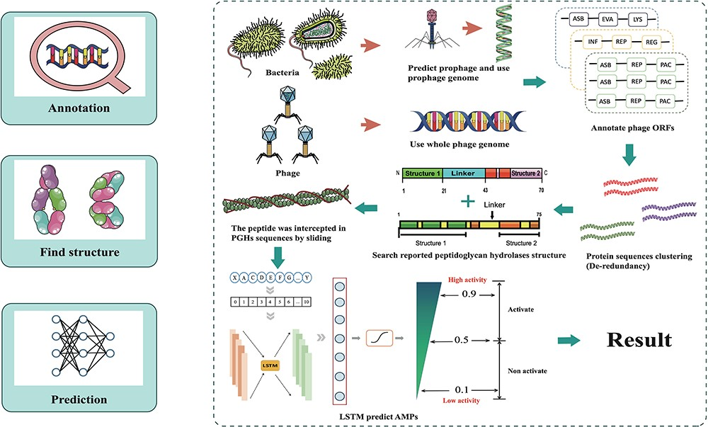
Figure 2. Overall design of ESKtides. ESKtides curated metadata information from NCBI, MVP, VHDB and PhagesDB, and the ...
Notes:
Figure 2. Overall design of ESKtides. ESKtides curated metadata information from NCBI, MVP, VHDB and PhagesDB, and the data in these four databases are subjected to the following procedures. First, for ESKAPE strains, we filter incomplete assembly to ensure the accuracy of mining. Second, for ESKAPE phages, we downloaded the phage genome corresponding to their strains (phages are isolated from corresponding strains) from MVP, PhagesDB, VHDB and marked as corresponding phages. All raw data were processed by using a standard pipeline. ESKtides includes ‘Browse’, ‘Search’, ‘Download’ and ‘Submission’.
Unless provided in the caption above, the following copyright applies to the content of this slide: © The Author(s) 2024. Published by Oxford University Press.This is an Open Access article distributed under the terms of the Creative Commons Attribution License (https://creativecommons.org/licenses/by/4.0/), which permits unrestricted reuse, distribution, and reproduction in any medium, provided the original work is properly cited.

