Slide 1
Figure 1. Flowchart of the JAMIR-eQTL database.
Notes:
Figure 1. Flowchart of the JAMIR-eQTL database.
Unless provided in the caption above, the following copyright applies to the content of this slide: © The Author(s) 2021. Published by Oxford University Press.This is an Open Access article distributed under the terms of the Creative Commons Attribution License (https://creativecommons.org/licenses/by/4.0/), which permits unrestricted reuse, distribution, and reproduction in any medium, provided the original work is properly cited.

Slide 2
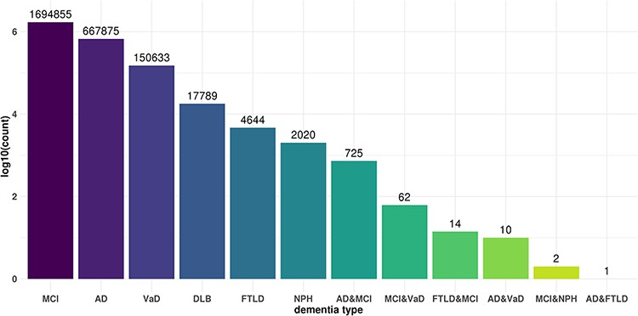
Figure 2. Commonality and specificity of miR-eQTLs among dementia types. X axis shows dementia types and Y axis shows ...
Notes:
Figure 2. Commonality and specificity of miR-eQTLs among dementia types. X axis shows dementia types and Y axis shows the total numbers of cis-miR-eQTLs and trans-miR-eQTLs at an FDR <0.05 for each dementia type or combination of dementia types.
Unless provided in the caption above, the following copyright applies to the content of this slide: © The Author(s) 2021. Published by Oxford University Press.This is an Open Access article distributed under the terms of the Creative Commons Attribution License (https://creativecommons.org/licenses/by/4.0/), which permits unrestricted reuse, distribution, and reproduction in any medium, provided the original work is properly cited.

Slide 3
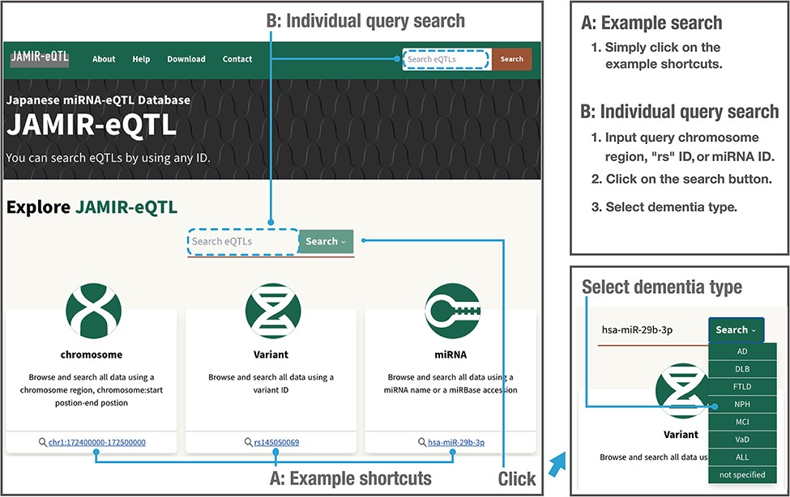
Figure 3. Example and individual query searches in the JAMIR-eQTL database.
Notes:
Figure 3. Example and individual query searches in the JAMIR-eQTL database.
Unless provided in the caption above, the following copyright applies to the content of this slide: © The Author(s) 2021. Published by Oxford University Press.This is an Open Access article distributed under the terms of the Creative Commons Attribution License (https://creativecommons.org/licenses/by/4.0/), which permits unrestricted reuse, distribution, and reproduction in any medium, provided the original work is properly cited.

Slide 4
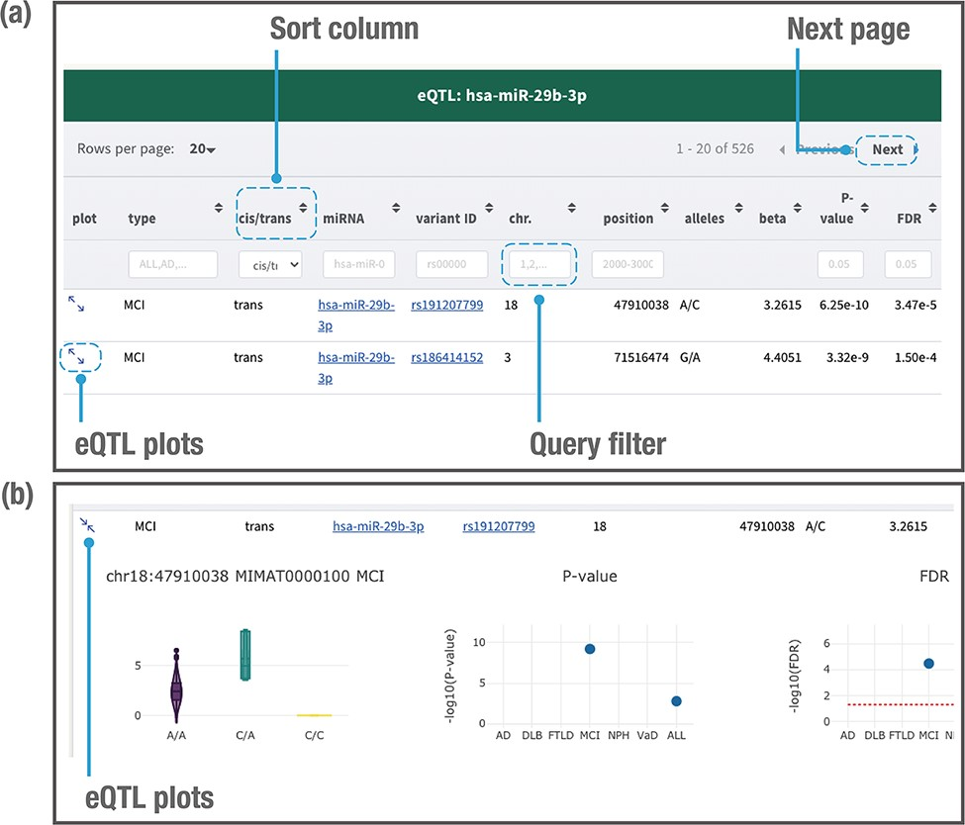
Figure 4. Example of a page displaying search results. The JAMIR-eQTL database returns a table of related miR-eQTL ...
Notes:
Figure 4. Example of a page displaying search results. The JAMIR-eQTL database returns a table of related miR-eQTL records (a). All columns can be sorted, and records without variant alleles and beta values can be filtered. Detailed information on each eQTL plot can be displayed by clicking on the plot column link (b). A vector diagram of a boxplot displaying the association between variant genotypes and miRNA expression is presented, along with P-values and FDRs among the six dementia types and ALL.
Unless provided in the caption above, the following copyright applies to the content of this slide: © The Author(s) 2021. Published by Oxford University Press.This is an Open Access article distributed under the terms of the Creative Commons Attribution License (https://creativecommons.org/licenses/by/4.0/), which permits unrestricted reuse, distribution, and reproduction in any medium, provided the original work is properly cited.

Slide 5
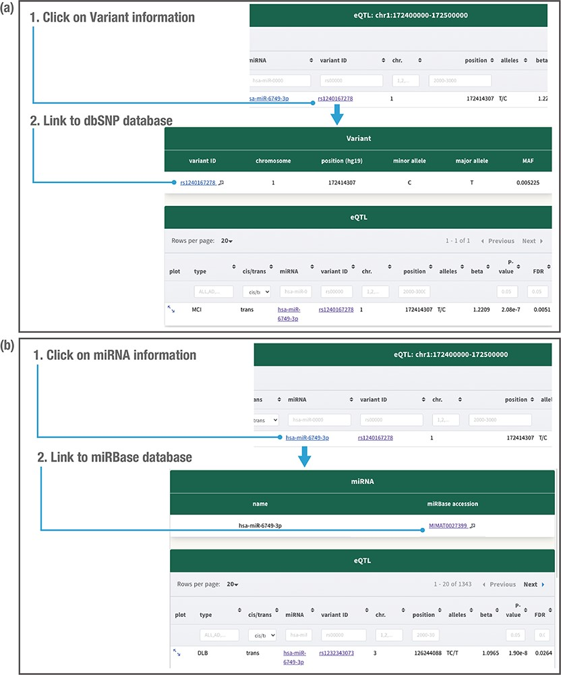
Figure 5. Detailed variant and miRNA information. Clicking on the variant related to the miR-eQTL provides the variant ...
Notes:
Figure 5. Detailed variant and miRNA information. Clicking on the variant related to the miR-eQTL provides the variant minor allele, major allele and minor allele frequency (MAF) in the JAMIR-eQTL database (a). Clicking on the miRNA provides the microRNA ID and accession number (b). The variant information further links to the public database dbSNP, whereas the miRNA information links to the public database miRbase.
Unless provided in the caption above, the following copyright applies to the content of this slide: © The Author(s) 2021. Published by Oxford University Press.This is an Open Access article distributed under the terms of the Creative Commons Attribution License (https://creativecommons.org/licenses/by/4.0/), which permits unrestricted reuse, distribution, and reproduction in any medium, provided the original work is properly cited.

