Slide 1
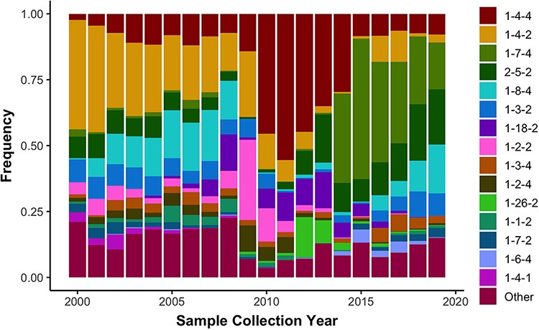
Figure 3. Observed frequency of the top 15 most commonly detected restriction fragment length polymorphism (RFLP) ...
Notes:
Figure 3. Observed frequency of the top 15 most commonly detected restriction fragment length polymorphism (RFLP) patterns in Type 2 porcine reproductive and respiratory syndrome virus sampled in the USA from 2000 to present (n = 16 403). Less common RFLP patterns were grouped together and labeled as “Other”.
Unless provided in the caption above, the following copyright applies to the content of this slide: Published by Oxford University Press 2021. This work is written by (a) US Government employee(s) and is in the public domain in the US.This work is written by (a) US Government employee(s) and is in the public domain in the US.

