Slide 1
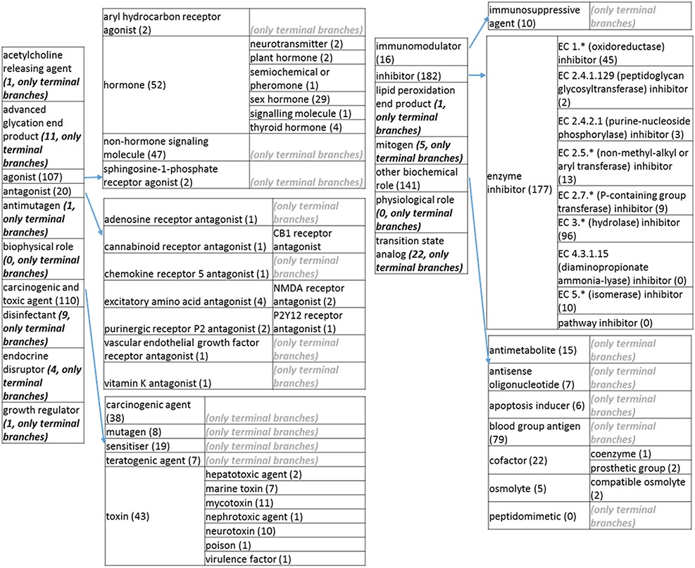
Figure 3. (c) The ‘biological role classes of the revised role tree, which is further subcategorized into the most ...
Notes:
Figure 3. (c) The ‘biological role classes of the revised role tree, which is further subcategorized into the most prominent biological functions. Some of these are terminal branches, while others are subdivided into more specific biological role types for greater specificity. The number of entries per level is indicated at the end of each branch’s label.
Unless provided in the caption above, the following copyright applies to the content of this slide: © The Author(s) 2021. Published by Oxford University Press.This is an Open Access article distributed under the terms of the Creative Commons Attribution License (http://creativecommons.org/licenses/by/4.0/), which permits unrestricted reuse, distribution, and reproduction in any medium, provided the original work is properly cited.

