Slide 1
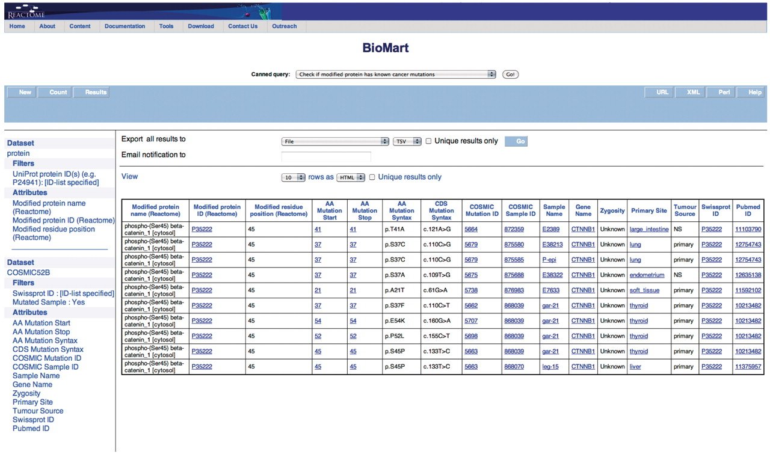
Figure 6. Results of checking if the modified protein has known cancer mutations. The modified protein's UniProt ID, ...
Notes:
Figure 6. Results of checking if the modified protein has known cancer mutations. The modified protein's UniProt ID, the COSMIC Sample ID and name, the gene name, the nucleotide and residue changes caused by the mutation, the zygosity, primary histology, tumor source and the reference paper for the study are returned. By further choosing more attributes finer details can be retrieved. The query spans the ‘Protein’ and ‘COSMIC’ data sets.
Unless provided in the caption above, the following copyright applies to the content of this slide: © The Author(s) 2011. Published by Oxford University Press.This is Open Access article distributed under the terms of the Creative Commons Attribution Non-Commercial License (http://creativecommons.org/licenses/by-nc/2.5), which permits unrestricted non-commercial use, distribution, and reproduction in any medium, provided the original work is properly cited.

