Slide 1
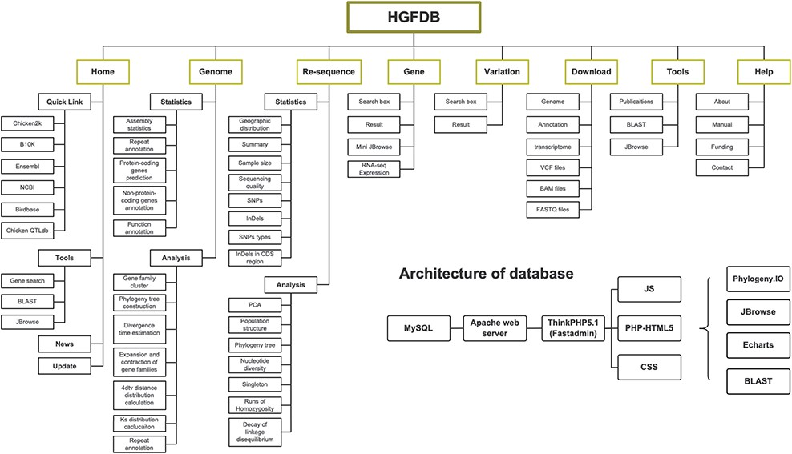
Figure 1. Framework of HGFDB. Eight main modules are highlighted in the dark yellow boxes. The corresponding contents ...
Notes:
Figure 1. Framework of HGFDB. Eight main modules are highlighted in the dark yellow boxes. The corresponding contents of each module are listed below. The bottom right shows the architecture of HGFDB.
Unless provided in the caption above, the following copyright applies to the content of this slide: © The Author(s) 2021. Published by Oxford University Press.This is an Open Access article distributed under the terms of the Creative Commons Attribution License (http://creativecommons.org/licenses/by/4.0/), which permits unrestricted reuse, distribution, and reproduction in any medium, provided the original work is properly cited.

Slide 2
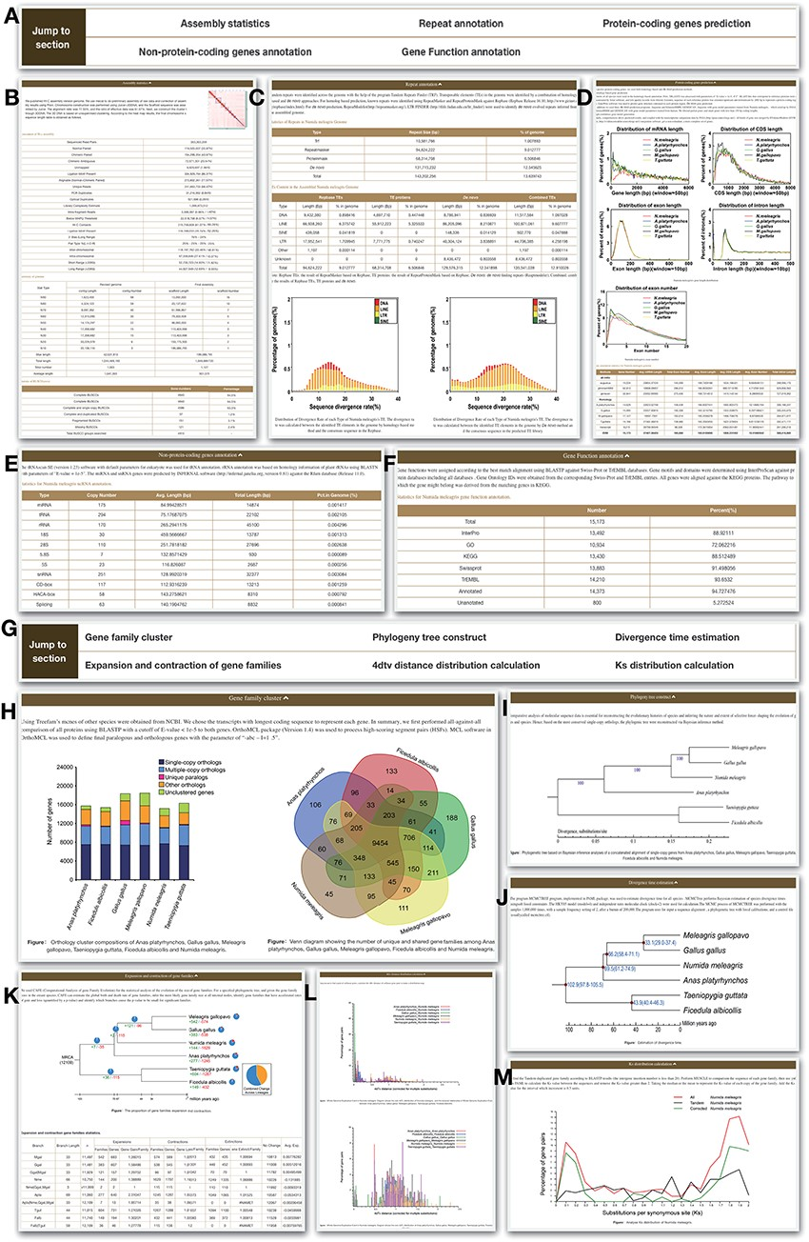
Figure 2. Genome module. Genome module has subpages, which are Statistics (A–F) and Analysis pages (G–M). (A) ...
Notes:
Figure 2. Genome module. Genome module has subpages, which are Statistics (A–F) and Analysis pages (G–M). (A) Navigation bar of the Statistics page, which provides a quick access to each section. (B) Assembly statistics. (C) Repeat annotation. (D) Protein-coding genes prediction. (E) Non-protein-coding genes annotation. (F) Functional annotation. (G) Navigation bar of the Analysis page. (H) Gene family cluster. (I) Phylogeny tree. (J) Divergence time. (K) Expansion and contraction of gene families. (L) 4dtv distance distribution. (M) Ks distribution.
Unless provided in the caption above, the following copyright applies to the content of this slide: © The Author(s) 2021. Published by Oxford University Press.This is an Open Access article distributed under the terms of the Creative Commons Attribution License (http://creativecommons.org/licenses/by/4.0/), which permits unrestricted reuse, distribution, and reproduction in any medium, provided the original work is properly cited.

Slide 3
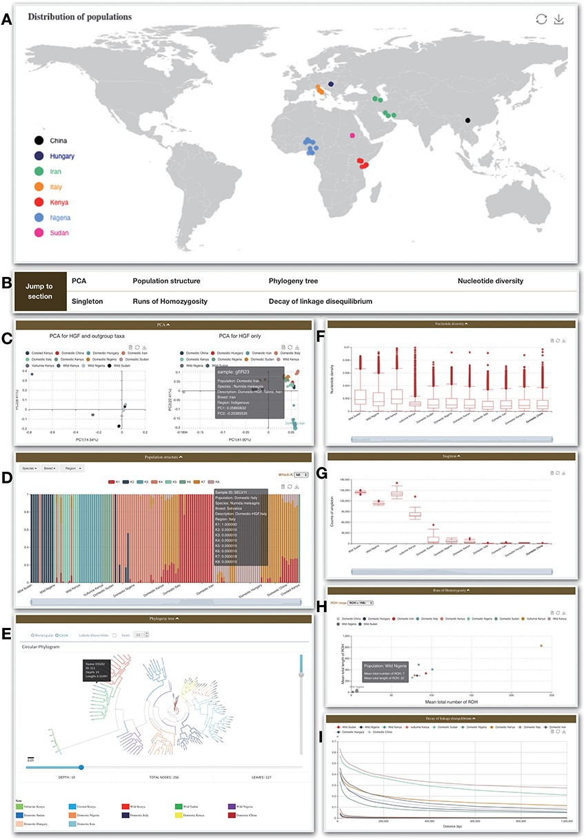
Figure 3. Re-sequence module. (A) Geological distribution of 129 individuals. In addition, there are some bar charts on ...
Notes:
Figure 3. Re-sequence module. (A) Geological distribution of 129 individuals. In addition, there are some bar charts on this page. (B) Navigation bar of the Analysis page in the Re-sequence module. (C) The PCA section shows all 129 individuals belonging to HGF and outgroup taxa (left) and PCA for HGF only (right). (D) Bar plot of ADMIXTURE analysis for all samples with K from 2 to 10. (E) Phylogenetic tree. (F) Nucleotide diversity. (G) Singleton statistic. (H) ROHs. (I) Decay of linkage disequilibrium.
Unless provided in the caption above, the following copyright applies to the content of this slide: © The Author(s) 2021. Published by Oxford University Press.This is an Open Access article distributed under the terms of the Creative Commons Attribution License (http://creativecommons.org/licenses/by/4.0/), which permits unrestricted reuse, distribution, and reproduction in any medium, provided the original work is properly cited.

Slide 4
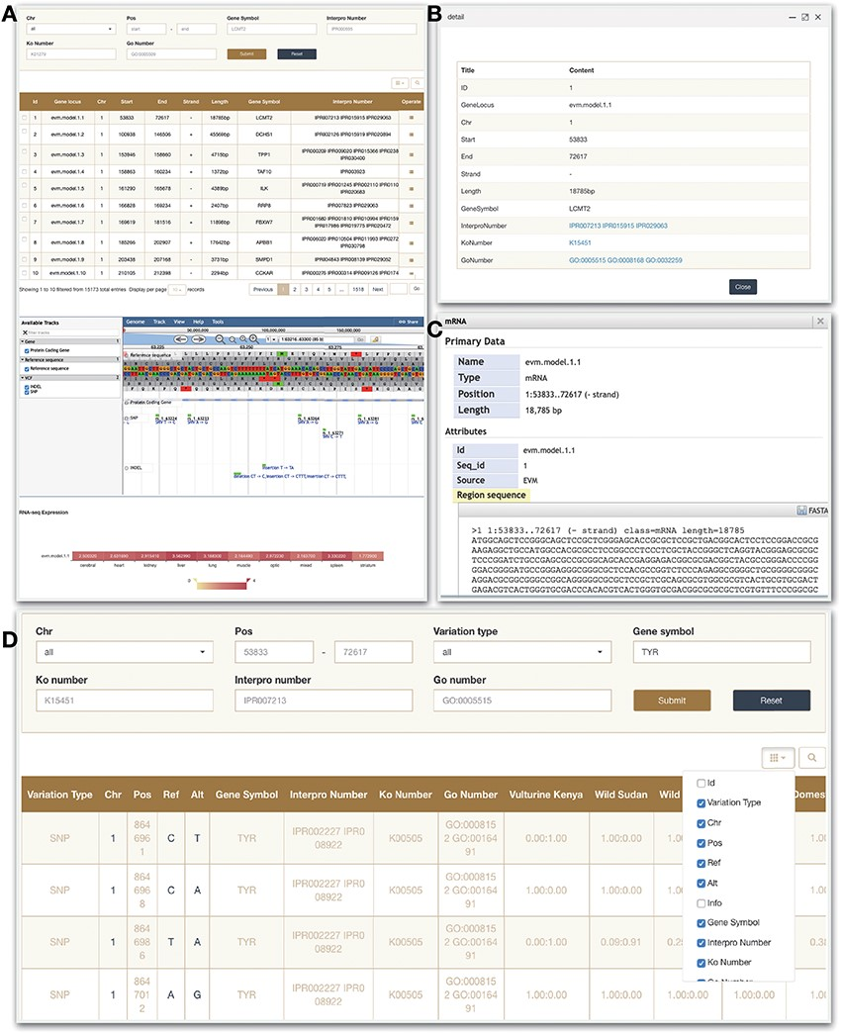
Figure 4. Gene and Variation modules. (A) Gene search module. (B) Click on operate button shows the detailed ...
Notes:
Figure 4. Gene and Variation modules. (A) Gene search module. (B) Click on operate button shows the detailed information. (C) Click on sequence in the JBrowse to view detailed information. (D) Variation module.
Unless provided in the caption above, the following copyright applies to the content of this slide: © The Author(s) 2021. Published by Oxford University Press.This is an Open Access article distributed under the terms of the Creative Commons Attribution License (http://creativecommons.org/licenses/by/4.0/), which permits unrestricted reuse, distribution, and reproduction in any medium, provided the original work is properly cited.

Slide 5
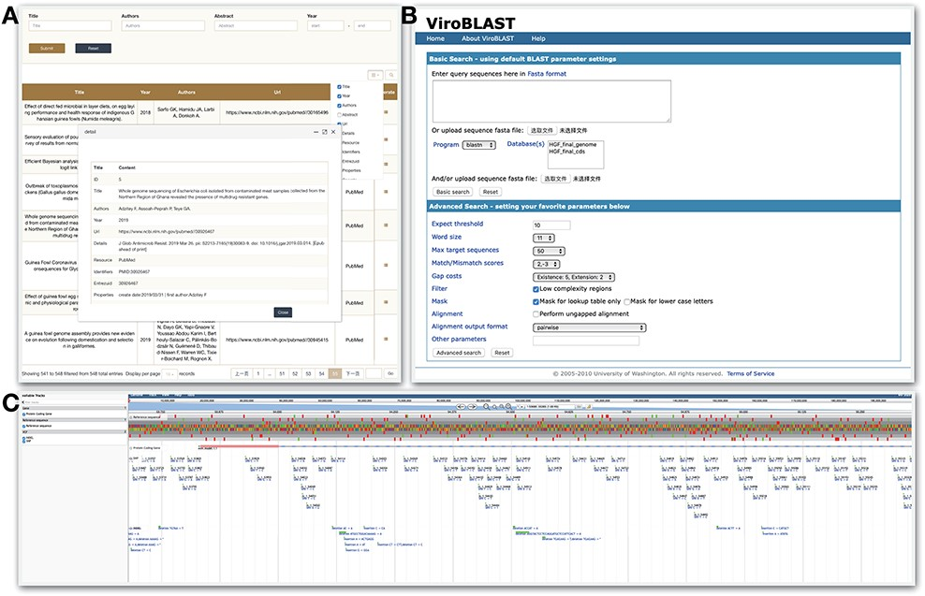
Figure 5. Tools module. HGFDB provides three tools, which are (A) Publication that allows to search related papers by ...
Notes:
Figure 5. Tools module. HGFDB provides three tools, which are (A) Publication that allows to search related papers by keywords, (B) BLAST that compares users’ nucleotide or protein sequence with our assembly and annotation results and (C) JBrowse that provides the view of genomic features of HGF assembly.
Unless provided in the caption above, the following copyright applies to the content of this slide: © The Author(s) 2021. Published by Oxford University Press.This is an Open Access article distributed under the terms of the Creative Commons Attribution License (http://creativecommons.org/licenses/by/4.0/), which permits unrestricted reuse, distribution, and reproduction in any medium, provided the original work is properly cited.

