Slide 1
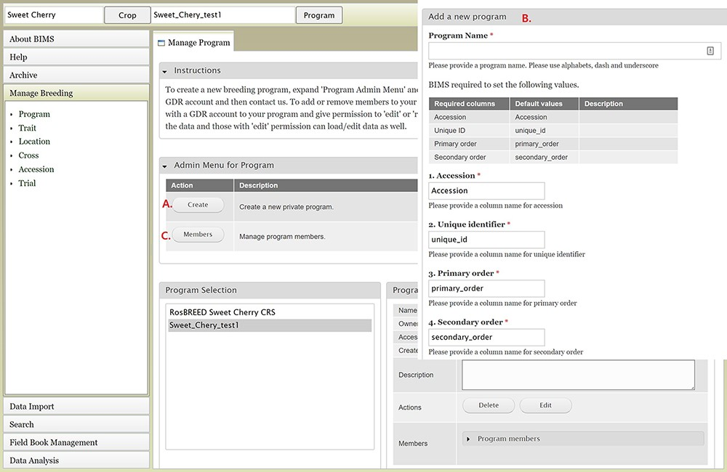
Figure 2. BIMS interfaces for creating, editing and managing programs. A. Manage Program tab showing the list of ...
Notes:
Figure 2. BIMS interfaces for creating, editing and managing programs. A. Manage Program tab showing the list of programs, the details of the highlighted program and admin menu for managing program. B. Add Program tab where users can enter the new program name and modify the four column names required in the BIMS template and Field Book to match their dataset. C. Members tab where users can add other account holders as members of the breeding program with edit or read-only privilege.
Unless provided in the caption above, the following copyright applies to the content of this slide: © The Author(s) 2021. Published by Oxford University Press.This is an Open Access article distributed under the terms of the Creative Commons Attribution License (http://creativecommons.org/licenses/by/4.0/), which permits unrestricted reuse, distribution, and reproduction in any medium, provided the original work is properly cited.

