Slide 1
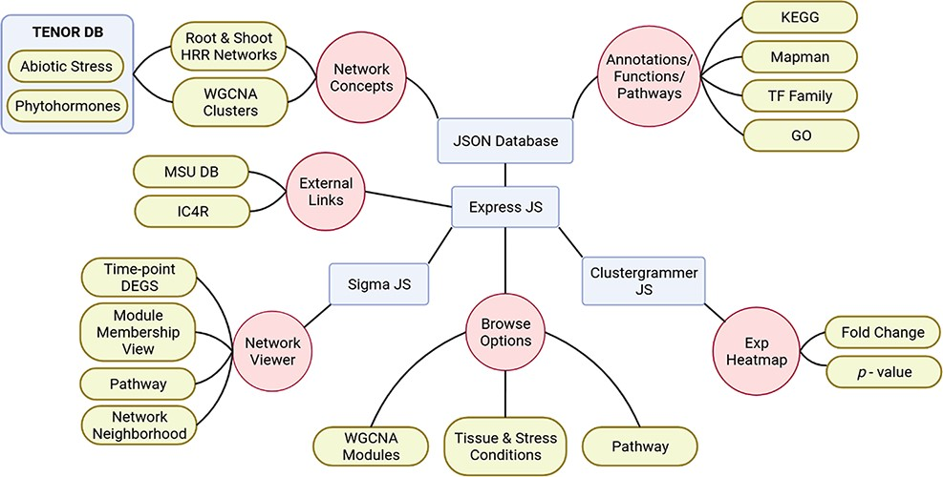
Figure 1. Schematic representation of NetREx architecture, modules and visualizations.
Notes:
Figure 1. Schematic representation of NetREx architecture, modules and visualizations.
Unless provided in the caption above, the following copyright applies to the content of this slide: © The Author(s) 2022. Published by Oxford University Press on behalf of the Center for Excellence in Molecular Cell Science, Chinese Academy of Sciences.This is an Open Access article distributed under the terms of the Creative Commons Attribution-NonCommercial License (https://creativecommons.org/licenses/by-nc/4.0/), which permits non-commercial re-use, distribution, and reproduction in any medium, provided the original work is properly cited. For commercial re-use, please contact journals.permissions@oup.com

Slide 2
Figure 2. A schematic representation of the ABA signalling pathway from the KEGG database.
Notes:
Figure 2. A schematic representation of the ABA signalling pathway from the KEGG database.
Unless provided in the caption above, the following copyright applies to the content of this slide: © The Author(s) 2022. Published by Oxford University Press on behalf of the Center for Excellence in Molecular Cell Science, Chinese Academy of Sciences.This is an Open Access article distributed under the terms of the Creative Commons Attribution-NonCommercial License (https://creativecommons.org/licenses/by-nc/4.0/), which permits non-commercial re-use, distribution, and reproduction in any medium, provided the original work is properly cited. For commercial re-use, please contact journals.permissions@oup.com

Slide 3
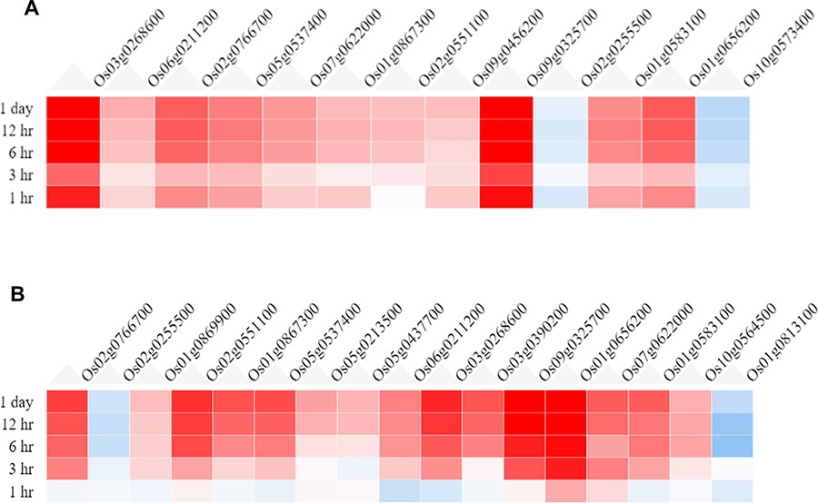
Figure 3. Heatmaps from the Expression Viewer for (A) the root tissue and (B) the shoot tissue under drought stress. ...
Notes:
Figure 3. Heatmaps from the Expression Viewer for (A) the root tissue and (B) the shoot tissue under drought stress. The figure depicts transcriptional changes across time points after drought stress with genes having high positive fold change and those in blue having high negative fold change with respect to control (0 h, no stress).
Unless provided in the caption above, the following copyright applies to the content of this slide: © The Author(s) 2022. Published by Oxford University Press on behalf of the Center for Excellence in Molecular Cell Science, Chinese Academy of Sciences.This is an Open Access article distributed under the terms of the Creative Commons Attribution-NonCommercial License (https://creativecommons.org/licenses/by-nc/4.0/), which permits non-commercial re-use, distribution, and reproduction in any medium, provided the original work is properly cited. For commercial re-use, please contact journals.permissions@oup.com

Slide 4
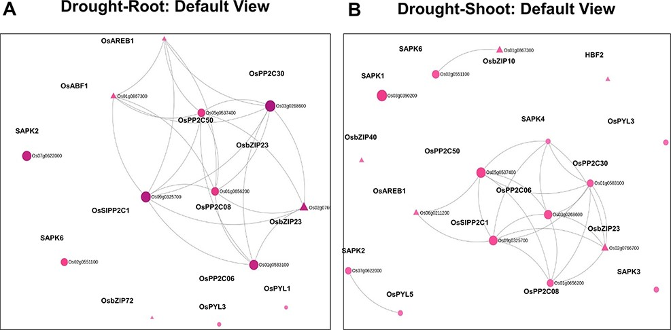
Figure 4. Default views for the Network Viewer from (A) the root tissue and (B) the shoot tissue under drought stress.
Notes:
Figure 4. Default views for the Network Viewer from (A) the root tissue and (B) the shoot tissue under drought stress.
Unless provided in the caption above, the following copyright applies to the content of this slide: © The Author(s) 2022. Published by Oxford University Press on behalf of the Center for Excellence in Molecular Cell Science, Chinese Academy of Sciences.This is an Open Access article distributed under the terms of the Creative Commons Attribution-NonCommercial License (https://creativecommons.org/licenses/by-nc/4.0/), which permits non-commercial re-use, distribution, and reproduction in any medium, provided the original work is properly cited. For commercial re-use, please contact journals.permissions@oup.com

Slide 5
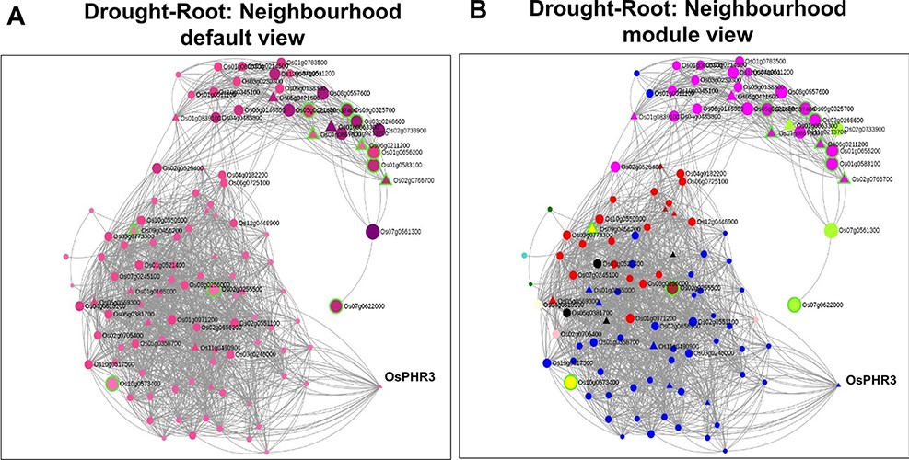
Figure 7. Neighbourhood View of 13 root-specific genes with (A) default view and (B) module views under drought ...
Notes:
Figure 7. Neighbourhood View of 13 root-specific genes with (A) default view and (B) module views under drought stress.
Unless provided in the caption above, the following copyright applies to the content of this slide: © The Author(s) 2022. Published by Oxford University Press on behalf of the Center for Excellence in Molecular Cell Science, Chinese Academy of Sciences.This is an Open Access article distributed under the terms of the Creative Commons Attribution-NonCommercial License (https://creativecommons.org/licenses/by-nc/4.0/), which permits non-commercial re-use, distribution, and reproduction in any medium, provided the original work is properly cited. For commercial re-use, please contact journals.permissions@oup.com

Slide 6
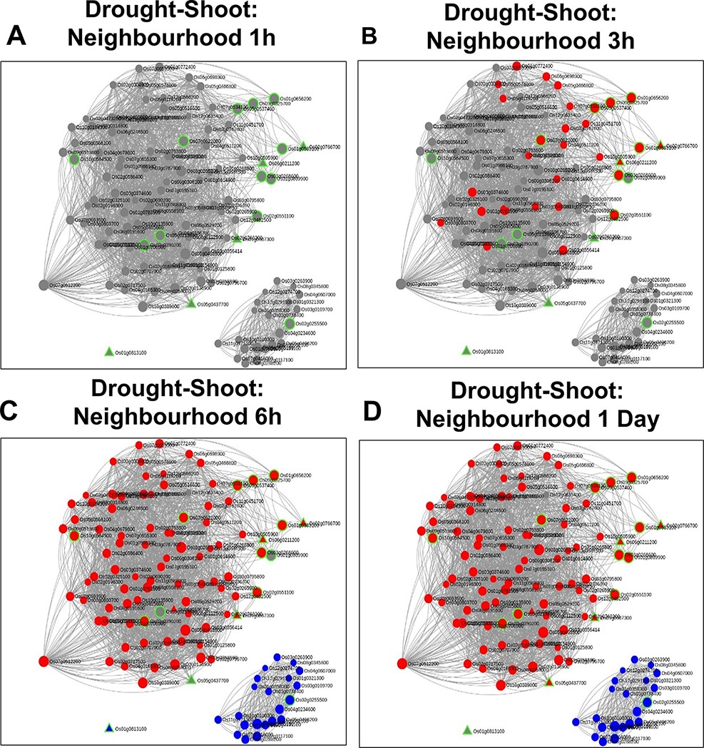
Figure 11. Time point–specific views for the extended neighbourhood for shoot-specific genes at early time points (A and ...
Notes:
Figure 11. Time point–specific views for the extended neighbourhood for shoot-specific genes at early time points (A and B) and late time points (C and D).
Unless provided in the caption above, the following copyright applies to the content of this slide: © The Author(s) 2022. Published by Oxford University Press on behalf of the Center for Excellence in Molecular Cell Science, Chinese Academy of Sciences.This is an Open Access article distributed under the terms of the Creative Commons Attribution-NonCommercial License (https://creativecommons.org/licenses/by-nc/4.0/), which permits non-commercial re-use, distribution, and reproduction in any medium, provided the original work is properly cited. For commercial re-use, please contact journals.permissions@oup.com

Slide 7
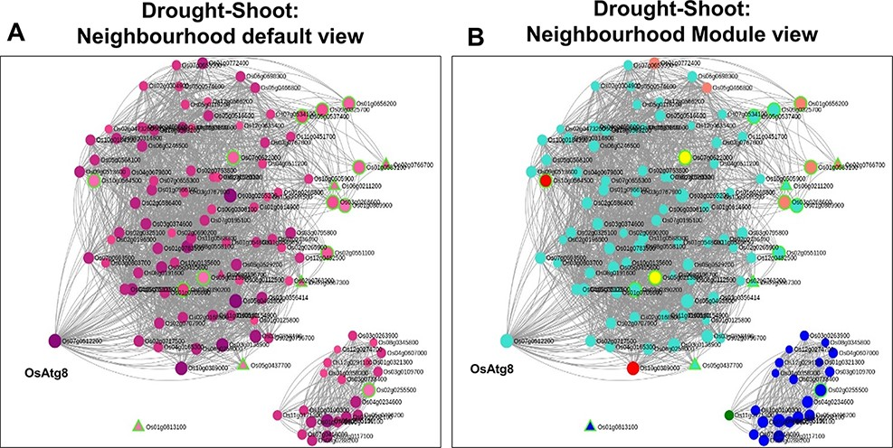
Figure 10. Neighbourhood View of 17 shoot-specific genes with (A) default view and (B) module views under drought ...
Notes:
Figure 10. Neighbourhood View of 17 shoot-specific genes with (A) default view and (B) module views under drought stress.
Unless provided in the caption above, the following copyright applies to the content of this slide: © The Author(s) 2022. Published by Oxford University Press on behalf of the Center for Excellence in Molecular Cell Science, Chinese Academy of Sciences.This is an Open Access article distributed under the terms of the Creative Commons Attribution-NonCommercial License (https://creativecommons.org/licenses/by-nc/4.0/), which permits non-commercial re-use, distribution, and reproduction in any medium, provided the original work is properly cited. For commercial re-use, please contact journals.permissions@oup.com

Slide 8
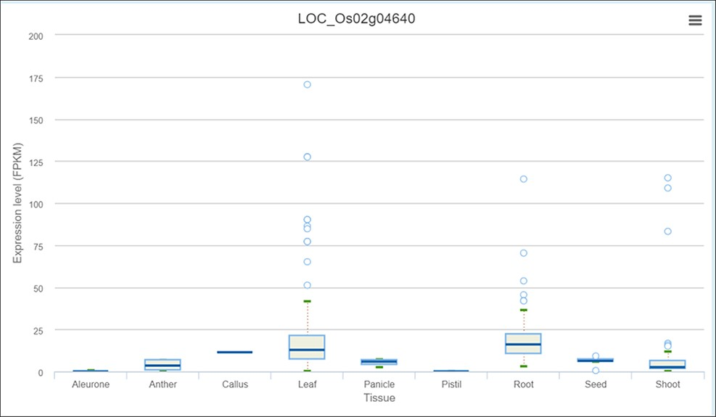
Figure 9. Expression profile of OsPHR3 from IC4R across different tissues and developmental stages.
Notes:
Figure 9. Expression profile of OsPHR3 from IC4R across different tissues and developmental stages.
Unless provided in the caption above, the following copyright applies to the content of this slide: © The Author(s) 2022. Published by Oxford University Press on behalf of the Center for Excellence in Molecular Cell Science, Chinese Academy of Sciences.This is an Open Access article distributed under the terms of the Creative Commons Attribution-NonCommercial License (https://creativecommons.org/licenses/by-nc/4.0/), which permits non-commercial re-use, distribution, and reproduction in any medium, provided the original work is properly cited. For commercial re-use, please contact journals.permissions@oup.com

Slide 9
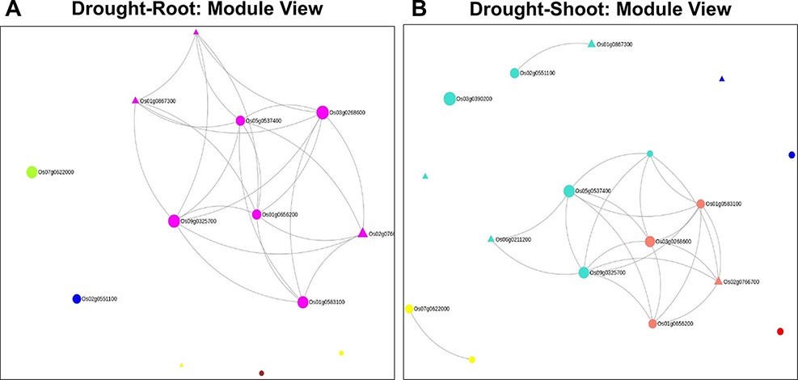
Figure 6. Module views of the Network Viewer for (A) the root tissue and (B) the shoot tissue under drought stress.
Notes:
Figure 6. Module views of the Network Viewer for (A) the root tissue and (B) the shoot tissue under drought stress.
Unless provided in the caption above, the following copyright applies to the content of this slide: © The Author(s) 2022. Published by Oxford University Press on behalf of the Center for Excellence in Molecular Cell Science, Chinese Academy of Sciences.This is an Open Access article distributed under the terms of the Creative Commons Attribution-NonCommercial License (https://creativecommons.org/licenses/by-nc/4.0/), which permits non-commercial re-use, distribution, and reproduction in any medium, provided the original work is properly cited. For commercial re-use, please contact journals.permissions@oup.com

Slide 10
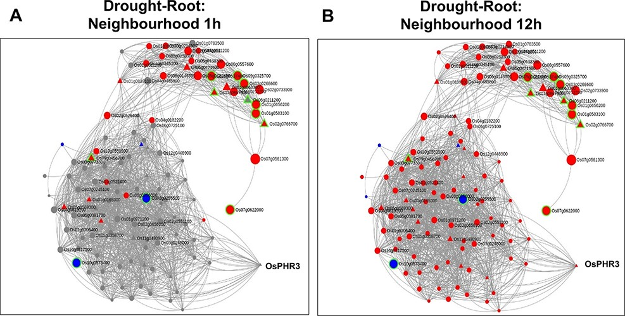
Figure 8. Time point–specific views for the extended neighbourhood for root-specific genes at (A) early time point of ...
Notes:
Figure 8. Time point–specific views for the extended neighbourhood for root-specific genes at (A) early time point of 1 h and (B) late time point of 12 h under drought stress.
Unless provided in the caption above, the following copyright applies to the content of this slide: © The Author(s) 2022. Published by Oxford University Press on behalf of the Center for Excellence in Molecular Cell Science, Chinese Academy of Sciences.This is an Open Access article distributed under the terms of the Creative Commons Attribution-NonCommercial License (https://creativecommons.org/licenses/by-nc/4.0/), which permits non-commercial re-use, distribution, and reproduction in any medium, provided the original work is properly cited. For commercial re-use, please contact journals.permissions@oup.com

Slide 11
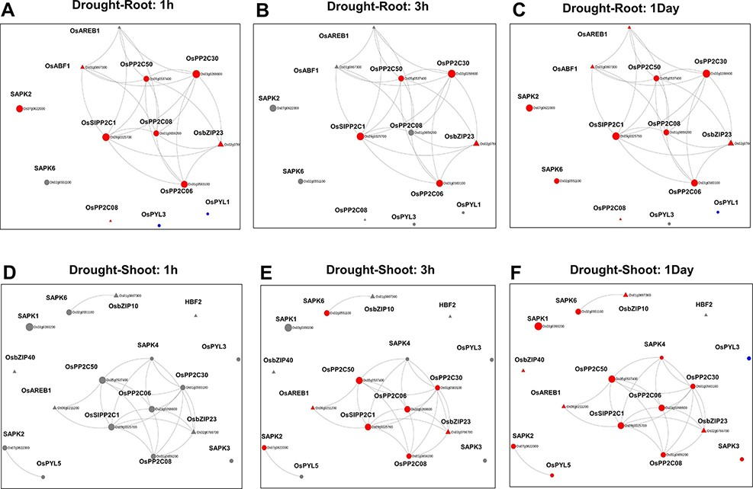
Figure 5. Time point–specific views from the Network Viewer for root tissue at (A) 1h, (B) 3h, (C) 1day and shoot ...
Notes:
Figure 5. Time point–specific views from the Network Viewer for root tissue at (A) 1h, (B) 3h, (C) 1day and shoot tissue at (D) 1h, (E) 3h and (F) 6h. The figure provides a comparative view of the transcriptional changes for the different time points along with tissue-specific gene connectivities.
Unless provided in the caption above, the following copyright applies to the content of this slide: © The Author(s) 2022. Published by Oxford University Press on behalf of the Center for Excellence in Molecular Cell Science, Chinese Academy of Sciences.This is an Open Access article distributed under the terms of the Creative Commons Attribution-NonCommercial License (https://creativecommons.org/licenses/by-nc/4.0/), which permits non-commercial re-use, distribution, and reproduction in any medium, provided the original work is properly cited. For commercial re-use, please contact journals.permissions@oup.com

