Slide 1
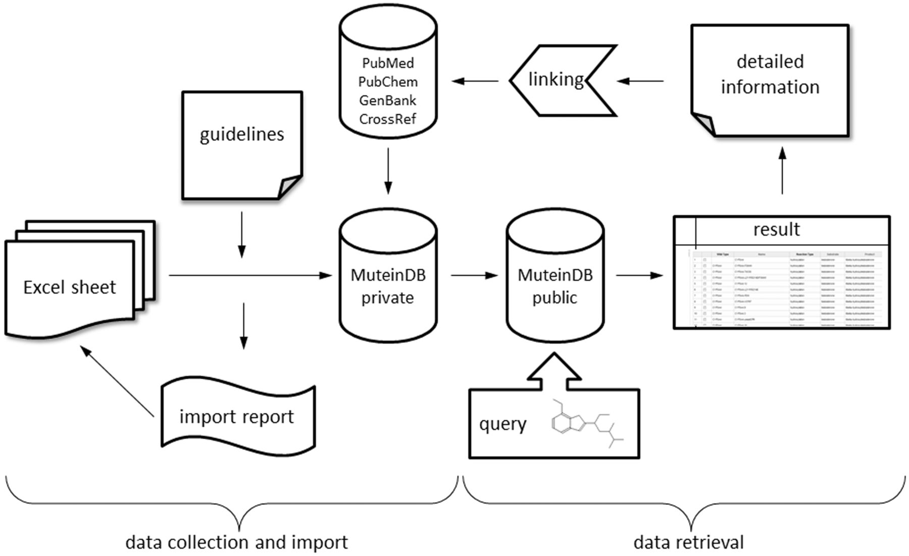
Figure 1 Schematic diagram of database structure. MuteinDB structure can be divided into two major parts. Firstly, the ...
Notes:
Figure 1 Schematic diagram of database structure. MuteinDB structure can be divided into two major parts. Firstly, the data collection and import structure within MuteinDB, illustrated on the left. Detailed guidelines structure and specify the correct and unified data collection as well as the data import. The standardized excel data import template guarantees data quality and consistency. During the automated data import from the data import excel sheet, metadata from third party databases such as PubMed, PubChem, GenBank and CrossRef are retrieved and added. The data import procedure ends either with a summary including imported muteins, molecules, reactions, activities or with a detailed error report. Secondly, stored public mutein data can be easily retrieved via various search mechanisms. For example, chemical structures can be used for identifying molecules of interest and their catalyzed reactions. Results are presented in tabular listings with links to third party databases or to detailed information contained in MuteinDB.
Unless provided in the caption above, the following copyright applies to the content of this slide: © The Author(s) 2012. Published by Oxford University Press.This is an Open Access article distributed under the terms of the Creative Commons Attribution Non-Commercial License (http://creativecommons.org/licenses/by-nc/3.0), which permits unrestricted non-commercial use, distribution, and reproduction in any medium, provided the original work is properly cited.

