Slide 1
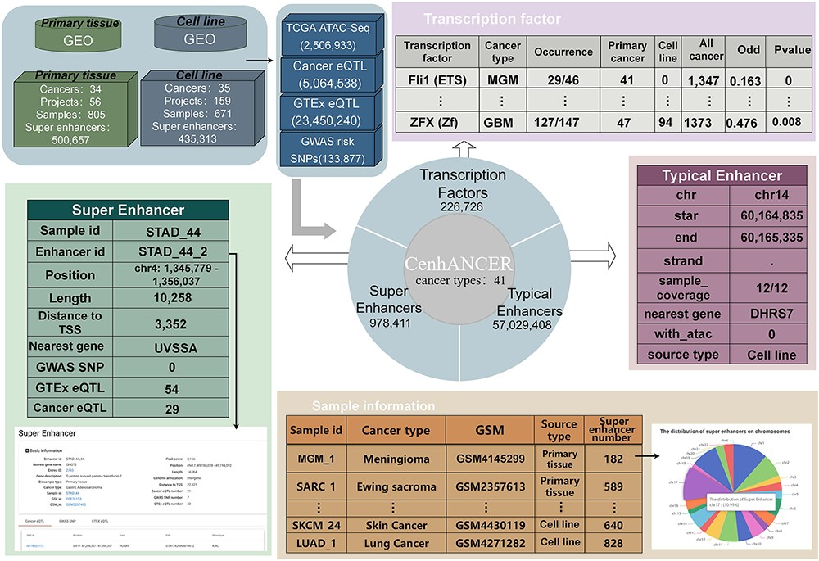
Figure 1. CenhANCER database structure and content. The main data include ChIP-Seq data of H3K27ac samples covering ...
Notes:
Figure 1. CenhANCER database structure and content. The main data include ChIP-Seq data of H3K27ac samples covering cancer primary tissues and cell line samples. ATAC-seq ACRs, cancer eQTLs, GTEx eQTLs and GWAS risk SNPs are supplementary annotation for enhancers. CenhANCER consist of four major parts, namely, sample information, super-enhancers, typical enhancers and TFs.
Unless provided in the caption above, the following copyright applies to the content of this slide: © The Author(s) 2023. Published by Oxford University Press.This is an Open Access article distributed under the terms of the Creative Commons Attribution License (https://creativecommons.org/licenses/by/4.0/), which permits unrestricted reuse, distribution, and reproduction in any medium, provided the original work is properly cited.

