Slide 1
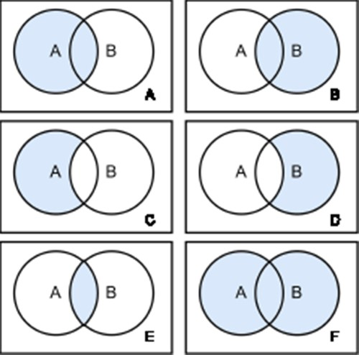
Figure 4. Join Types. There are six different join types: left Outer Join (A), right Outer Join (B), left Outer Join ...
Notes:
Figure 4. Join Types. There are six different join types: left Outer Join (A), right Outer Join (B), left Outer Join with Null (C), right Outer Join with Null (D), inner Join (E) and full Outer Join (F). Each circle represents a table and the blue color highlights the retrieved data from the joined tables.
Unless provided in the caption above, the following copyright applies to the content of this slide: © The Author(s) 2024. Published by Oxford University Press.This is an Open Access article distributed under the terms of the Creative Commons Attribution License (https://creativecommons.org/licenses/by/4.0/), which permits unrestricted reuse, distribution, and reproduction in any medium, provided the original work is properly cited.

