Slide 1
Figure 1. Examples of the intra-variability and anomalies that can be encountered on images of wood (end-grain ...
Notes:
Figure 1. Examples of the intra-variability and anomalies that can be encountered on images of wood (end-grain surface). From left to right: (a) An example of the variability of wood anatomical features (such as axial parenchyma) on a single specimen. (b) An example of a possible anomaly on wood, a crack. (c) An example of a possible anomaly on wood, insect holes. (d) An example of a possible anomaly on wood, fungi damage. RubenDeBlaere©RMCA.
Unless provided in the caption above, the following copyright applies to the content of this slide: © The Author(s) 2023. Published by Oxford University Press.This is an Open Access article distributed under the terms of the Creative Commons Attribution License (https://creativecommons.org/licenses/by/4.0/), which permits unrestricted reuse, distribution, and reproduction in any medium, provided the original work is properly cited.

Slide 2
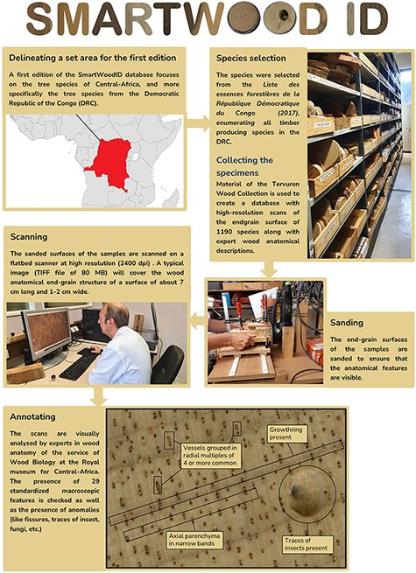
Figure 2. A flowchart showing the procedure of building the database.
Notes:
Figure 2. A flowchart showing the procedure of building the database.
Unless provided in the caption above, the following copyright applies to the content of this slide: © The Author(s) 2023. Published by Oxford University Press.This is an Open Access article distributed under the terms of the Creative Commons Attribution License (https://creativecommons.org/licenses/by/4.0/), which permits unrestricted reuse, distribution, and reproduction in any medium, provided the original work is properly cited.

Slide 3
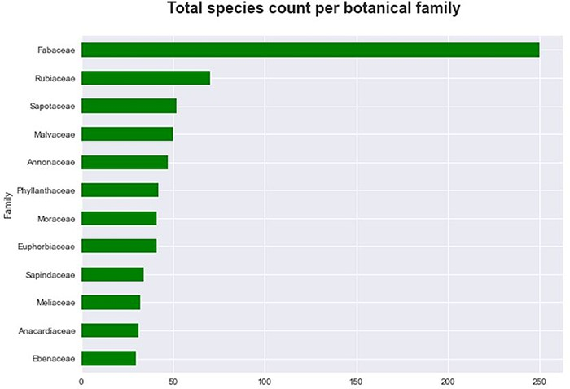
Figure 3. The 12 largest botanical families of tree species ranked according to the highest number of species in the ...
Notes:
Figure 3. The 12 largest botanical families of tree species ranked according to the highest number of species in the database.
Unless provided in the caption above, the following copyright applies to the content of this slide: © The Author(s) 2023. Published by Oxford University Press.This is an Open Access article distributed under the terms of the Creative Commons Attribution License (https://creativecommons.org/licenses/by/4.0/), which permits unrestricted reuse, distribution, and reproduction in any medium, provided the original work is properly cited.

Slide 4
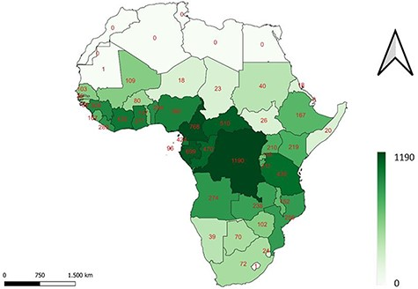
Figure 4. A map of the African continent, indicating the number of DRC tree species present in each country. The darker ...
Notes:
Figure 4. A map of the African continent, indicating the number of DRC tree species present in each country. The darker the colour, the more species present.
Unless provided in the caption above, the following copyright applies to the content of this slide: © The Author(s) 2023. Published by Oxford University Press.This is an Open Access article distributed under the terms of the Creative Commons Attribution License (https://creativecommons.org/licenses/by/4.0/), which permits unrestricted reuse, distribution, and reproduction in any medium, provided the original work is properly cited.

Slide 5
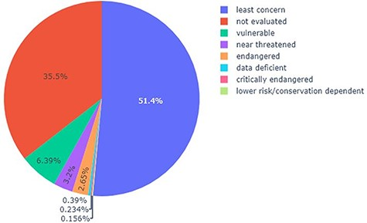
Figure 5. Pie chart showing the percentage of each category (according to the IUCN Red List) present in the list of ...
Notes:
Figure 5. Pie chart showing the percentage of each category (according to the IUCN Red List) present in the list of trees in the DRC, capable of providing timber.
Unless provided in the caption above, the following copyright applies to the content of this slide: © The Author(s) 2023. Published by Oxford University Press.This is an Open Access article distributed under the terms of the Creative Commons Attribution License (https://creativecommons.org/licenses/by/4.0/), which permits unrestricted reuse, distribution, and reproduction in any medium, provided the original work is properly cited.

