Slide 1
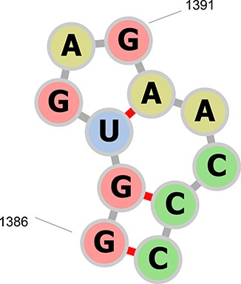
Figure 3 The secondary structure representation of residues A1386–A1396 in PDB ID 1N8R drawn with forna (24). The ...
Notes:
Figure 3 The secondary structure representation of residues A1386–A1396 in PDB ID 1N8R drawn with forna (24). The previous RNA CoSSMos database contained a hairpin of seven nucleotides in residues A1387–A1395, a hairpin of three nucleotides in residues A1388–A1392, and a bulge of two nucleotides in residues A1387–A1388 and A1392–A1395. RNA CoSSMos 2.0 only contains a hairpin of seven nucleotides in residues 1386–1396.
Unless provided in the caption above, the following copyright applies to the content of this slide: © The Author(s) 2020. Published by Oxford University Press.This is an Open Access article distributed under the terms of the Creative Commons Attribution License (http://creativecommons.org/licenses/by/4.0/), which permits unrestricted reuse, distribution, and reproduction in any medium, provided the original work is properly cited.

