Slide 1
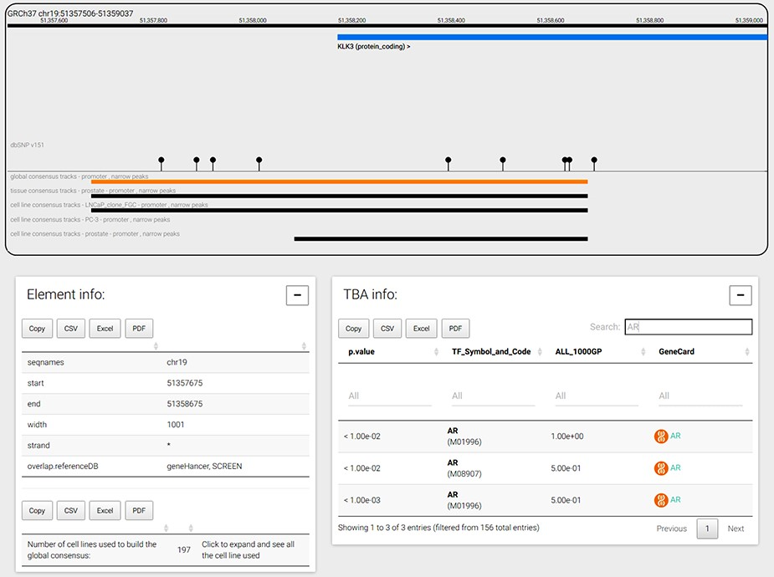
Figure 4. CONREL navigation web-page. The genome browser allows to navigate the selected genomic region or gene, while ...
Notes:
Figure 4. CONREL navigation web-page. The genome browser allows to navigate the selected genomic region or gene, while bottom panels allow to explore CRE information and TBA data. TBA data is shown in a multipage area where for each enriched TBA it is shown the significance at which the TF resulted enriched, and (when available) the fraction of 1000 Genomes Project common alleles that support the enrichment.
Unless provided in the caption above, the following copyright applies to the content of this slide: © The Author(s) 2020. Published by Oxford University Press.This is an Open Access article distributed under the terms of the Creative Commons Attribution License (http://creativecommons.org/licenses/by/4.0/), which permits unrestricted reuse, distribution, and reproduction in any medium, provided the original work is properly cited.

