Slide 1
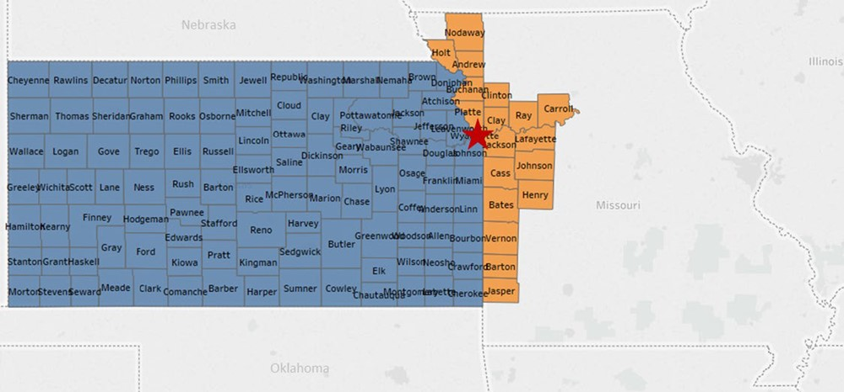
Figure 2 The University of Kansas Cancer Center catchment area. The red star designates the location of the University ...
Notes:
Figure 2 The University of Kansas Cancer Center catchment area. The red star designates the location of the University of Kansas Medical Center in Kansas City, Kansas, Wyandotte County.
Unless provided in the caption above, the following copyright applies to the content of this slide: © The Author(s) 2020. Published by Oxford University Press.This is an Open Access article distributed under the terms of the Creative Commons Attribution License (http://creativecommons.org/licenses/by/4.0/), which permits unrestricted reuse, distribution, and reproduction in any medium, provided the original work is properly cited.

Slide 2
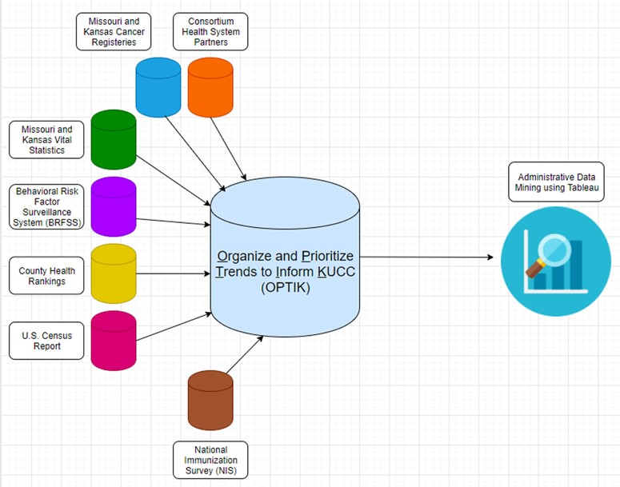
Figure 1 OPTIK data architecture.
Notes:
Figure 1 OPTIK data architecture.
Unless provided in the caption above, the following copyright applies to the content of this slide: © The Author(s) 2020. Published by Oxford University Press.This is an Open Access article distributed under the terms of the Creative Commons Attribution License (http://creativecommons.org/licenses/by/4.0/), which permits unrestricted reuse, distribution, and reproduction in any medium, provided the original work is properly cited.

Slide 3
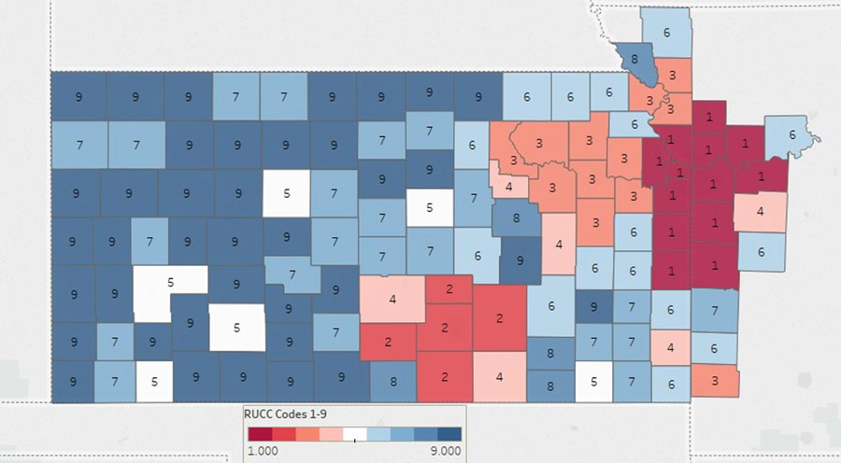
Figure 3 The University of Kansas Cancer Center Catchment Area. Color coding classifies counties by population ...
Notes:
Figure 3 The University of Kansas Cancer Center Catchment Area. Color coding classifies counties by population density. Urban (150.0 persons per square mile (ppsm) or more), semi-urban (40–149.9 ppsm), densely settled rural (20–39.9 ppsm), rural (6–19.9 ppsm) and frontier (<6 ppsm).
Unless provided in the caption above, the following copyright applies to the content of this slide: © The Author(s) 2020. Published by Oxford University Press.This is an Open Access article distributed under the terms of the Creative Commons Attribution License (http://creativecommons.org/licenses/by/4.0/), which permits unrestricted reuse, distribution, and reproduction in any medium, provided the original work is properly cited.

Slide 4
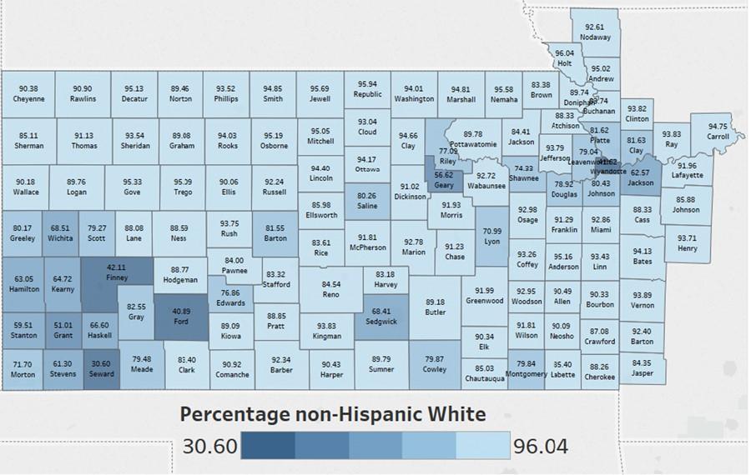
Figure 4 The University of Kansas Cancer Center catchment area counties color coded by the percentage of non-Hispanic ...
Notes:
Figure 4 The University of Kansas Cancer Center catchment area counties color coded by the percentage of non-Hispanic White in each county.
Unless provided in the caption above, the following copyright applies to the content of this slide: © The Author(s) 2020. Published by Oxford University Press.This is an Open Access article distributed under the terms of the Creative Commons Attribution License (http://creativecommons.org/licenses/by/4.0/), which permits unrestricted reuse, distribution, and reproduction in any medium, provided the original work is properly cited.

Slide 5
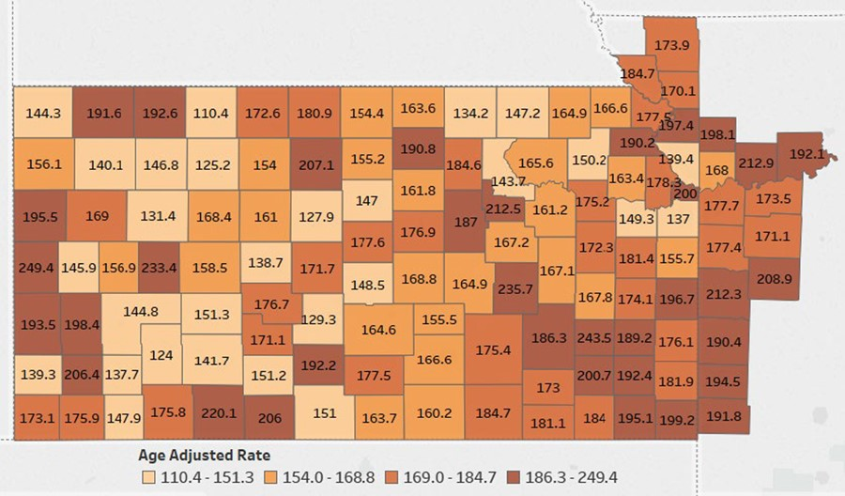
Figure 5 The University of Kansas Cancer Center catchment area counties color coded by the age adjusted cancer ...
Notes:
Figure 5 The University of Kansas Cancer Center catchment area counties color coded by the age adjusted cancer mortality rates. Data Source: Centers for Disease Control and Prevention.
Unless provided in the caption above, the following copyright applies to the content of this slide: © The Author(s) 2020. Published by Oxford University Press.This is an Open Access article distributed under the terms of the Creative Commons Attribution License (http://creativecommons.org/licenses/by/4.0/), which permits unrestricted reuse, distribution, and reproduction in any medium, provided the original work is properly cited.

Slide 6
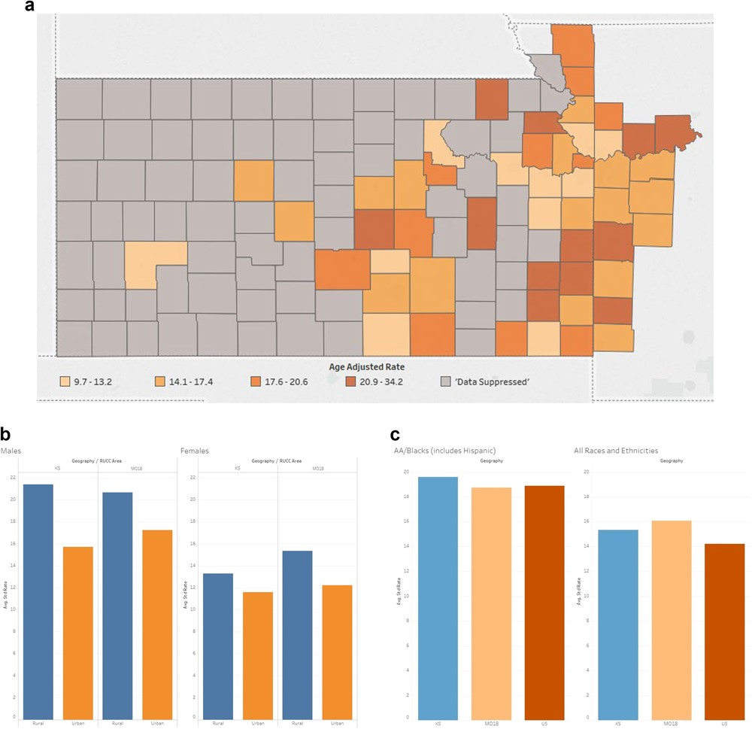
Figure 6 (A) The University of Kansas Cancer Center catchment area counties’ heat map representing the mortality rates ...
Notes:
Figure 6 (A) The University of Kansas Cancer Center catchment area counties’ heat map representing the mortality rates of colorectal cancer. Colorectal cancer mortality data was suppressed in 72 counties, all of which had populations <34 000. (B) The University of Kansas Cancer Center catchment area average standard rate capturing the mortality rates of colorectal cancer comparing rural versus urban. (C) The University of Kansas Cancer Center catchment area average standard rate capturing the mortality rates of colorectal cancer comparing African American versus all the other races.
Unless provided in the caption above, the following copyright applies to the content of this slide: © The Author(s) 2020. Published by Oxford University Press.This is an Open Access article distributed under the terms of the Creative Commons Attribution License (http://creativecommons.org/licenses/by/4.0/), which permits unrestricted reuse, distribution, and reproduction in any medium, provided the original work is properly cited.

