Slide 1
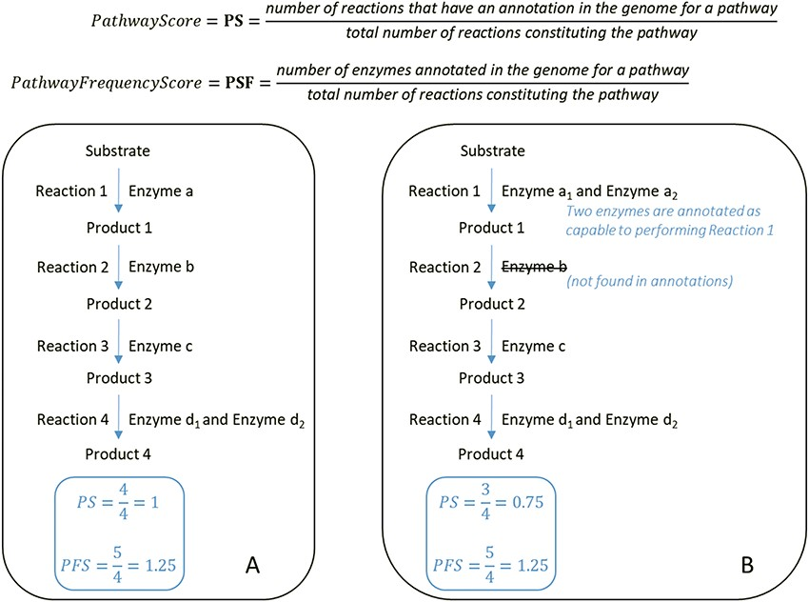
Figure 2 At the top, formulas for the computation of the PS and PFS. Below, examples of two types of computations of ...
Notes:
Figure 2 At the top, formulas for the computation of the PS and PFS. Below, examples of two types of computations of the PS and PFS based on an example of a hypothetical metabolic pathway. By comparing the PS and PFS in A and B, pathway A shows greater evidence of its veracity.
Unless provided in the caption above, the following copyright applies to the content of this slide: © The Author(s) 2019. Published by Oxford University Press.This is an Open Access article distributed under the terms of the Creative Commons Attribution License (http://creativecommons.org/licenses/by/4.0/), which permits unrestricted reuse, distribution, and reproduction in any medium, provided the original work is properly cited.

