Slide 1
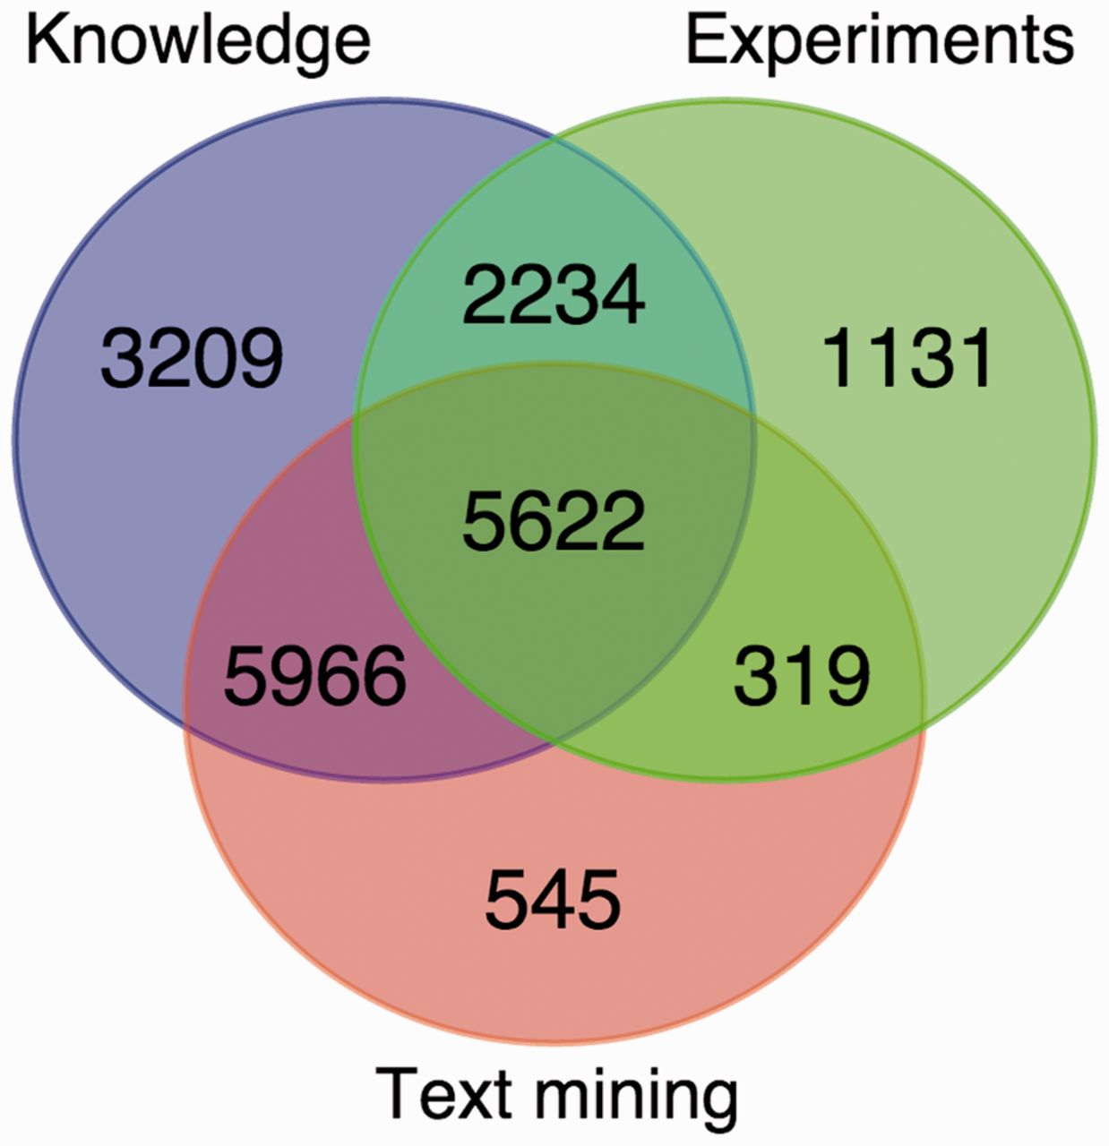
Figure 2. Overlap between the knowledge, experimental and text-mining evidence for human proteins. The Venn diagram ...
Notes:
Figure 2. Overlap between the knowledge, experimental and text-mining evidence for human proteins. The Venn diagram shows the number of proteins with localization evidence from one or more of the three types of evidence. The two sequence-based prediction methods are not included as they are able to provide a prediction for any protein sequence.
Unless provided in the caption above, the following copyright applies to the content of this slide: © The Author(s) 2014. Published by Oxford University Press.This is an Open Access article distributed under the terms of the Creative Commons Attribution License (http://creativecommons.org/licenses/by/3.0/), which permits unrestricted reuse, distribution, and reproduction in any medium, provided the original work is properly cited.

