Slide 1
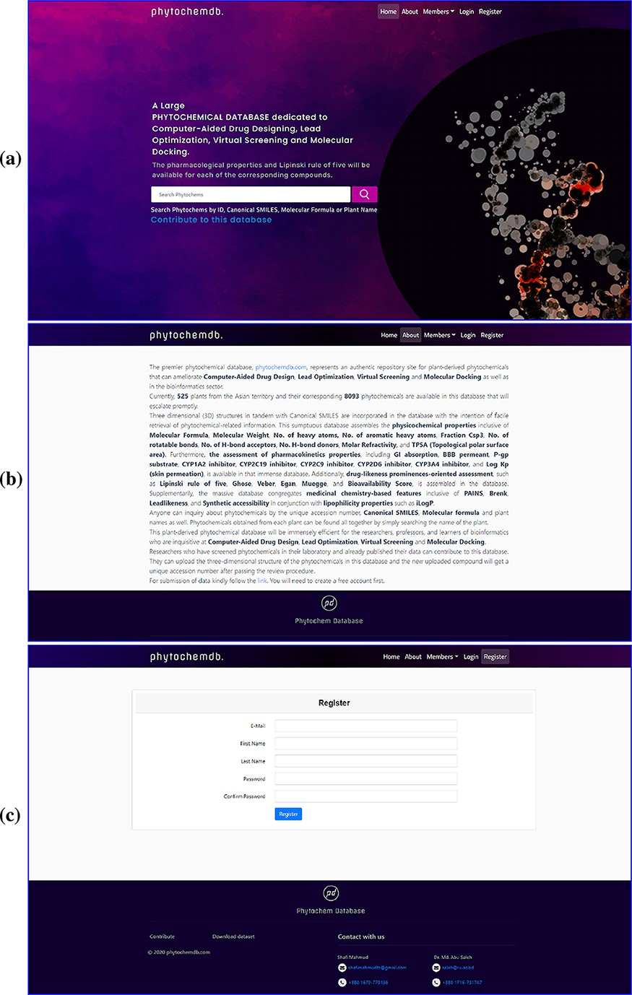
Figure 1. Web interface of the ‘phytochemdb’ database. (a) Demonstration of homepage containing the accessible search ...
Notes:
Figure 1. Web interface of the ‘phytochemdb’ database. (a) Demonstration of homepage containing the accessible search option. (b) ‘About’ web page encompasses a brief description about the database. (c) ‘Register’ web page comprehends the options for creating a free account in the database.
Unless provided in the caption above, the following copyright applies to the content of this slide: © The Author(s) 2022. Published by Oxford University Press.This is an Open Access article distributed under the terms of the Creative Commons Attribution License (https://creativecommons.org/licenses/by/4.0/), which permits unrestricted reuse, distribution, and reproduction in any medium, provided the original work is properly cited.

Slide 2
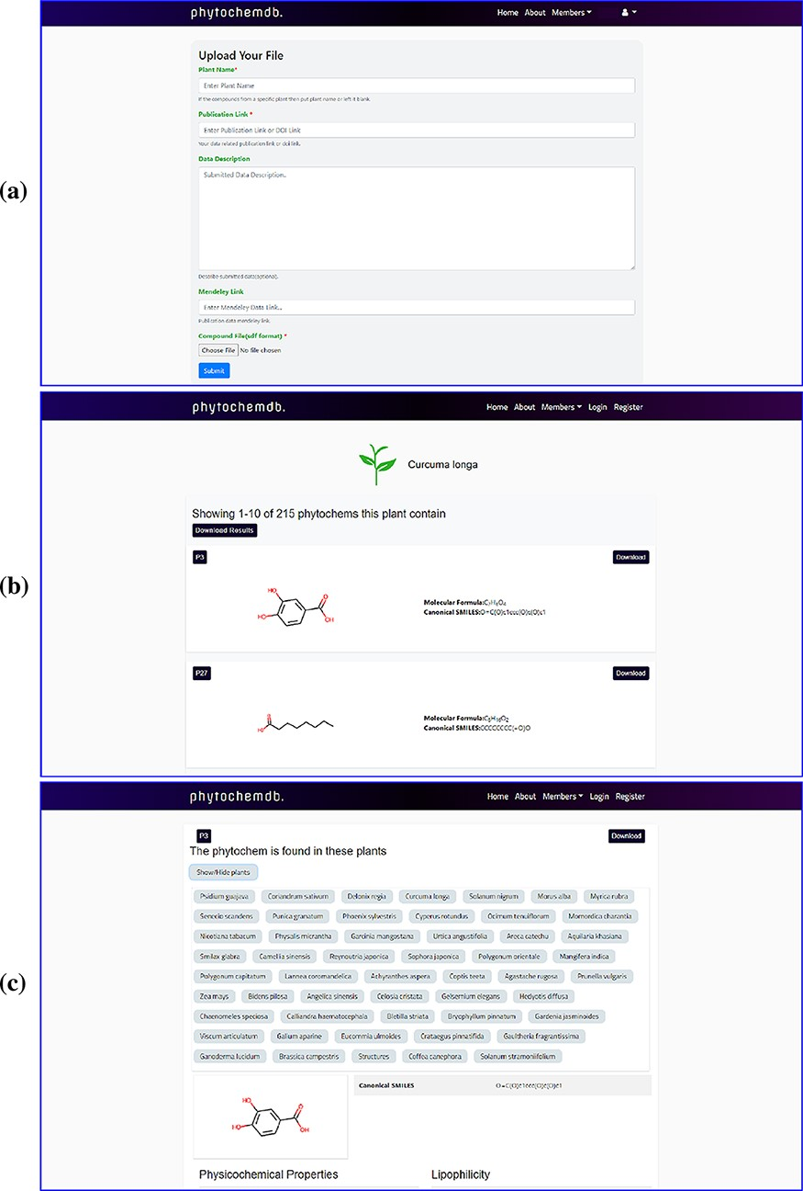
Figure 2. Web-interface of the ‘phytochemdb’ database. (a) Webpage for contribution to the database. (b) Webpage with ...
Notes:
Figure 2. Web-interface of the ‘phytochemdb’ database. (a) Webpage for contribution to the database. (b) Webpage with all available compounds for a specific plant. (c) Webpage with relative availability of a compound in distinct plants.
Unless provided in the caption above, the following copyright applies to the content of this slide: © The Author(s) 2022. Published by Oxford University Press.This is an Open Access article distributed under the terms of the Creative Commons Attribution License (https://creativecommons.org/licenses/by/4.0/), which permits unrestricted reuse, distribution, and reproduction in any medium, provided the original work is properly cited.

Slide 3
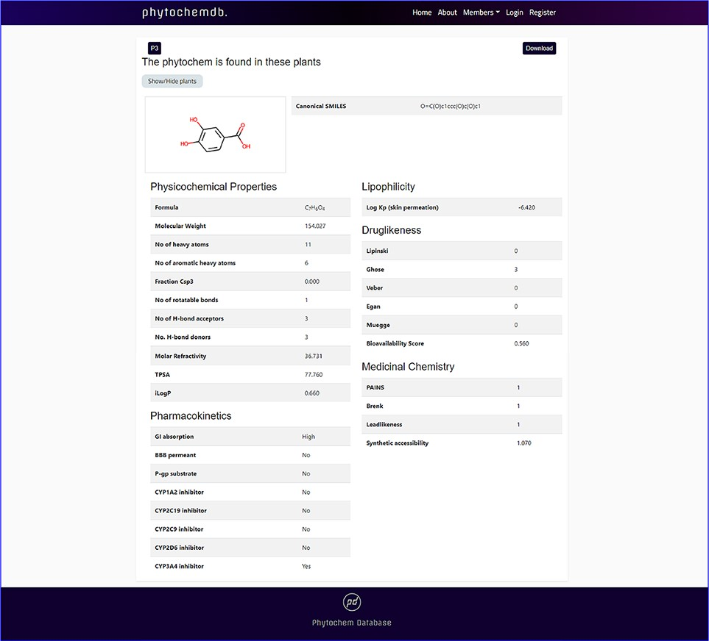
Figure 3. Features of ‘phytochemdb’ database encompassing the physicochemical properties of phytochemicals.
Notes:
Figure 3. Features of ‘phytochemdb’ database encompassing the physicochemical properties of phytochemicals.
Unless provided in the caption above, the following copyright applies to the content of this slide: © The Author(s) 2022. Published by Oxford University Press.This is an Open Access article distributed under the terms of the Creative Commons Attribution License (https://creativecommons.org/licenses/by/4.0/), which permits unrestricted reuse, distribution, and reproduction in any medium, provided the original work is properly cited.

Slide 4
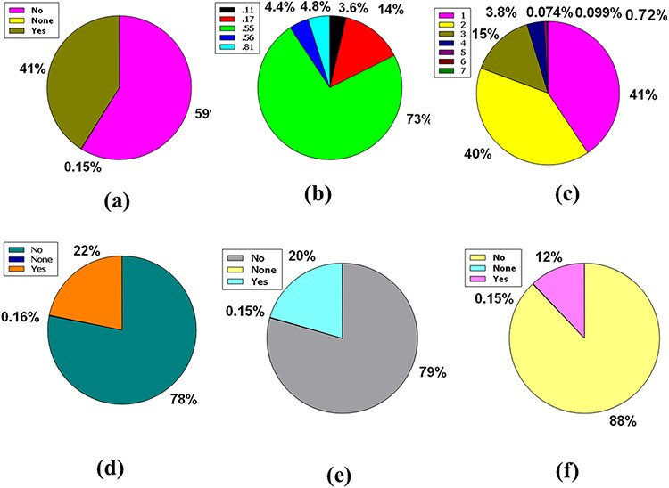
Figure 4. Venn diagram plot illustration of the physicochemical properties of phytochemicals in ‘phytochemdb’ database: ...
Notes:
Figure 4. Venn diagram plot illustration of the physicochemical properties of phytochemicals in ‘phytochemdb’ database: (a) BBB permeable and impermeable proportions of phytochemicals; (b) percentages of phytochemicals that satisfy diverse bioavailability scores; (c) the Brenk structural alert of compounds with different percentages; proportions of (d) CYP1A2, (e) CYP2C9, (f) CYP2C19 inhibitors and non-inhibitors of phytochemicals in the database.
Unless provided in the caption above, the following copyright applies to the content of this slide: © The Author(s) 2022. Published by Oxford University Press.This is an Open Access article distributed under the terms of the Creative Commons Attribution License (https://creativecommons.org/licenses/by/4.0/), which permits unrestricted reuse, distribution, and reproduction in any medium, provided the original work is properly cited.

Slide 5
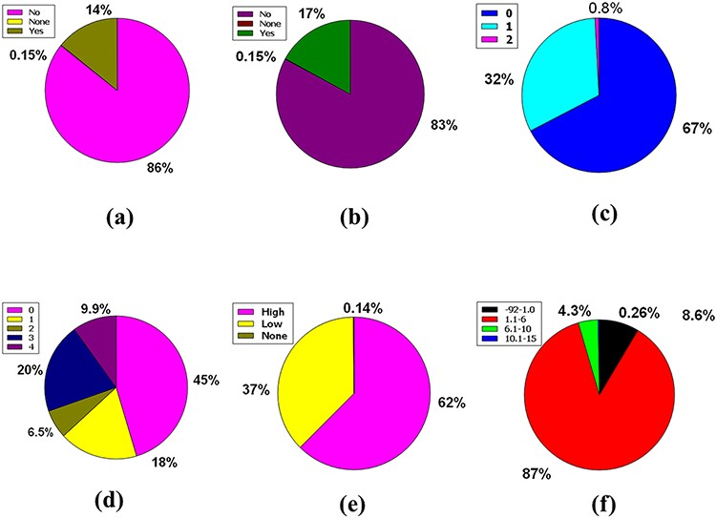
Figure 5. Venn diagram plot demonstration of the physicochemical properties of phytochemicals in ‘phytochemdb’ ...
Notes:
Figure 5. Venn diagram plot demonstration of the physicochemical properties of phytochemicals in ‘phytochemdb’ database: percentages of (a) CYP2D6, (b) CYP3A4 inhibitors and non-inhibitors of phytochemicals; (c) proportions of compounds that fulfil diverse criteria of Egan rule; (d) percentages of phytochemicals according to the Ghose filter; (e) gastrointestinal (GI) absorption rate of compounds; (f) percentages of phytochemicals that satisfy diverse iLOGP (lipophilicity) score.
Unless provided in the caption above, the following copyright applies to the content of this slide: © The Author(s) 2022. Published by Oxford University Press.This is an Open Access article distributed under the terms of the Creative Commons Attribution License (https://creativecommons.org/licenses/by/4.0/), which permits unrestricted reuse, distribution, and reproduction in any medium, provided the original work is properly cited.

Slide 6
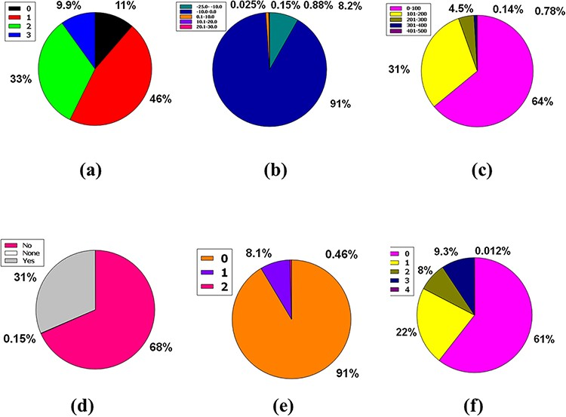
Figure 6. Venn diagram plot exhibition of the physicochemical properties of phytochemicals in ‘phytochemdb’ database: ...
Notes:
Figure 6. Venn diagram plot exhibition of the physicochemical properties of phytochemicals in ‘phytochemdb’ database: (a) proportions of compounds Leadlikeness; (b) LogKp percentages of compounds; (c) percentages of phytochemicals that satisfy diverse molar refractivity score; (d) P-gp substrate and P-gp non-substrate proportions of phytochemicals; (e) proportions of compounds that accomplish diverse standards of PAINS alert; (f) percentages of phytochemicals that satisfy diverse criteria of Lipinski rule of five.
Unless provided in the caption above, the following copyright applies to the content of this slide: © The Author(s) 2022. Published by Oxford University Press.This is an Open Access article distributed under the terms of the Creative Commons Attribution License (https://creativecommons.org/licenses/by/4.0/), which permits unrestricted reuse, distribution, and reproduction in any medium, provided the original work is properly cited.

Slide 7
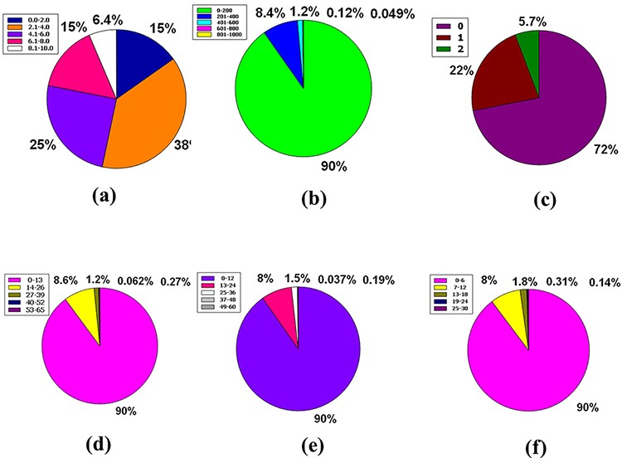
Figure 7. Venn diagram plot display of the physicochemical properties of phytochemicals in ‘phytochemdb’ database: (a) ...
Notes:
Figure 7. Venn diagram plot display of the physicochemical properties of phytochemicals in ‘phytochemdb’ database: (a) proportions of compounds’ synthetic accessibility; (b) proportions of phytochemicals that show diverse standards of TPSA; (c) percentages of phytochemicals according to the Veber filter; (d) proportions of compounds that fulfil different standards of rotatable bonds; (e) and (f) percentages of phytochemicals that satisfy various criteria of H bond acceptors and H bond donors, respectively.
Unless provided in the caption above, the following copyright applies to the content of this slide: © The Author(s) 2022. Published by Oxford University Press.This is an Open Access article distributed under the terms of the Creative Commons Attribution License (https://creativecommons.org/licenses/by/4.0/), which permits unrestricted reuse, distribution, and reproduction in any medium, provided the original work is properly cited.

Slide 8
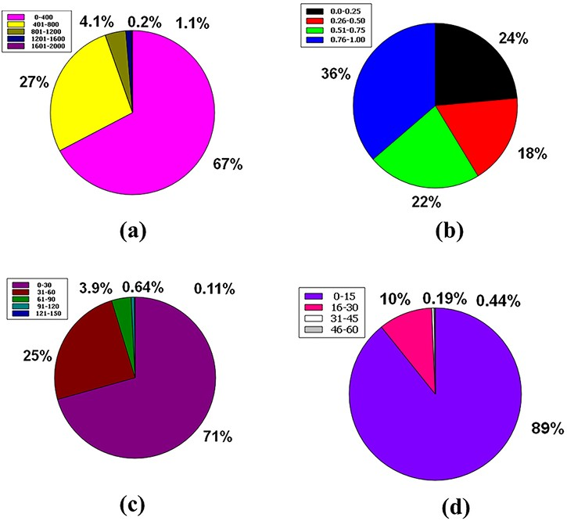
Figure 8. Venn diagram plot illustration of the physicochemical properties of phytochemicals in ‘phytochemdb’ database: ...
Notes:
Figure 8. Venn diagram plot illustration of the physicochemical properties of phytochemicals in ‘phytochemdb’ database: (a) proportions of compounds molecular weight; (b) percentages of phytochemicals that satisfy diverse fraction Csp3 score; (c) and (d) percentages of phytochemicals that fulfil various criteria of heavy atoms and aromatic heavy atoms, respectively.
Unless provided in the caption above, the following copyright applies to the content of this slide: © The Author(s) 2022. Published by Oxford University Press.This is an Open Access article distributed under the terms of the Creative Commons Attribution License (https://creativecommons.org/licenses/by/4.0/), which permits unrestricted reuse, distribution, and reproduction in any medium, provided the original work is properly cited.

