Slide 1
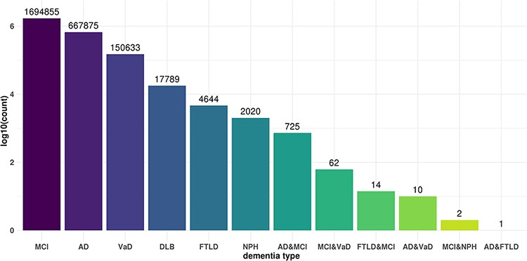
Figure 2. Commonality and specificity of miR-eQTLs among dementia types. X axis shows dementia types and Y axis shows ...
Notes:
Figure 2. Commonality and specificity of miR-eQTLs among dementia types. X axis shows dementia types and Y axis shows the total numbers of cis-miR-eQTLs and trans-miR-eQTLs at an FDR <0.05 for each dementia type or combination of dementia types.
Unless provided in the caption above, the following copyright applies to the content of this slide: © The Author(s) 2021. Published by Oxford University Press.This is an Open Access article distributed under the terms of the Creative Commons Attribution License (https://creativecommons.org/licenses/by/4.0/), which permits unrestricted reuse, distribution, and reproduction in any medium, provided the original work is properly cited.

