Slide 1
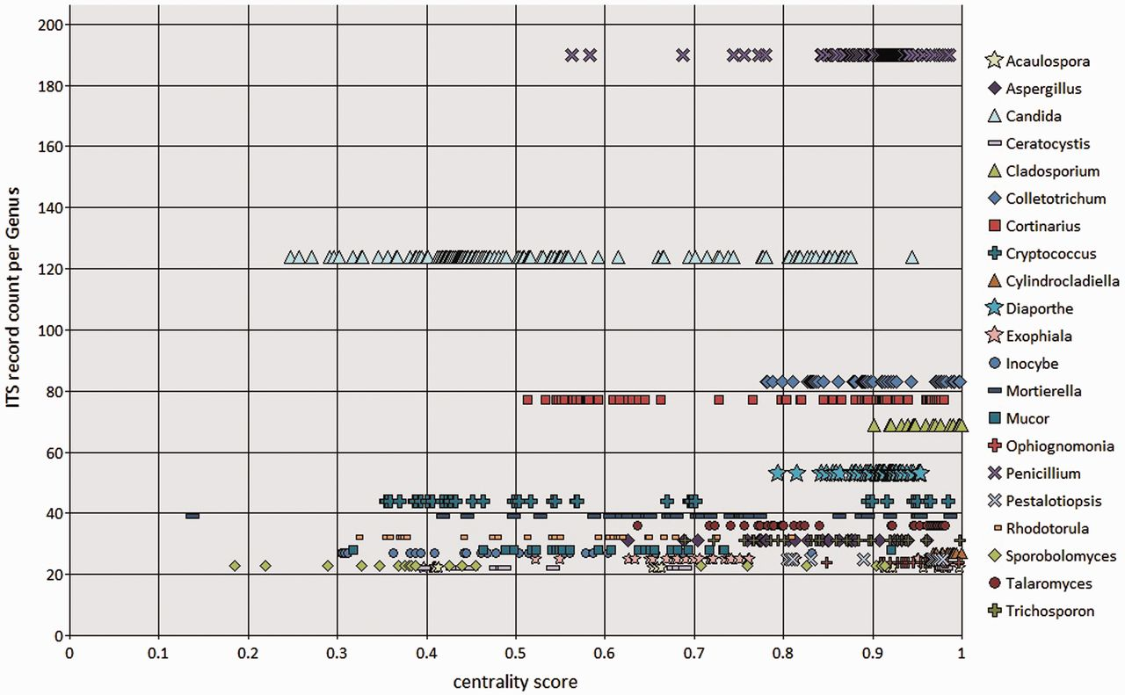
Figure 7. BioloMICS centrality scores of ITS sequences at genus rank, showing genera with ≥20 ITS records in the RefSeq ...
Notes:
Figure 7. BioloMICS centrality scores of ITS sequences at genus rank, showing genera with ≥20 ITS records in the RefSeq data set. Each marker represents an individual sequence.
Unless provided in the caption above, the following copyright applies to the content of this slide: Published by Oxford University Press 2013. This work is written by US Government employees and is in the public domain in the US.

