Slide 1
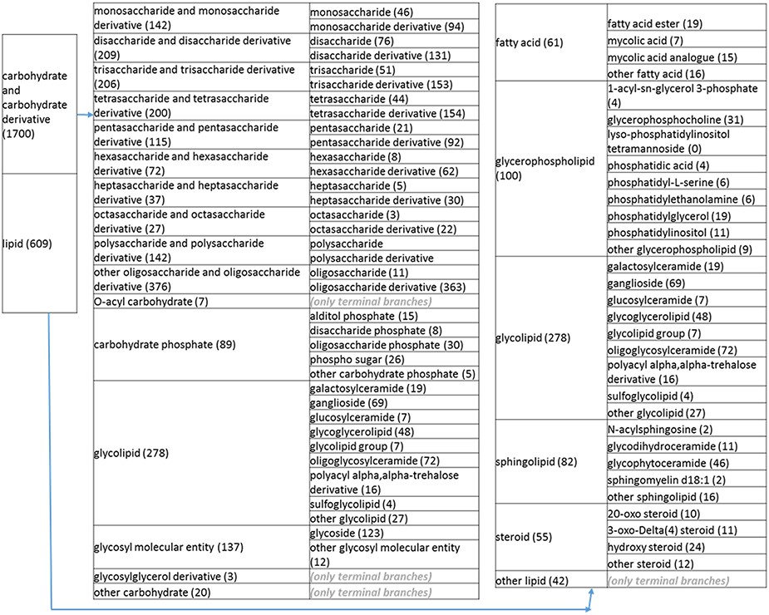
Figure 2. (b) A high-level breakdown of the carbohydrate and carbohydrate derivative, and lipid branches of structure ...
Notes:
Figure 2. (b) A high-level breakdown of the carbohydrate and carbohydrate derivative, and lipid branches of structure tree. Both of these are children of ‘organic molecular entity’. Some of these are terminal branches, while others are subdivided into more specific structures for greater specificity. The number of entries per level is indicated at the end of each branch’s label.
Unless provided in the caption above, the following copyright applies to the content of this slide: © The Author(s) 2021. Published by Oxford University Press.This is an Open Access article distributed under the terms of the Creative Commons Attribution License (http://creativecommons.org/licenses/by/4.0/), which permits unrestricted reuse, distribution, and reproduction in any medium, provided the original work is properly cited.

