Slide 1
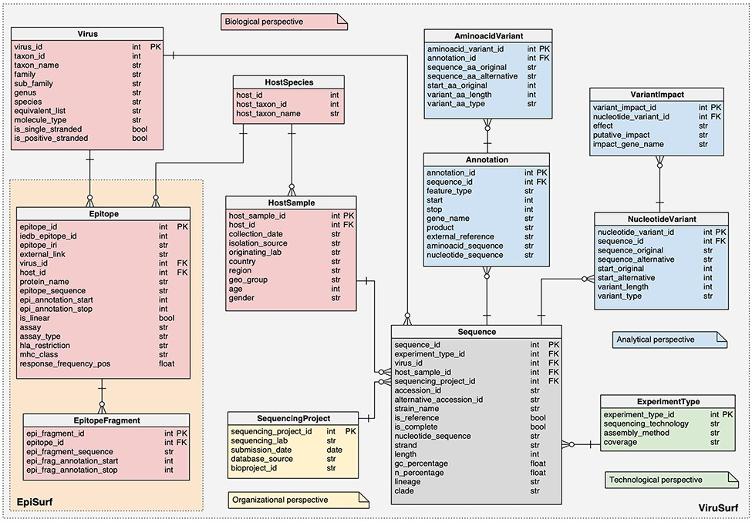
Figure 1. Logical schema of the relational database in the back-end of EpiSurf.
Notes:
Figure 1. Logical schema of the relational database in the back-end of EpiSurf.
Unless provided in the caption above, the following copyright applies to the content of this slide: © The Author(s) 2021. Published by Oxford University Press.This is an Open Access article distributed under the terms of the Creative Commons Attribution License (https://creativecommons.org/licenses/by/4.0/), which permits unrestricted reuse, distribution, and reproduction in any medium, provided the original work is properly cited.

Slide 2
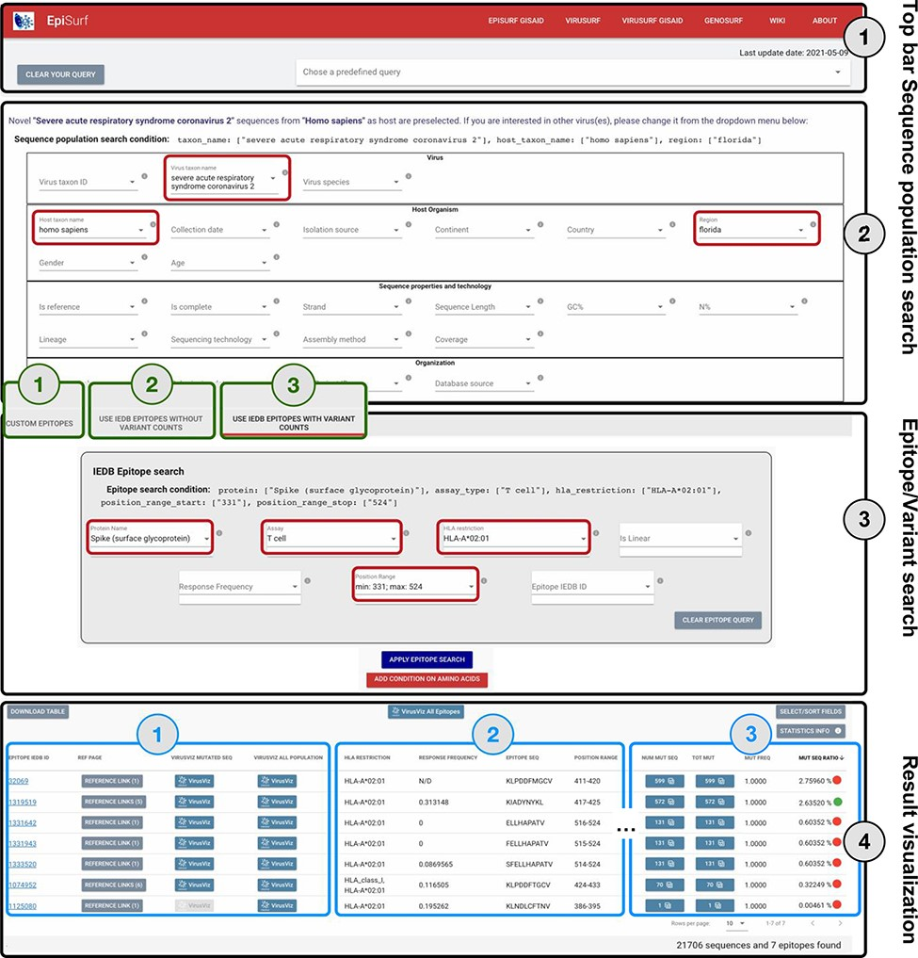
Figure 2. Overview of the EpiSurf interface, divided into four parts (see black rectangles). ‘Part 1’ (Top bar) allows ...
Notes:
Figure 2. Overview of the EpiSurf interface, divided into four parts (see black rectangles). ‘Part 1’ (Top bar) allows clearing all filters selected in the interface or selecting predefined example queries. ‘Part 2’ (Sequence population search) is used for selecting sequences of interest. SARS-CoV-2 and human host are pre-selected, whereas the ‘Florida’ location has been added as an example (see red rectangles). After metadata search, users select between three different modes (squared in green): (1) Custom epitopes (shown in detail in Figure 3); (2) Use IEDB epitopes without variant counts; (3) Use IEDB epitopes with variant counts. For Parts 3 and 4 of this figure, we assume the selection of Modes 2 or 3, whereas Figure 3 shows Parts 3 and 4 after selecting Mode 1. ‘Part 3’ (Epitope/Variant search) enables selecting epitopes from IEDB. The Spike protein is pre-selected (but users can easily change the choice of protein), whereas other conditions allow filtering the epitopes by using metadata available in IEDB. As an example, we show the selection of T cell assay, HLA-A*02:01 restriction and a position range covering the receptor binding domain (25)—see red rectangles. Finally, ‘Part 4’ (Result visualization) provides a table describing selected epitopes, further vertically decomposed into three areas (shown in blue): ‘Area 1’ includes a number of buttons to open the results within the IEDB page, VirusViz (considering only sequences mutated on the epitope range or all the ones in the population selected in Part 2); ‘Area 2’ includes sortable and adjustable metadata about epitopes; and ‘Area 3’ is present only in Mode 3 and includes counters that define the conservancy of the epitope in the population of interest. The columns of the table are customizable and the full table can be conveniently downloaded as a CSV file. The two most relevant counts in the search, i.e. the number of sequences and of epitopes, are provided at the bottom right corner of the web page.
Unless provided in the caption above, the following copyright applies to the content of this slide: © The Author(s) 2021. Published by Oxford University Press.This is an Open Access article distributed under the terms of the Creative Commons Attribution License (https://creativecommons.org/licenses/by/4.0/), which permits unrestricted reuse, distribution, and reproduction in any medium, provided the original work is properly cited.

Slide 3
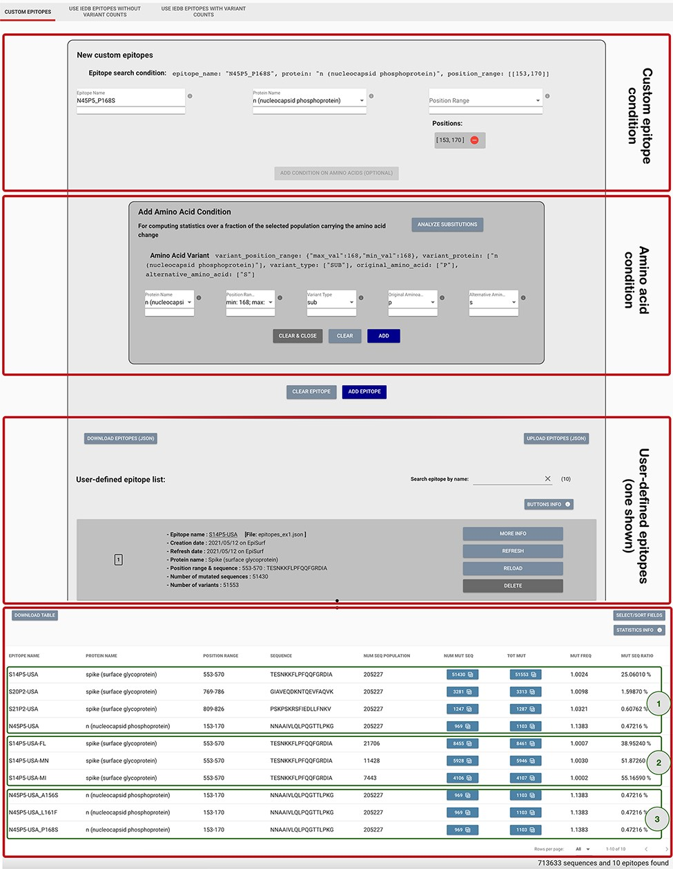
Figure 3. Epitope definition panels in the ‘Custom Epitope’ Mode 1, where users can input their defined epitopes, ...
Notes:
Figure 3. Epitope definition panels in the ‘Custom Epitope’ Mode 1, where users can input their defined epitopes, inserting a name, the protein and range (or collection of ranges, when the proposed epitope is nonlinear). In addition, the user can optionally add an amino acid condition for restricting the population selected in the Sequence Population Search panel (see Figure 2) to the viruses carrying a specific amino acid change. Once created, epitopes are added to a list, displayed on the page; each epitope information can be inspected by using the MORE INFO button, updated with the REFRESH button, modified with the RELOAD button or removed with the DELETE button. Epitopes can be downloaded and then uploaded during a different session of the EpiSurf use. The bottom table shows the results of the epitope design session, as further described in Example 1 of the Use Cases section.
Unless provided in the caption above, the following copyright applies to the content of this slide: © The Author(s) 2021. Published by Oxford University Press.This is an Open Access article distributed under the terms of the Creative Commons Attribution License (https://creativecommons.org/licenses/by/4.0/), which permits unrestricted reuse, distribution, and reproduction in any medium, provided the original work is properly cited.

Slide 4
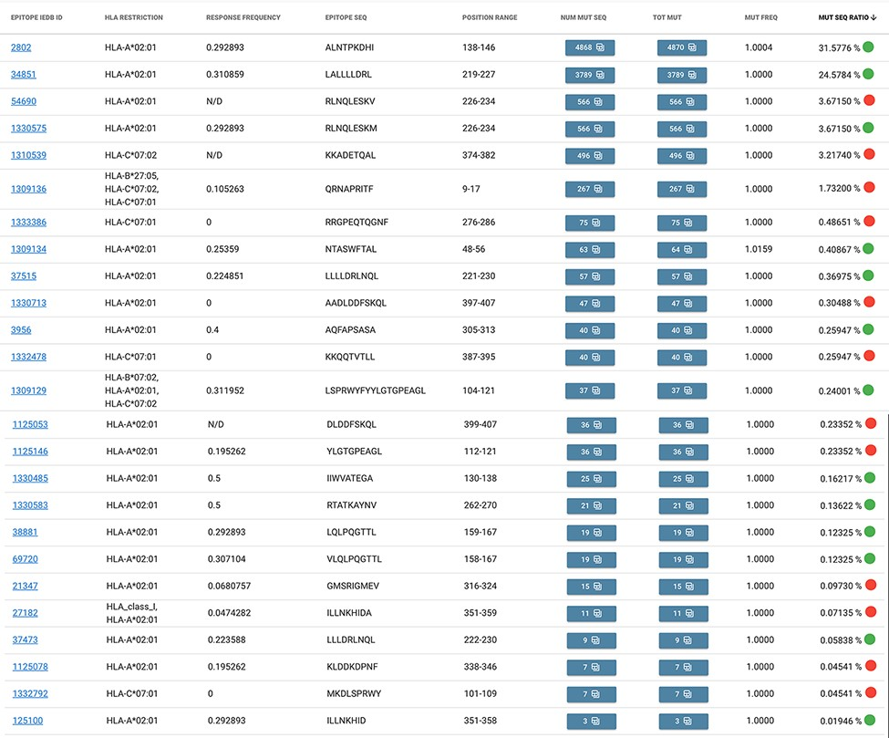
Figure 4. Result table of the query performed in Example 2: list of epitopes with their statistics descriptive of the ...
Notes:
Figure 4. Result table of the query performed in Example 2: list of epitopes with their statistics descriptive of the mutation rate over the selected population (Campania, Italy). Color codes are used to discriminate between epitopes with a response frequency > 0.2 (green) or < 0.2 (red).
Unless provided in the caption above, the following copyright applies to the content of this slide: © The Author(s) 2021. Published by Oxford University Press.This is an Open Access article distributed under the terms of the Creative Commons Attribution License (https://creativecommons.org/licenses/by/4.0/), which permits unrestricted reuse, distribution, and reproduction in any medium, provided the original work is properly cited.

Slide 5
Figure 5. Epitope mutation statistics result of Example 3.
Notes:
Figure 5. Epitope mutation statistics result of Example 3.
Unless provided in the caption above, the following copyright applies to the content of this slide: © The Author(s) 2021. Published by Oxford University Press.This is an Open Access article distributed under the terms of the Creative Commons Attribution License (https://creativecommons.org/licenses/by/4.0/), which permits unrestricted reuse, distribution, and reproduction in any medium, provided the original work is properly cited.

Slide 6
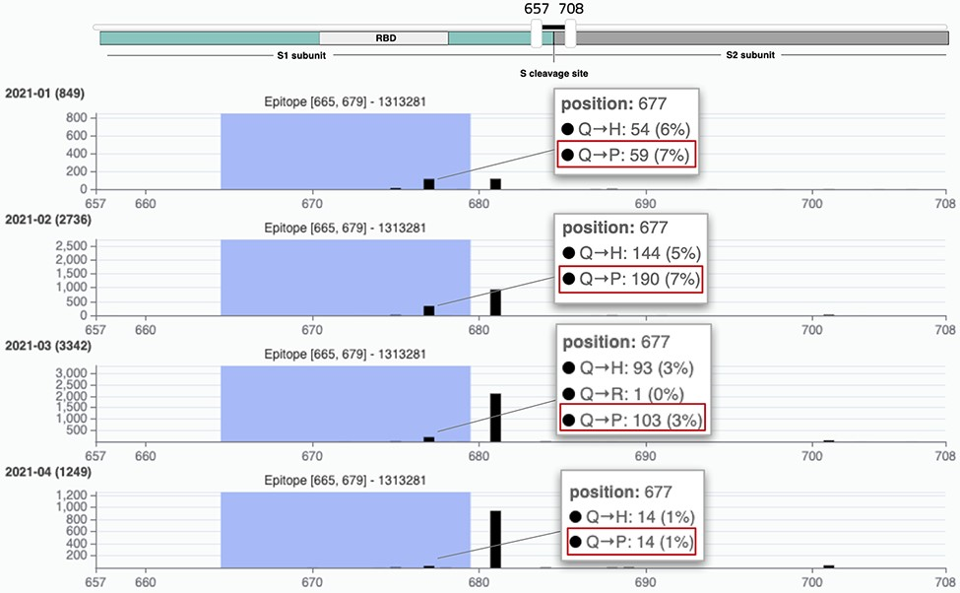
Figure 6. VirusViz compare functionality was applied to four groups of sequences collected in Texas in the first months ...
Notes:
Figure 6. VirusViz compare functionality was applied to four groups of sequences collected in Texas in the first months of 2021 (see Example 3). We highlight a particular epitope that does not include the highly mutated 681 position (belonging to B.1.1.7 lineage, known as the UK variant of concern) but does include the position 677 and thus the Q766P mutation.
Unless provided in the caption above, the following copyright applies to the content of this slide: © The Author(s) 2021. Published by Oxford University Press.This is an Open Access article distributed under the terms of the Creative Commons Attribution License (https://creativecommons.org/licenses/by/4.0/), which permits unrestricted reuse, distribution, and reproduction in any medium, provided the original work is properly cited.

