Slide 1
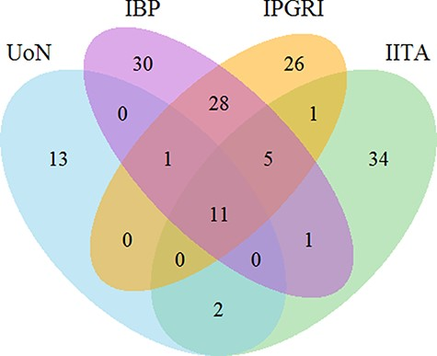
Figure 3. Venn diagram for the count of 230 trait names in bambara groundnut unique and shared across the different ...
Notes:
Figure 3. Venn diagram for the count of 230 trait names in bambara groundnut unique and shared across the different institutions. The numbers show the number of unique and shared trait names across the different institutions. Abbreviations in the sets are as follows: University of Nottingham (UoN), Integrated Breeding Platform (IBP), International Plant Genetic Resources Institute (IPGRI) and International Institute of Tropical Agriculture (IITA).
Unless provided in the caption above, the following copyright applies to the content of this slide: © The Author(s) 2021. Published by Oxford University Press.This is an Open Access article distributed under the terms of the Creative Commons Attribution License (http://creativecommons.org/licenses/by/4.0/), which permits unrestricted reuse, distribution, and reproduction in any medium, provided the original work is properly cited.

