Slide 1
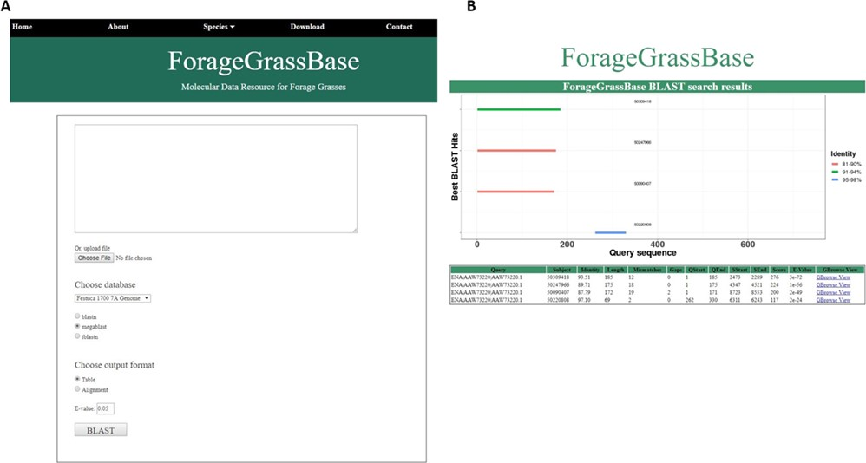
Figure 2 Festuca pratensis cultivars genome browsers with genome annotations and BLAST tool. (A) BLAST tool ...
Notes:
Figure 2 Festuca pratensis cultivars genome browsers with genome annotations and BLAST tool. (A) BLAST tool implemented to search for homologous regions in the reference genomes available. (B) BLAST results page shows the homologous regions.
Unless provided in the caption above, the following copyright applies to the content of this slide: © The Author(s) 2020. Published by Oxford University Press.This is an Open Access article distributed under the terms of the Creative Commons Attribution License (http://creativecommons.org/licenses/by/4.0/), which permits unrestricted reuse, distribution, and reproduction in any medium, provided the original work is properly cited.

