Slide 1
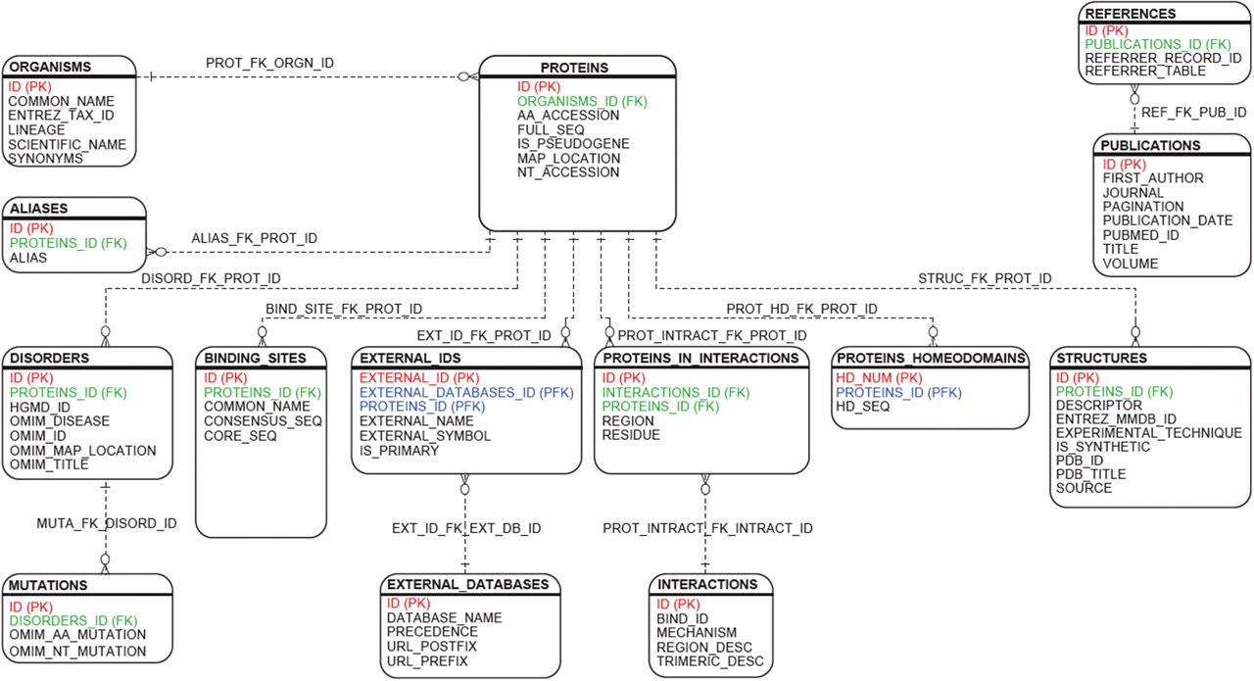
Figure 1. HDR relational framework. The relational design connecting the Homeodomain Resource's 14 primary tables are ...
Notes:
Figure 1. HDR relational framework. The relational design connecting the Homeodomain Resource's 14 primary tables are illustrated in the figure. Primary keys are indicated in red, foreign keys in green and keys characterized as both primary and foreign in blue. The new database design is centered around data found in the ‘Proteins’ table. All proteins are lineage-specific and linked to the ‘Organisms’ table. A single protein may contain one or more homeodomains related to the ‘Proteins_Homeodomains’ table. DNA-binding targets, protein–protein interactions, 3D structures and homeodomains implicated in human disorders are normalized and linked to the ‘Proteins’ table. External annotation from multiple databases are integrated via the ‘External_Ids’ table. Database entries are referenced with their primary citation via the ‘Publications’ table.
Unless provided in the caption above, the following copyright applies to the content of this slide: Published by Oxford University Press 2009.This is Open Access article distributed under the terms of the Creative Commons Attribution Non-Commercial License (http://creativecommons.org/licenses/by-nc/2.0/uk/) which permits unrestricted non-commercial use, distribution, and reproduction in any medium, provided the original work is properly cited.

Slide 2
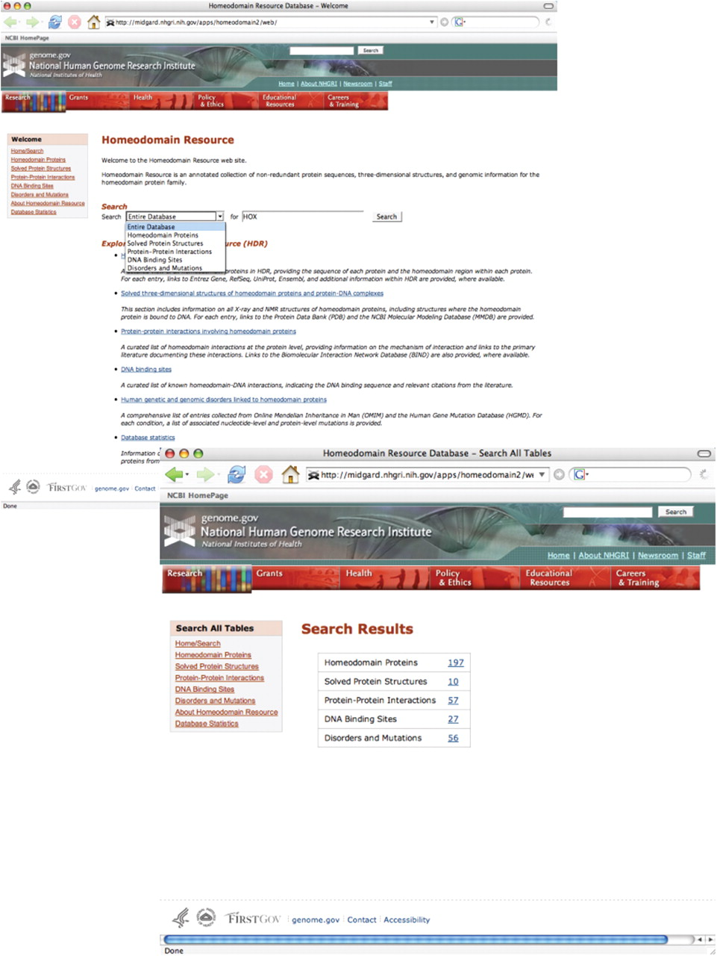
Figure 2. The Homeodomain Resource provides a simple search query interface, allowing the user to either query part or ...
Notes:
Figure 2. The Homeodomain Resource provides a simple search query interface, allowing the user to either query part or all of the Resource (top). Selecting ‘Entire Database’ from the pull-down menu returns a summary screen, indicating how many entries of each type were identified (bottom). Clicking on any of the hyperlinked numbers in the table takes the user directly to that set of results. In addition, overall navigation within the site has been improved with the addition of sidebar tools and links to complete datasets in each homeodomain category.
Unless provided in the caption above, the following copyright applies to the content of this slide: Published by Oxford University Press 2009.This is Open Access article distributed under the terms of the Creative Commons Attribution Non-Commercial License (http://creativecommons.org/licenses/by-nc/2.0/uk/) which permits unrestricted non-commercial use, distribution, and reproduction in any medium, provided the original work is properly cited.

Slide 3
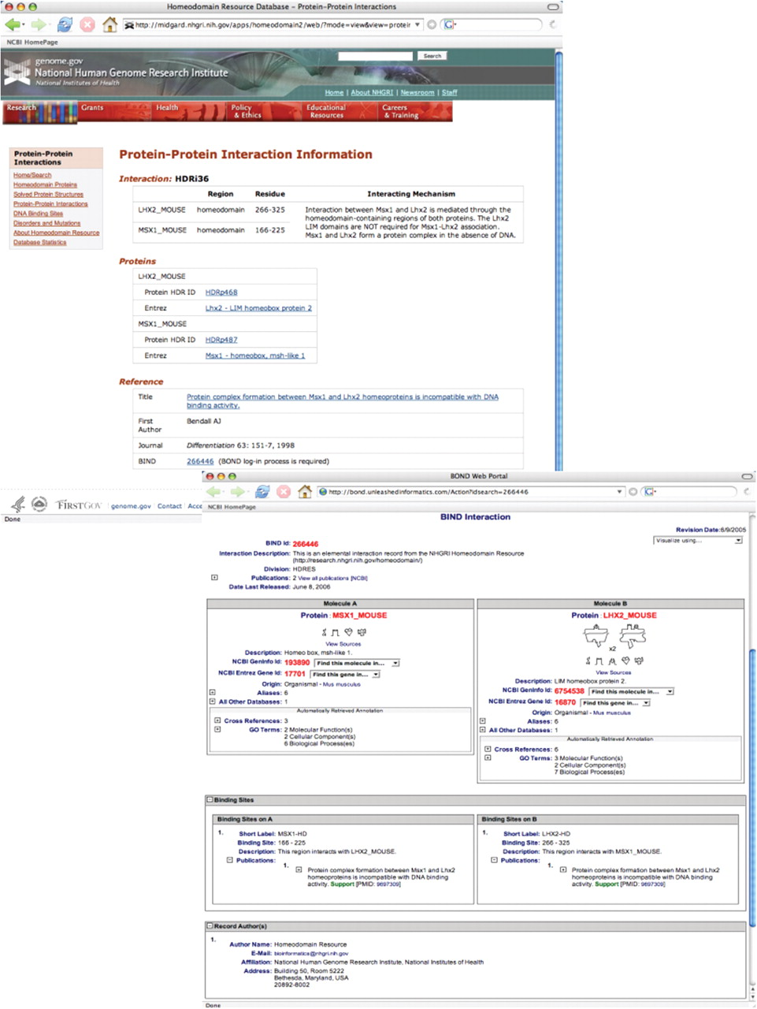
Figure 3. Search results from a query of protein–protein interactions data for the interaction of homeodomain proteins ...
Notes:
Figure 3. Search results from a query of protein–protein interactions data for the interaction of homeodomain proteins Lhx2 and Msx1 (SEARCH ‘Protein-Protein Interactions’ FOR ‘MSX1’) (top). Each protein–protein interaction entry within the Homeodomain Resource is hyperlinked to the corresponding entry in BIND, which provides additional details on the mechanism(s) of interaction (bottom). See text for additional details.
Unless provided in the caption above, the following copyright applies to the content of this slide: Published by Oxford University Press 2009.This is Open Access article distributed under the terms of the Creative Commons Attribution Non-Commercial License (http://creativecommons.org/licenses/by-nc/2.0/uk/) which permits unrestricted non-commercial use, distribution, and reproduction in any medium, provided the original work is properly cited.

