Slide 1
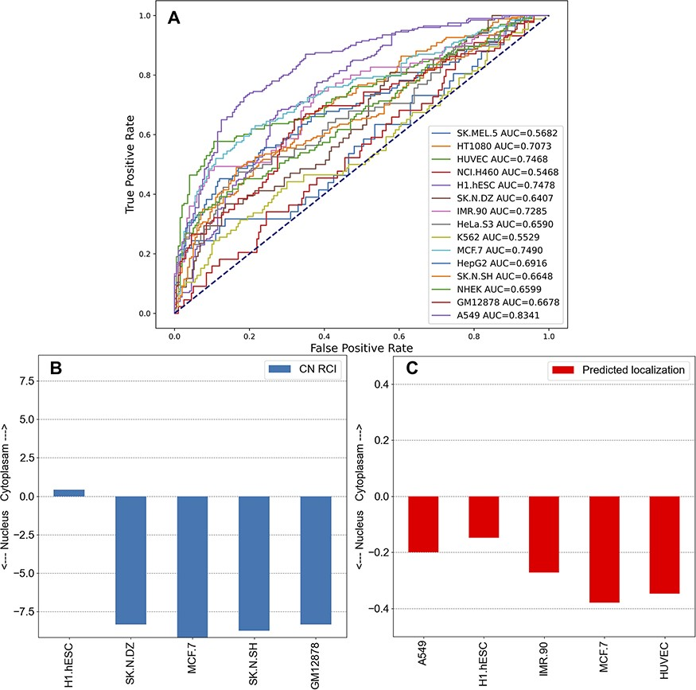
Figure 5. Unsupervised learning to predict the localization of lncRNAs by cell line. (A) Co-expression gene–gene ...
Notes:
Figure 5. Unsupervised learning to predict the localization of lncRNAs by cell line. (A) Co-expression gene–gene correlations were used to predict localization values for each human lncRNA for the 15 cell lines in lncAtlas. For each human lncRNA, the 35 371 genes present across the cell types in lncAtlas were ranked by PCCs and ranks were multiplied by the existing RCIs from lncAtlas and summed. True positives and false positives were calculated for CN RCIs >1 and <−1 per cell line. (B) Subcellular localization RCIs for XIST, which are available for the displayed cell lines from lncAtlas. (C) Predicted subcellular localization for TSIX, an antisense gene to XIST. Subcellular localization information for TSIX is not available in lncAtlas for the five cell lines. These cell lines have the highest AUROCs as reported in (A).
Unless provided in the caption above, the following copyright applies to the content of this slide: © The Author(s) 2023. Published by Oxford University Press.This is an Open Access article distributed under the terms of the Creative Commons Attribution License (https://creativecommons.org/licenses/by/4.0/), which permits unrestricted reuse, distribution, and reproduction in any medium, provided the original work is properly cited.

