Slide 1
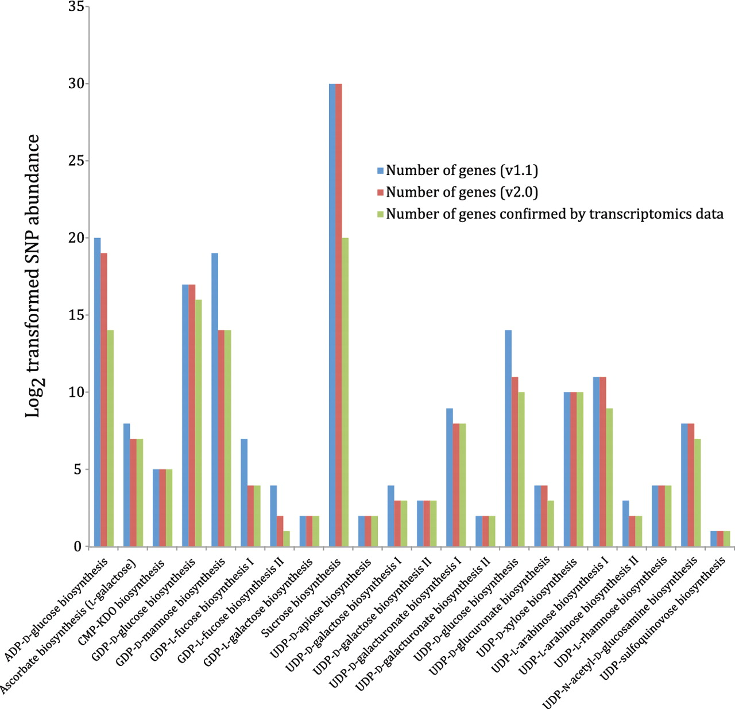
Figure 9. Nucleotide-sugar biosynthetic genes expressed in xylem tissue from 20 different Populus trees with different ...
Notes:
Figure 9. Nucleotide-sugar biosynthetic genes expressed in xylem tissue from 20 different Populus trees with different wood properties. Log2 transformed SNP abundance data for individual Populus nucleotide-sugar biosynthetic genes are overlaid with the curated nucleotide-sugar biosynthetic pathways in the prototype Populus PGDB. Genes that exhibit at least one SNP are considered expressed, whereas the status of genes lacking SNPs cannot be ascertained. UDP-L-arabinose synthesis I (from UDP-D-xylose, catalyzed by UDP-arabinose 4-epimerase) is currently represented in the PGDB as occurring in the cytosol and two different organelles—ER and Golgi, based on sequence analyses of UDP-arabinose 4-epimerase isoforms. The localization of any UDP-arabinose 4-epimerase isoform to the ER is yet to be validated by experimental data.
Unless provided in the caption above, the following copyright applies to the content of this slide: © The Author(s) 2012. Published by Oxford University Press.This is an Open Access article distributed under the terms of the Creative Commons Attribution Non-Commercial License (http://creativecommons.org/licenses/by-nc/3.0), which permits unrestricted non-commercial use, distribution, and reproduction in any medium, provided the original work is properly cited.

