Slide 1
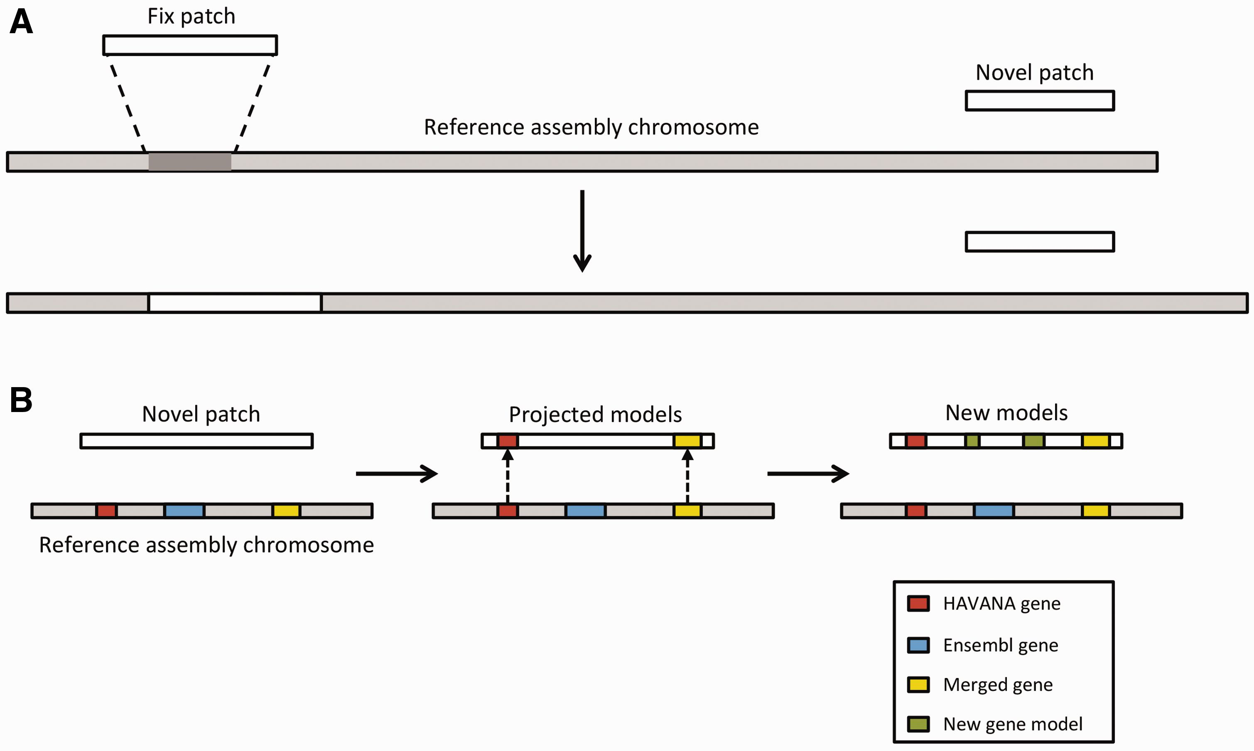
Figure 7. Annotation of patches. ( A ) Currently, we have two different types of patches: fix patches and novel ...
Notes:
Figure 7. Annotation of patches. ( A ) Currently, we have two different types of patches: fix patches and novel patches. Both types are anchored to the assembly by shared sequence. Fix patches become part of the next major version of the assembly while novel patches remain as alternative sequence. ( B ) When annotating a novel patch, we first project gene models from the reference assembly. In this example, the HAVANA (red) and merged (yellow) genes are copied to the patch sequence. The Ensembl gene (blue) is not copied because the underlying genomic DNA is too different between the chromosome and the patch to enable the projection process. After projection, a patch will be annotated fully using the Ensembl annotation pipeline. In this case, two new gene models (green) have been annotated on the novel patch.
Unless provided in the caption above, the following copyright applies to the content of this slide: © The Author(s) 2016. Published by Oxford University Press. This is an Open Access article distributed under the terms of the Creative Commons Attribution License ( http://creativecommons.org/licenses/by/4.0/ ), which permits unrestricted reuse, distribution, and reproduction in any medium, provided the original work is properly cited.

