Slide 1
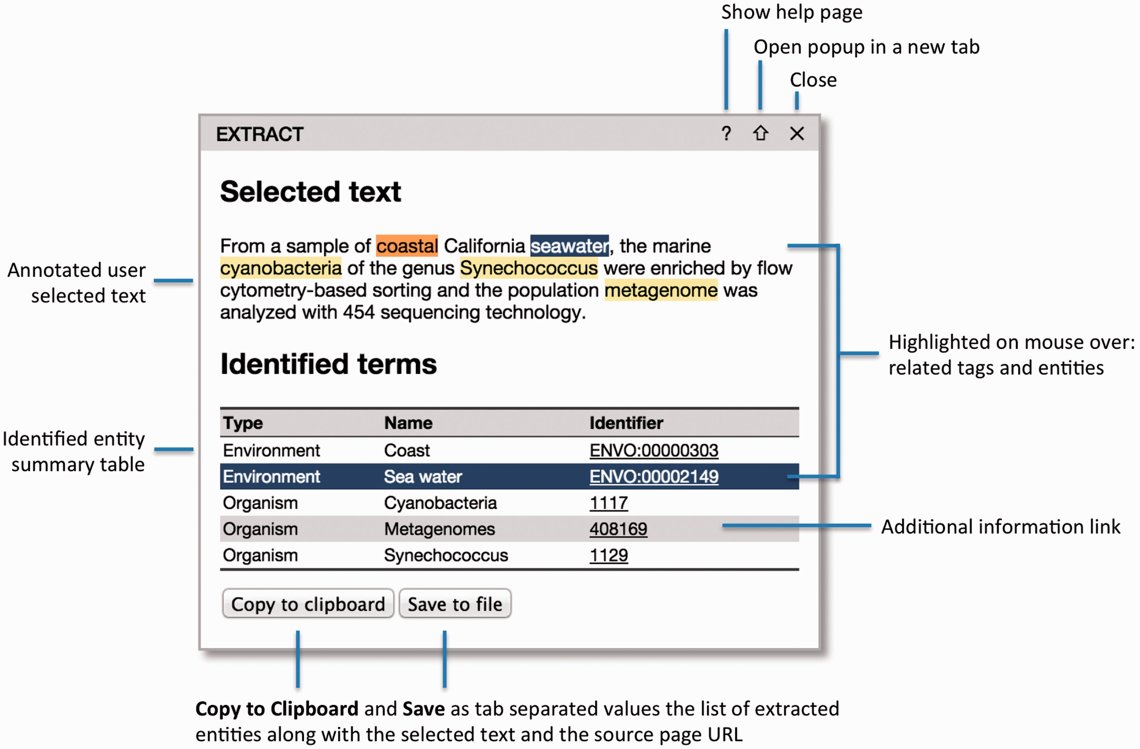
Figure 1. The EXTRACT popup. Hovering the mouse cursor over the text tags or the table rows enables users to visually ...
Notes:
Figure 1. The EXTRACT popup. Hovering the mouse cursor over the text tags or the table rows enables users to visually inspect which words have been identified as which entities. To allow for easy collection of annotations in tabular form, e.g. in an Excel spreadsheet, two buttons allow the user to either copy the information to the clipboard or save it to a tab-delimited file. When doing so, the selected text and the address of the source webpage are also included for provenance.
Unless provided in the caption above, the following copyright applies to the content of this slide: © The Author(s) 2016. Published by Oxford University Press. This is an Open Access article distributed under the terms of the Creative Commons Attribution License ( http://creativecommons.org/licenses/by/4.0/ ), which permits unrestricted reuse, distribution, and reproduction in any medium, provided the original work is properly cited.

