Slide 1
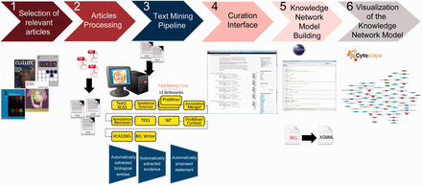
Figure 1. Overall workflow used to create the atherosclerosis plaque destabilization network. The knowledge extraction ...
Notes:
Figure 1. Overall workflow used to create the atherosclerosis plaque destabilization network. The knowledge extraction workflow contains six steps. Step 1: Selection of articles that represent specific biological context from which the knowledge base was constructed. Step 2: Text-processing with special character clearance and line break corrections to ensure proper machine parsing. Step 3: Text mining pipeline with an automated recognition of NER and relationships and coding into a BEL-compliant syntax. Step 4: Domain expert curation process in the curation interface based on the automatically created and proposed BEL statements. Step 5: Validation and transformation of BEL statements into knowledge network models. Step 6: Visualization of the knowledge network model.
Unless provided in the caption above, the following copyright applies to the content of this slide: © The Author(s) 2015. Published by Oxford University Press.This is an Open Access article distributed under the terms of the Creative Commons Attribution License (http://creativecommons.org/licenses/by/4.0/), which permits unrestricted reuse, distribution, and reproduction in any medium, provided the original work is properly cited.

