Slide 1
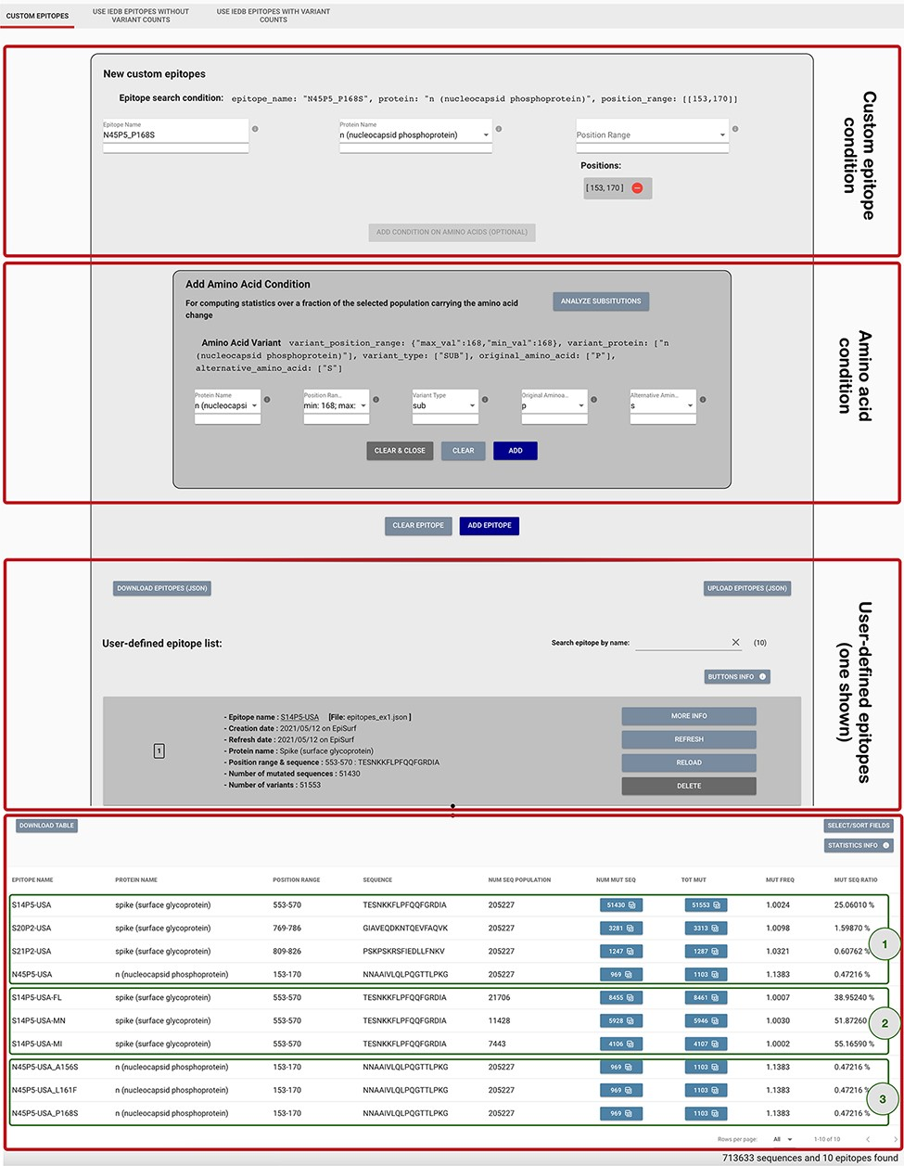
Figure 3. Epitope definition panels in the ‘Custom Epitope’ Mode 1, where users can input their defined epitopes, ...
Notes:
Figure 3. Epitope definition panels in the ‘Custom Epitope’ Mode 1, where users can input their defined epitopes, inserting a name, the protein and range (or collection of ranges, when the proposed epitope is nonlinear). In addition, the user can optionally add an amino acid condition for restricting the population selected in the Sequence Population Search panel (see Figure 2) to the viruses carrying a specific amino acid change. Once created, epitopes are added to a list, displayed on the page; each epitope information can be inspected by using the MORE INFO button, updated with the REFRESH button, modified with the RELOAD button or removed with the DELETE button. Epitopes can be downloaded and then uploaded during a different session of the EpiSurf use. The bottom table shows the results of the epitope design session, as further described in Example 1 of the Use Cases section.
Unless provided in the caption above, the following copyright applies to the content of this slide: © The Author(s) 2021. Published by Oxford University Press.This is an Open Access article distributed under the terms of the Creative Commons Attribution License (https://creativecommons.org/licenses/by/4.0/), which permits unrestricted reuse, distribution, and reproduction in any medium, provided the original work is properly cited.

