Slide 1
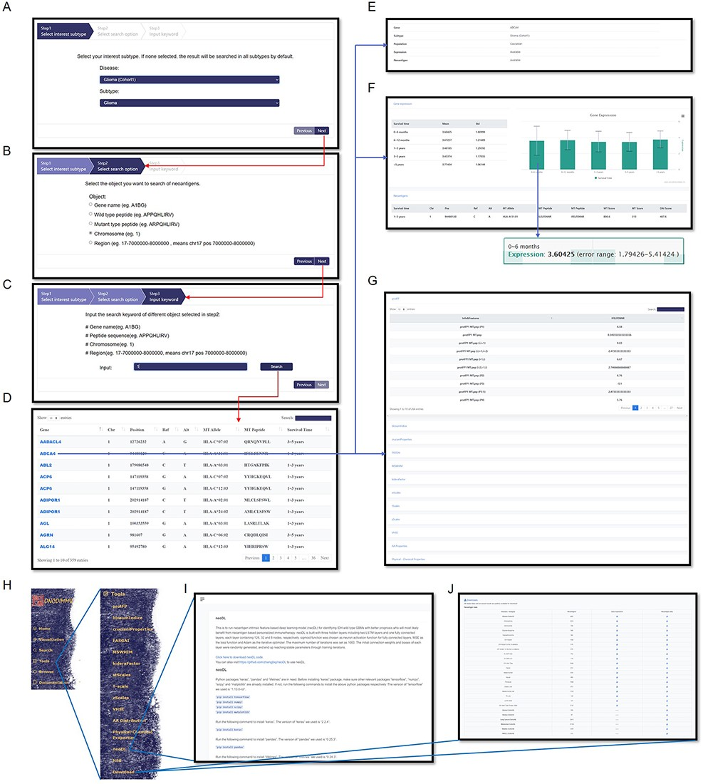
Figure 4. Information query and tools in GNIFdb. An example demonstrates that querying glioma (Cohort 1) (A), ...
Notes:
Figure 4. Information query and tools in GNIFdb. An example demonstrates that querying glioma (Cohort 1) (A), chromosome category (B) and chromosome 1 (C) generates the list of information associated gene, mutation, neoantigen, corresponding HLA-I subtype and survival time period (D) in the genomic region of interests. The query results also provide the summary of information availability (E) and detailed gene expression (F) and the full list of neoantigen intrinsic features (G). (H) Tools provide codes for calculating neoantigen intrinsic feature calculations, neoDL (I) and downloading of neoantigen and gene expression data for all cohorts (J).
Unless provided in the caption above, the following copyright applies to the content of this slide: © The Author(s) 2022. Published by Oxford University Press.This is an Open Access article distributed under the terms of the Creative Commons Attribution License (https://creativecommons.org/licenses/by/4.0/), which permits unrestricted reuse, distribution, and reproduction in any medium, provided the original work is properly cited.

