Slide 1
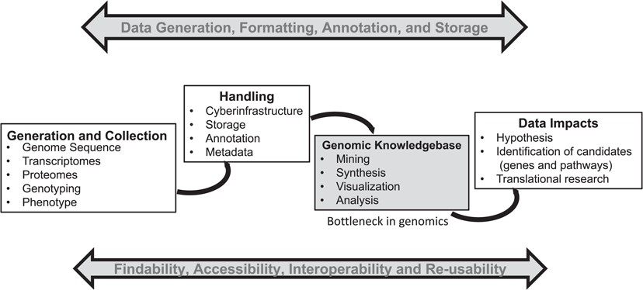
Figure 1 A general summary of the genomics pipeline depicting ‘Big Data’ generation, handling, analysis and its ...
Notes:
Figure 1 A general summary of the genomics pipeline depicting ‘Big Data’ generation, handling, analysis and its potential translation. The development of cyber-infrastructure and analysis tools is ongoing for storage, analysis and visualization of the raw and processed data simultaneously to make it available for integration across various public platforms using the FAIR (findable, accessible, interoperable and reusable) principle. A genomic knowledgebase such as Plant Reactome represents the downstream end of this pipeline, which can directly support the generation of a data-driven hypothesis for translation of biological knowledge.
Unless provided in the caption above, the following copyright applies to the content of this slide: Published by Oxford University Press 2019.This work is written by US Government employees and is in the public domain in the US.

