Slide 1
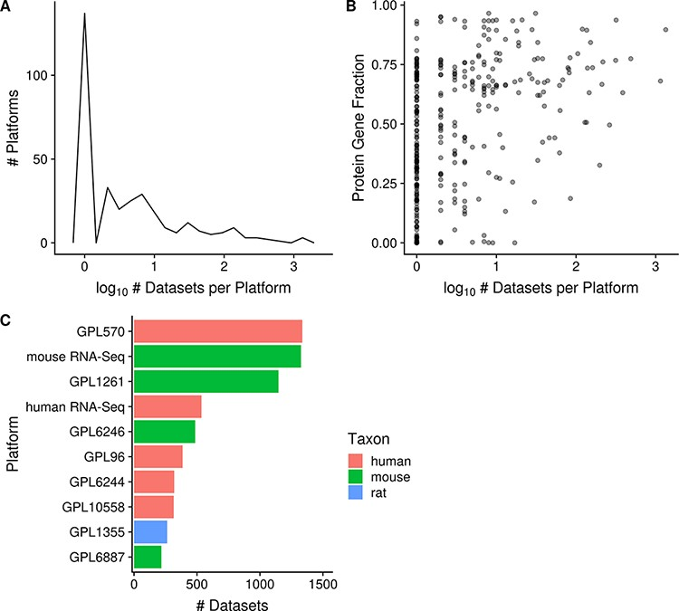
Figure 4. Distribution of platforms by the number of associated datasets for each platform (N = 357; A); scatterplot of ...
Notes:
Figure 4. Distribution of platforms by the number of associated datasets for each platform (N = 357; A); scatterplot of the fraction of protein-coding gene coverage of each microarray platform with its number of associated datasets (N = 354; B) and bar chart of the top 10 platforms with the most associated datasets for human, mouse and rat (C). The names of the listed platforms (C): Affymetrix GeneChip Human Genome U133 Plus 2.0 Array (GPL570), Affymetrix GeneChip Mouse Genome 430 2.0 Array (GPL1261), Affymetrix Mouse Gene 1.0 ST Array (GPL6246), Affymetrix GeneChip Human Genome U133 Array Set HG-U133A (GPL96), Affymetrix Human Gene 1.0 ST Array (GPL6244), Illumina HumanHT-12 v4.0 Expression Beadchip (GPL10558), Affymetrix GeneChip Rat Genome 230 2.0 Array (GPL1355) and Illumina MouseWG-6 v2.0 Expression Beadchip (GPL6887).
Unless provided in the caption above, the following copyright applies to the content of this slide: © The Author(s) 2021. Published by Oxford University Press.This is an Open Access article distributed under the terms of the Creative Commons Attribution License (http://creativecommons.org/licenses/by/4.0/), which permits unrestricted reuse, distribution, and reproduction in any medium, provided the original work is properly cited.

