Slide 1
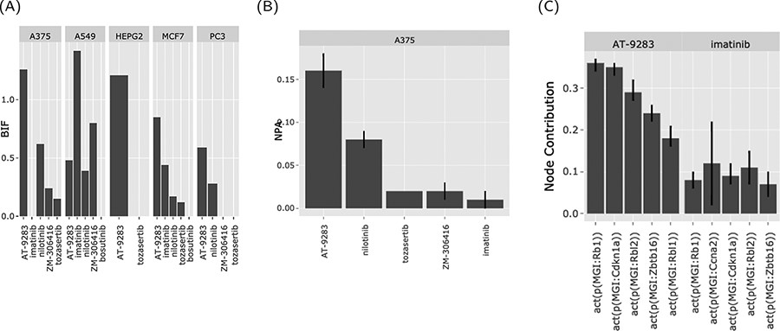
Figure 4. The web interface graphical output. The output of the ‘Abl kinase inhibitors’ on the CPR networks in five ...
Notes:
Figure 4. The web interface graphical output. The output of the ‘Abl kinase inhibitors’ on the CPR networks in five cancer cell lines (as selected in Figure 3). (A) BIF of every drug on the CPR networks stratified by the cell line. (B) NPA of every drug on the ‘cell cycle’ biological network in A375. (C) The relative contribution of each node (top five) in the cell cycle network in response to the drug perturbations in A375.
Unless provided in the caption above, the following copyright applies to the content of this slide: © The Author(s) 2021. Published by Oxford University Press.This is an Open Access article distributed under the terms of the Creative Commons Attribution License (http://creativecommons.org/licenses/by/4.0/), which permits unrestricted reuse, distribution, and reproduction in any medium, provided the original work is properly cited.

