Slide 1
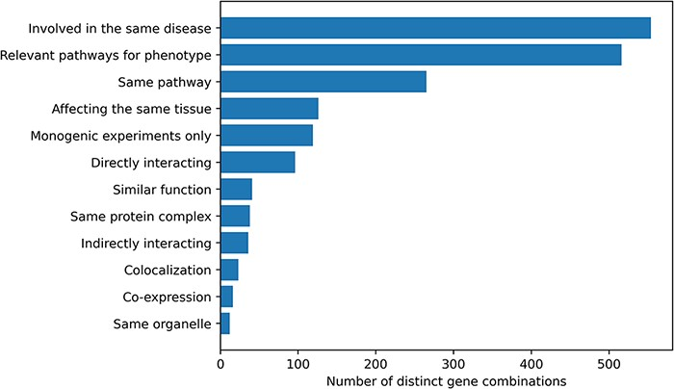
Figure 2. Histogram of the different gene relationship types found between the genes involved in an oligogenic variant ...
Notes:
Figure 2. Histogram of the different gene relationship types found between the genes involved in an oligogenic variant combination. The types of gene relationship were obtained either directly from the articles or from public databases (for the ‘Relevant pathways for phenotype’, ‘Same Pathway’ and ‘Directly Interacting’ relationships). Genes are ‘Involved in the same disease’ if patients with the same phenotype described or referenced in the manuscript carried mutations in those genes, together or independently. Pathway information for each gene was either described in the article or found in the KEGG (38) or Reactome (39) databases and was then manually screened to check if the genes belong to ‘Relevant pathways for the phenotype’ (e.g. glucose metabolism pathway for a diabetic phenotype) or in the ‘Same pathway’. Similarly, genes ‘Affecting the same tissue’ must also be expressed in the same relevant tissue for the phenotype. The ‘Directly interacting’ denotes a PPI, either described in the article or retrieved from the comPPI database (37). It is distinguished from the ‘Same protein complex’ relation where the gene products are considered to only fulfil their function when linked together (e.g. the subunits of a channel). ‘Indirectly interacting’ genes are those whose products indirectly interact with an intermediate protein or are involved in a gene regulation mechanism with other gene products (e.g. transcription factors). ‘Similar function’ indicates that genes have the same function (e.g. motor proteins). ‘Co-localization’ implies a direct overlap of the location of the gene products in the cell (e.g. shown using immunofluorescence), while ‘Same organelle’ implies that the protein products exercise their function in the same organelle (e.g. cilia proteins). The ‘Co-expression’ relationship implies a positive correlation of the mRNA expression of the genes in a temporal fashion shown or referenced in the article. Finally the ‘Monogenic experiments only’ notes the fact that the experimental evidence and the assessment of their pathogenicity were done on the genes independently (e.g. single knockouts).
Unless provided in the caption above, the following copyright applies to the content of this slide: © The Author(s) 2022. Published by Oxford University Press.This is an Open Access article distributed under the terms of the Creative Commons Attribution License (https://creativecommons.org/licenses/by/4.0/), which permits unrestricted reuse, distribution, and reproduction in any medium, provided the original work is properly cited.

