Slide 1
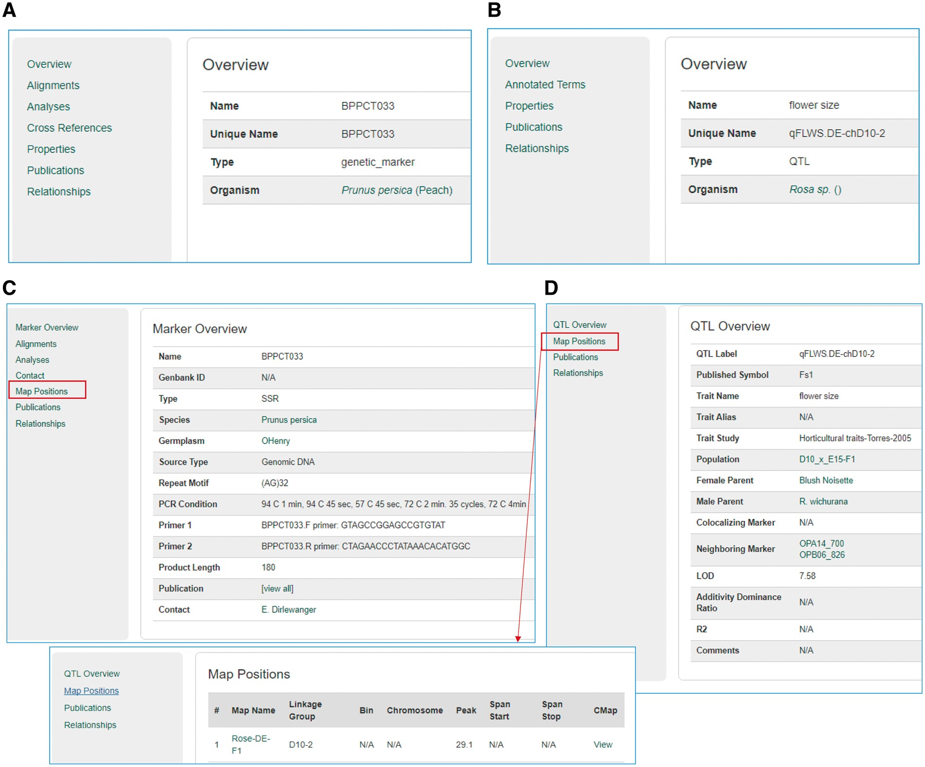
Figure 12. Sample pages from the Tripal core module and the Mainlab Tripal Chado Data Display module. (A) A marker page ...
Notes:
Figure 12. Sample pages from the Tripal core module and the Mainlab Tripal Chado Data Display module. (A) A marker page using the feature template from the Tripal core module. (B) A QTL page using the feature template from the Tripal core module. (C) A marker page using the marker template from the custom module. (D) A QTL page using the QTL template from the custom module.
Unless provided in the caption above, the following copyright applies to the content of this slide: © The Author(s) 2017. Published by Oxford University Press.This is an Open Access article distributed under the terms of the Creative Commons Attribution License (http://creativecommons.org/licenses/by/4.0/), which permits unrestricted reuse, distribution, and reproduction in any medium, provided the original work is properly cited.

