Slide 1
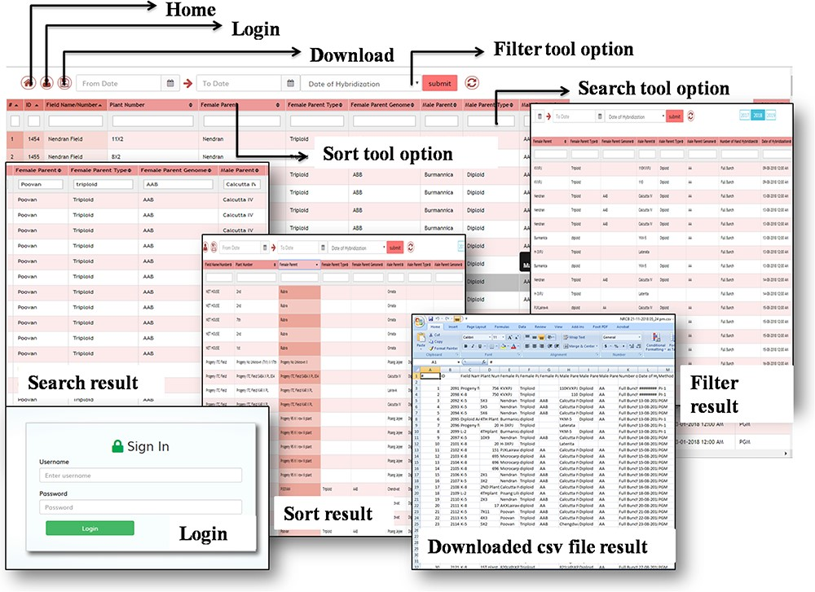
Figure 3 Search, sort, filter and login and download tool options in the BBT and their outcome. The user can access ...
Notes:
Figure 3 Search, sort, filter and login and download tool options in the BBT and their outcome. The user can access their data by using (A) filter, (B) sort, (C) search and (D) browsing options. Pop-ups showing some examples of (J) filtered, (H) searched, (L) sorted data and (K) downloaded data as csv file. The obtained result can be downloaded by (G) save file option.
Unless provided in the caption above, the following copyright applies to the content of this slide: © The Author(s) 2020. Published by Oxford University Press.This is an Open Access article distributed under the terms of the Creative Commons Attribution License (http://creativecommons.org/licenses/by/4.0/), which permits unrestricted reuse, distribution, and reproduction in any medium, provided the original work is properly cited.

