Slide 1
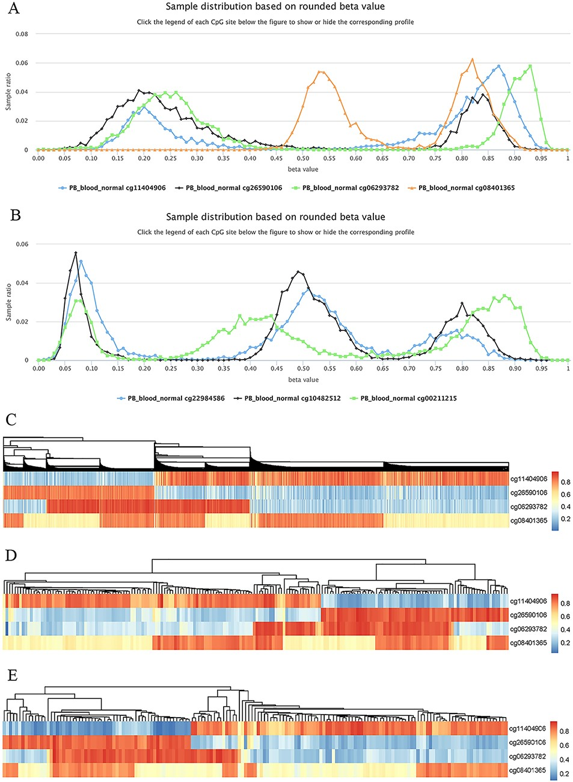
Figure 8. Examples to show split methylation sites. (A) Examples of split methylation sites with two main peaks in the ...
Notes:
Figure 8. Examples to show split methylation sites. (A) Examples of split methylation sites with two main peaks in the methylation profiles. B. Examples of split methylation sites with three main peaks in the methylation profiles. Methylation profiles in A and B are from normal human peripheral blood samples (PB_blood_normal from 450k, n = 5181). C, D and E represent heatmaps to show sample subdivisions of normal human peripheral blood samples (C), normal human peripheral CD4+ T cell samples (D) and normal human peripheral CD8+ T cell samples (E) based on the split methylation sites in A, respectively. Color bars in C, D and E indicate DNA methylation from low (blue) to high (red) beta values.
Unless provided in the caption above, the following copyright applies to the content of this slide: © The Author(s) 2022. Published by Oxford University Press.This is an Open Access article distributed under the terms of the Creative Commons Attribution License (https://creativecommons.org/licenses/by/4.0/), which permits unrestricted reuse, distribution, and reproduction in any medium, provided the original work is properly cited.

