Slide 1
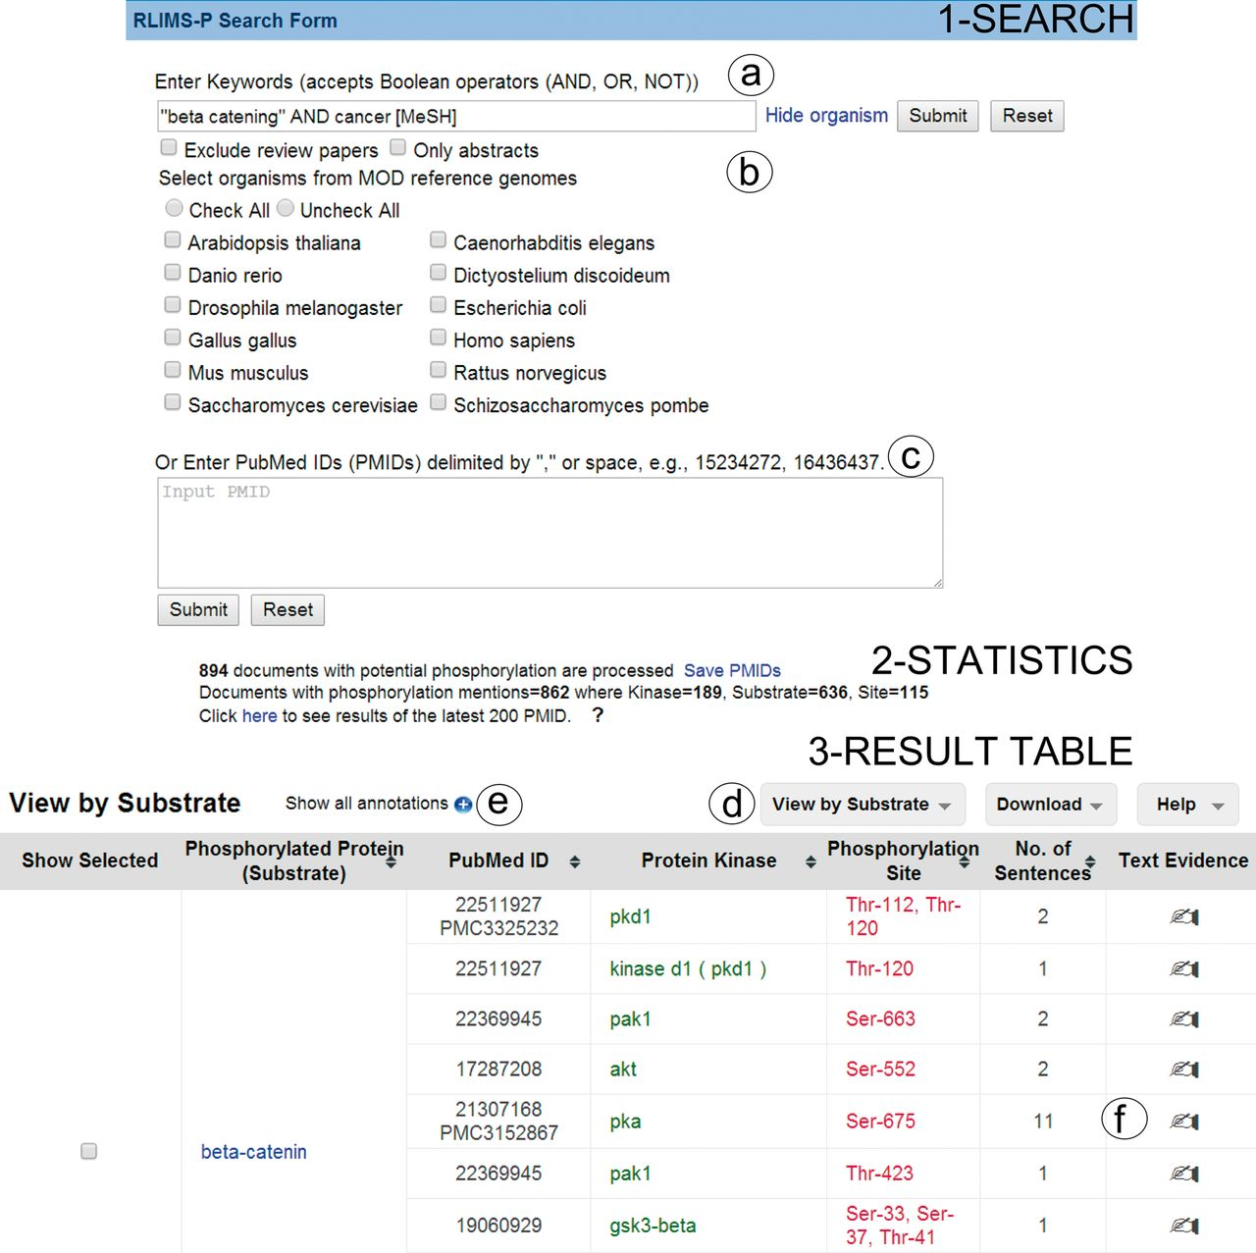
Figure 1. Snapshot of RLIMS-P interface. Search page (1-Search) and result page with statistics (2-Statistics) and ...
Notes:
Figure 1. Snapshot of RLIMS-P interface. Search page (1-Search) and result page with statistics (2-Statistics) and table (3-Result Table). The search interface allows queries based on keywords (a) with selection of species and/or abstracts only search and possibility to exclude review articles (b), or, alternatively, enter a list of PMIDs (c). The result table displays the text-mining results along with functionalities (d), such as multiple views of the result table (by PMID, by substrate or by kinase), download of table in tab-delimited format, link to help document, expansion of text-mining result by clicking on the plus icon (e) and links to text evidence page via the hand icon (f). For display convenience, the result table only shows a small subset of the full table.
Unless provided in the caption above, the following copyright applies to the content of this slide: © The Author(s) 2014. Published by Oxford University Press.This is an Open Access article distributed under the terms of the Creative Commons Attribution License (http://creativecommons.org/licenses/by/4.0/), which permits unrestricted reuse, distribution, and reproduction in any medium, provided the original work is properly cited.

