Slide 1
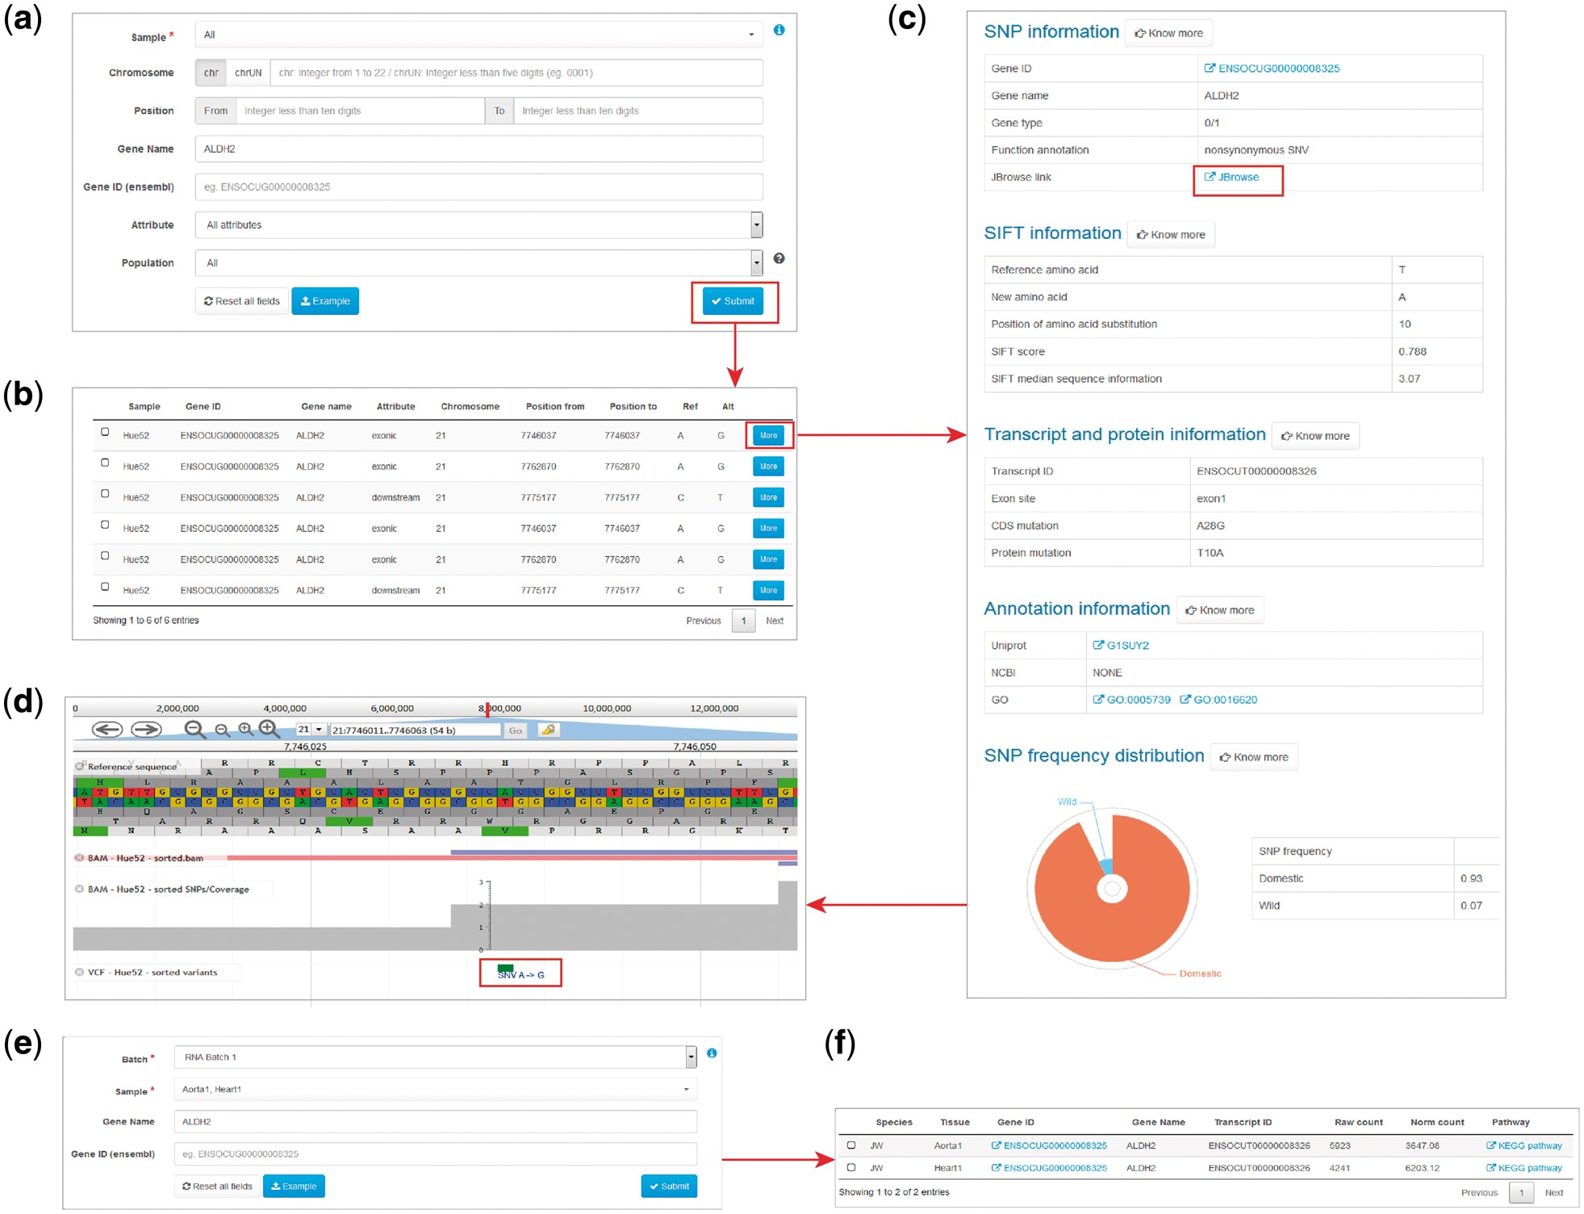
Figure 2. Examples of variant and expression search. (a) Entry of variant search. (b) Results of variant search. (c) ...
Notes:
Figure 2. Examples of variant and expression search. (a) Entry of variant search. (b) Results of variant search. (c) Extended results of variant search. (d) Display of the variant with JBrowse. (e) Entry of expression search. (f) Result of expression search.
Unless provided in the caption above, the following copyright applies to the content of this slide: © The Author(s) 2018. Published by Oxford University Press.This is an Open Access article distributed under the terms of the Creative Commons Attribution License (http://creativecommons.org/licenses/by/4.0/), which permits unrestricted reuse, distribution, and reproduction in any medium, provided the original work is properly cited.

