Slide 1
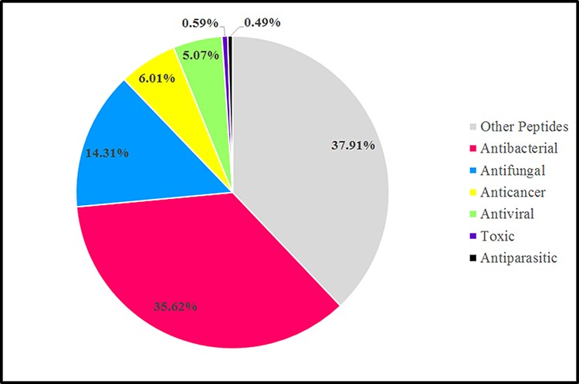
Figure 3. Graphic representation sources of AMPs in the antimicrobial peptide database (dbAMP 2.0) in 2022 (78).
Notes:
Figure 3. Graphic representation sources of AMPs in the antimicrobial peptide database (dbAMP 2.0) in 2022 (78).
Unless provided in the caption above, the following copyright applies to the content of this slide: © The Author(s) 2022. Published by Oxford University Press.This is an Open Access article distributed under the terms of the Creative Commons Attribution License (https://creativecommons.org/licenses/by/4.0/), which permits unrestricted reuse, distribution, and reproduction in any medium, provided the original work is properly cited.

Slide 2
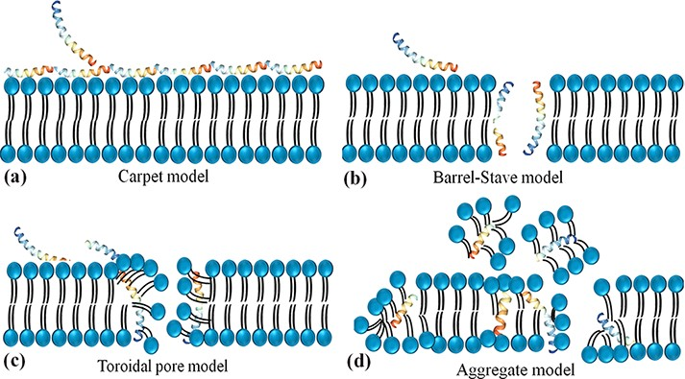
Figure 2. Schematic representation of the potential mechanism of membrane disruption and/or translocation by ...
Notes:
Figure 2. Schematic representation of the potential mechanism of membrane disruption and/or translocation by antimicrobial peptides. (a) Carpet model: Another face of the membrane is covered by AMPs to form a ‘carpet’ and the membrane undergoes some perturbation and deformation. (b) Barrel-Stave model: AMPs interact laterally and form transmembrane pores. (c) Toroidal pore model: AMPs penetrate the bilayer membrane and form a toroid of high curvature. (d) Aggregate model.
Unless provided in the caption above, the following copyright applies to the content of this slide: © The Author(s) 2022. Published by Oxford University Press.This is an Open Access article distributed under the terms of the Creative Commons Attribution License (https://creativecommons.org/licenses/by/4.0/), which permits unrestricted reuse, distribution, and reproduction in any medium, provided the original work is properly cited.

Slide 3
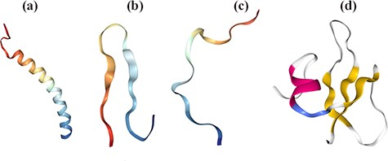
Figure 1. Structural diversity of AMPs based on their secondary conformations using Protein Data Bank (PDB). [(a) 2K6O: ...
Notes:
Figure 1. Structural diversity of AMPs based on their secondary conformations using Protein Data Bank (PDB). [(a) 2K6O: Antimicrobial Peptide, the α-helical structure of cathelicidin LL-37 in Homo sapiens. (b) 1RKK: Antimicrobial Peptide, β-sheeted polyphemusin in Limulus polyphemus. (c) 1G89: Antimicrobial Peptide, extended indolicidin in Bos taurus. (d) 1FQQ: Antimicrobial Peptide, Antibiotic and mixed structures like human β- defensin-2 in Homo sapiens].
Unless provided in the caption above, the following copyright applies to the content of this slide: © The Author(s) 2022. Published by Oxford University Press.This is an Open Access article distributed under the terms of the Creative Commons Attribution License (https://creativecommons.org/licenses/by/4.0/), which permits unrestricted reuse, distribution, and reproduction in any medium, provided the original work is properly cited.

Slide 4
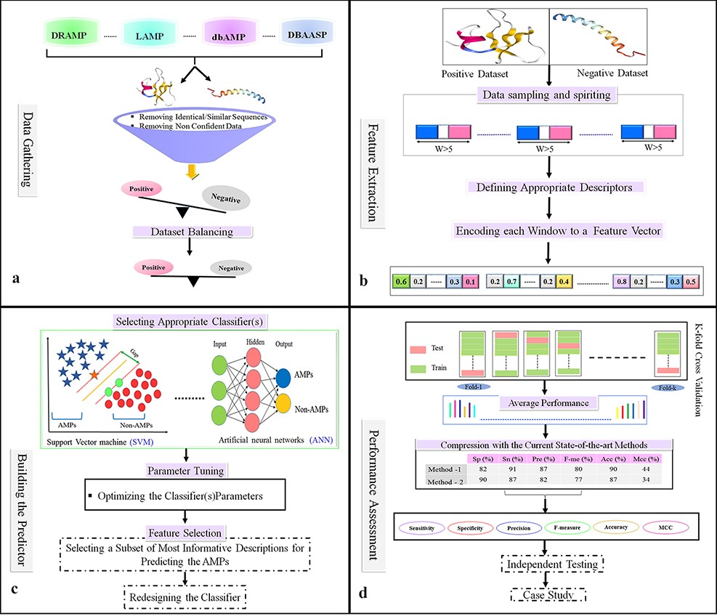
Figure 4. Flowchart of the statistical and machine learning techniques for the detection of AMPs. (a) Collection of ...
Notes:
Figure 4. Flowchart of the statistical and machine learning techniques for the detection of AMPs. (a) Collection of data and creation of datasets. (b) Feature selection. (c) Designing training and testing models. (d) Evaluation of model performance.
Unless provided in the caption above, the following copyright applies to the content of this slide: © The Author(s) 2022. Published by Oxford University Press.This is an Open Access article distributed under the terms of the Creative Commons Attribution License (https://creativecommons.org/licenses/by/4.0/), which permits unrestricted reuse, distribution, and reproduction in any medium, provided the original work is properly cited.

