Slide 1
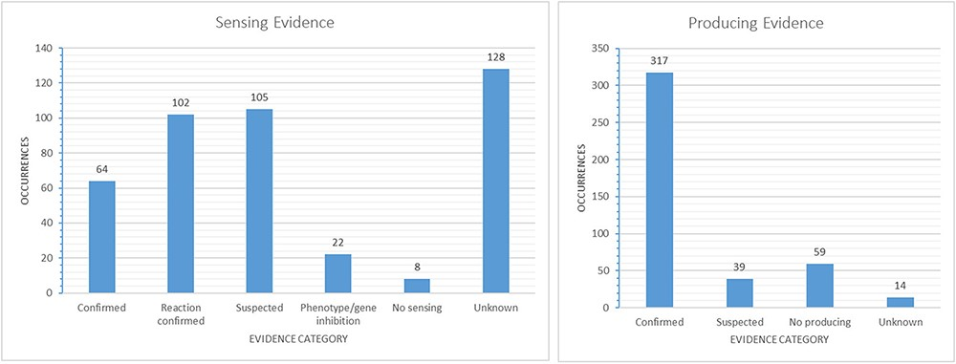
Figure 5. Evidence-based categories of the reported sensing and producing mechanisms: confirmed, suspected, evidence of ...
Notes:
Figure 5. Evidence-based categories of the reported sensing and producing mechanisms: confirmed, suspected, evidence of a reaction to a signal without certainty about a receptor involved (sensing only), inhibition of a phenotype or gene through a signal (sensing only), no sensing or producing (e.g. only producing/sensing) and unknown.
Unless provided in the caption above, the following copyright applies to the content of this slide: © The Author(s) 2021. Published by Oxford University Press.This is an Open Access article distributed under the terms of the Creative Commons Attribution License (https://creativecommons.org/licenses/by/4.0/), which permits unrestricted reuse, distribution, and reproduction in any medium, provided the original work is properly cited.

