Slide 1
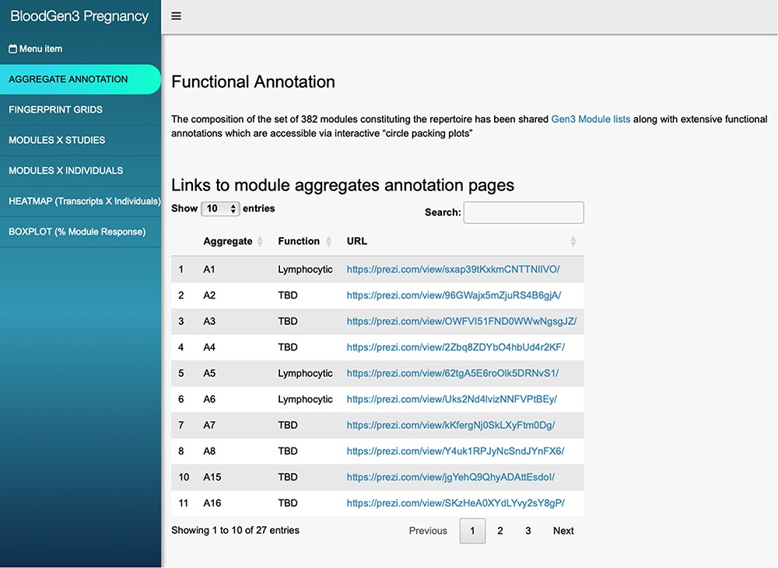
Figure 1. BloodGen3 application user interface. Users navigate the user interface primarily through the tabs on the ...
Notes:
Figure 1. BloodGen3 application user interface. Users navigate the user interface primarily through the tabs on the left that provide access to different information and visual representations of the results. Parameters can be adjusted via drop-down menus and sliders to customize the plots. The latter can then be used in reports or publications.
Unless provided in the caption above, the following copyright applies to the content of this slide: © The Author(s) 2024. Published by Oxford University Press.This is an Open Access article distributed under the terms of the Creative Commons Attribution License (https://creativecommons.org/licenses/by/4.0/), which permits unrestricted reuse, distribution, and reproduction in any medium, provided the original work is properly cited.

