Slide 1
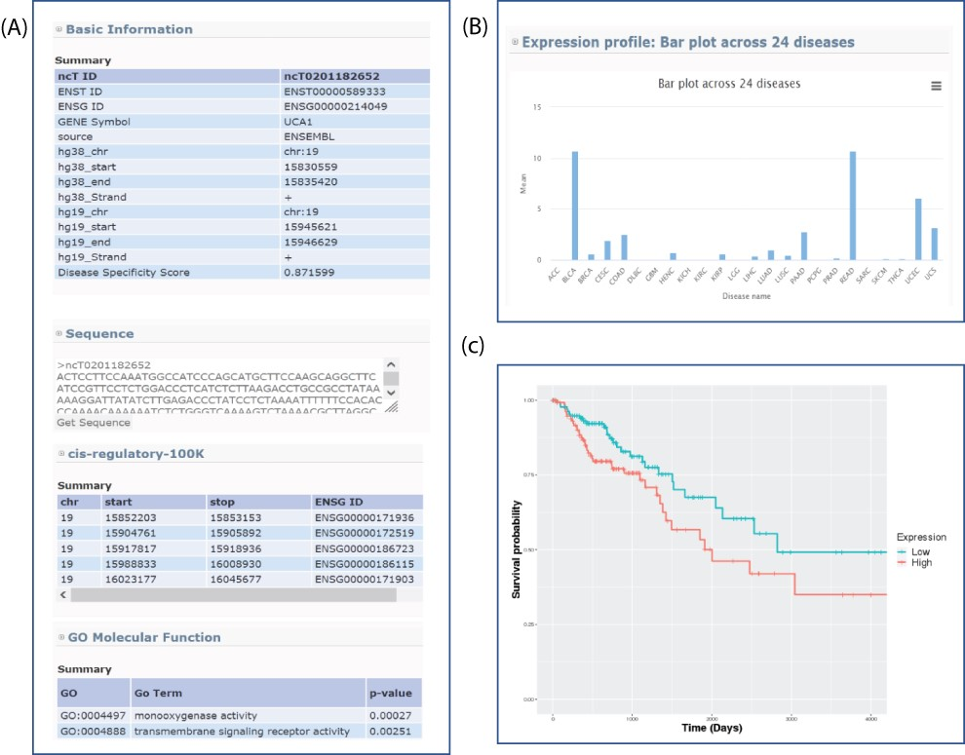
Figure 3. Sample output for searching lncRNA UCA1. (A) Basic genome information for each lncRNAs including genomic ...
Notes:
Figure 3. Sample output for searching lncRNA UCA1. (A) Basic genome information for each lncRNAs including genomic information, sequence, potential cis-regulatory elements and GO in the lncExplore database. (B) The average of expression values (FPKM) across 24 diseases were represented by bar charts. (C) Kaplan–Meier plot of lncRNA UCA1 in colon adenocarcinoma was displayed in different colors for two groups (high and low expression), respectively.
Unless provided in the caption above, the following copyright applies to the content of this slide: © The Author(s) 2021. Published by Oxford University Press.This is an Open Access article distributed under the terms of the Creative Commons Attribution License (https://creativecommons.org/licenses/by/4.0/), which permits unrestricted reuse, distribution, and reproduction in any medium, provided the original work is properly cited.

