Slide 1
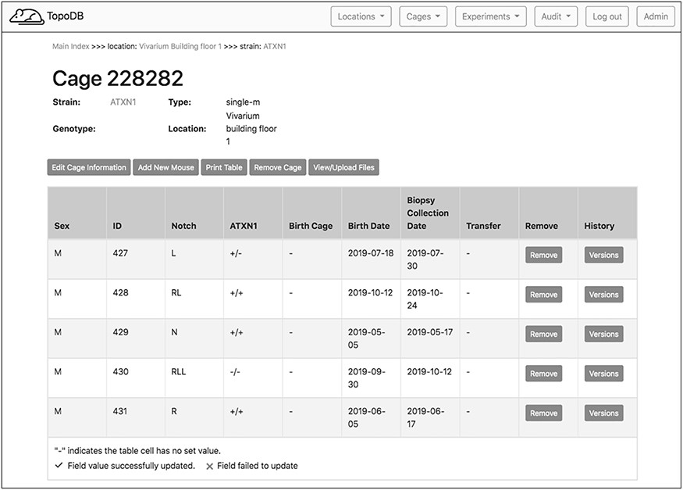
Figure 3. The single cage view in TopoDB summarizes all the principle information about the animals housed in each cage ...
Notes:
Figure 3. The single cage view in TopoDB summarizes all the principle information about the animals housed in each cage of the colony. This includes the sex, the unique identification number, the corresponding identification code (such as ear punches or ear tags), the date of birth and the biopsy collection date. The possible transfer date from or to another cage is also displayed in this interface.
Unless provided in the caption above, the following copyright applies to the content of this slide: © The Author(s) 2020. Published by Oxford University Press.This is an Open Access article distributed under the terms of the Creative Commons Attribution License (http://creativecommons.org/licenses/by/4.0/), which permits unrestricted reuse, distribution, and reproduction in any medium, provided the original work is properly cited.

