Slide 1
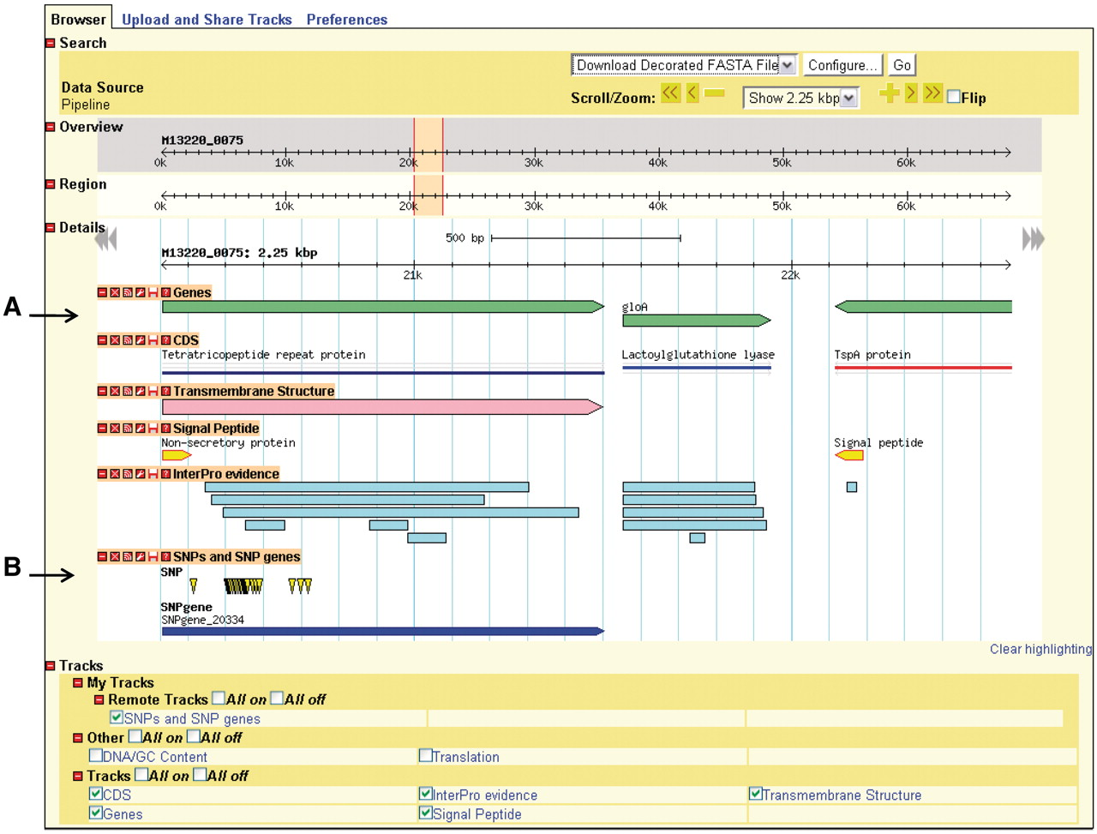
Figure 3. Genome depiction. The genome is represented linearly, with features on their respective coordinates. (A) ...
Notes:
Figure 3. Genome depiction. The genome is represented linearly, with features on their respective coordinates. (A) Genes and their coding sequences (CDS) each have their own track and are links to their own details page. (B) Uploaded tracks.
Unless provided in the caption above, the following copyright applies to the content of this slide: © The Author(s) 2011. Published by Oxford University Press.This is Open Access article distributed under the terms of the Creative Commons Attribution Non-Commercial License (http://creativecommons.org/licenses/by-nc/2.5), which permits unrestricted non-commercial use, distribution, and reproduction in any medium, provided the original work is properly cited.

