Slide 1
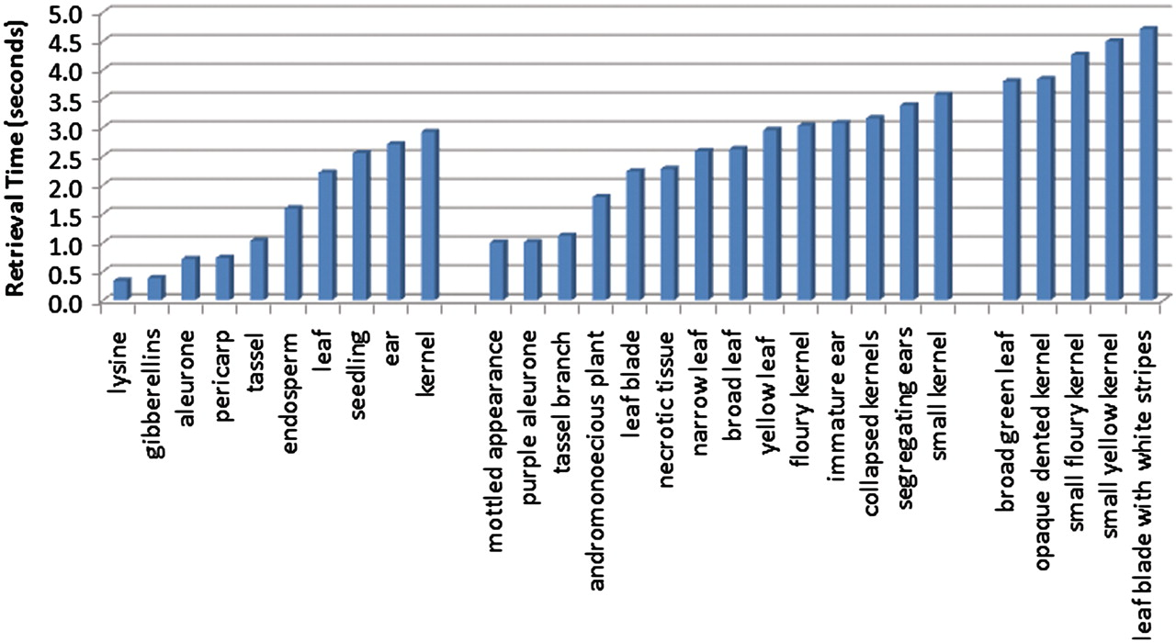
Figure 8. Average retrieval speeds for queries, ordered by query length. The leftmost group corresponds to the ...
Notes:
Figure 8. Average retrieval speeds for queries, ordered by query length. The leftmost group corresponds to the single-term queries, and these have the quickest execution times. The middle group contains queries consisting of two terms, and the query speeds for these are on average slightly slower than the single-term queries. The rightmost group of queries all contain three terms, and these are the most time consuming of the queries tested.
Unless provided in the caption above, the following copyright applies to the content of this slide: © The Author(s) 2011. Published by Oxford University Press.This is Open Access article distributed under the terms of the Creative Commons Attribution Non-Commercial License (http://creativecommons.org/licenses/by-nc/2.5), which permits unrestricted non-commercial use, distribution, and reproduction in any medium, provided the original work is properly cited.

