Slide 1
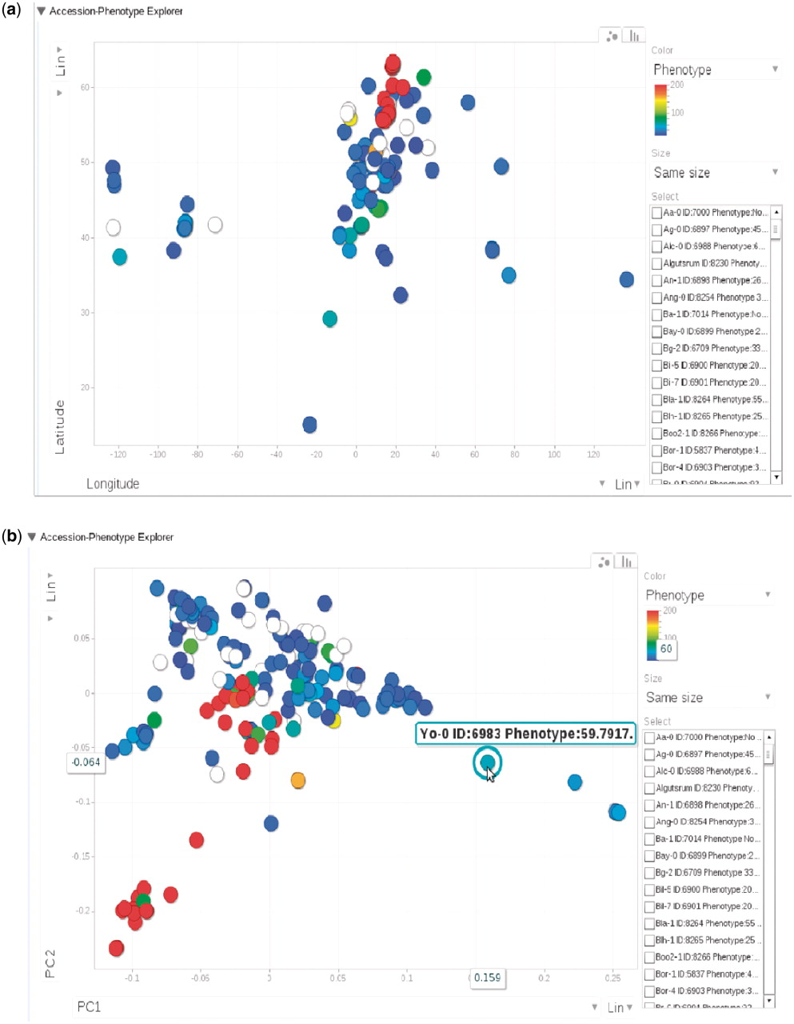
Figure 9. (a) Phenotype for each accession, represented by dots, plotted by longitude and latitude. The plot is ...
Notes:
Figure 9. (a) Phenotype for each accession, represented by dots, plotted by longitude and latitude. The plot is visualized through Google Motion Chart. (b) Change the two axes in (a) to the first two principal components from PCA analysis on the genotype matrix. Mouse-over or clicking each dot in the chart displays the information for that accession. This dynamic widget is available in any phenotype page. The example used here is at http://arabidopsis.usc.edu/DisplayResults/showGWA?call_method_id=32&phenotype_method_id=1.
Unless provided in the caption above, the following copyright applies to the content of this slide: © The Author(s) 2011. Published by Oxford University Press.This is Open Access article distributed under the terms of the Creative Commons Attribution Non-Commercial License (http://creativecommons.org/licenses/by-nc/2.5), which permits unrestricted non-commercial use, distribution, and reproduction in any medium, provided the original work is properly cited.

