Slide 1
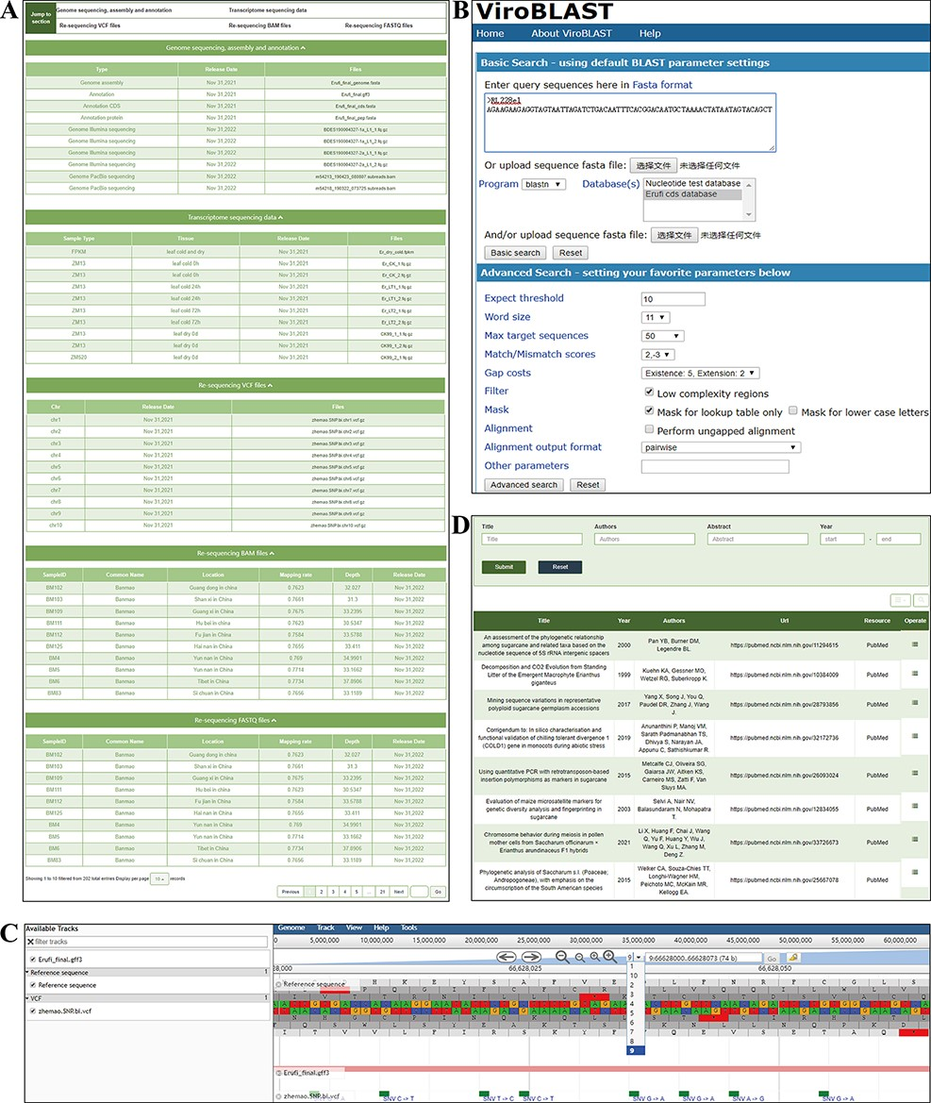
Figure 6. ‘Download’ and ‘Tools’ modules. (A) ‘Download’ module, providing genome, transcriptome, variation and ...
Notes:
Figure 6. ‘Download’ and ‘Tools’ modules. (A) ‘Download’ module, providing genome, transcriptome, variation and resequencing files to download. (B) BLAST Tool. (C) JBrowse tool. (D) Publication tool.
Unless provided in the caption above, the following copyright applies to the content of this slide: © The Author(s) 2022. Published by Oxford University Press.This is an Open Access article distributed under the terms of the Creative Commons Attribution-NonCommercial License (https://creativecommons.org/licenses/by-nc/4.0/), which permits non-commercial re-use, distribution, and reproduction in any medium, provided the original work is properly cited. For commercial re-use, please contact journals.permissions@oup.com

Slide 2
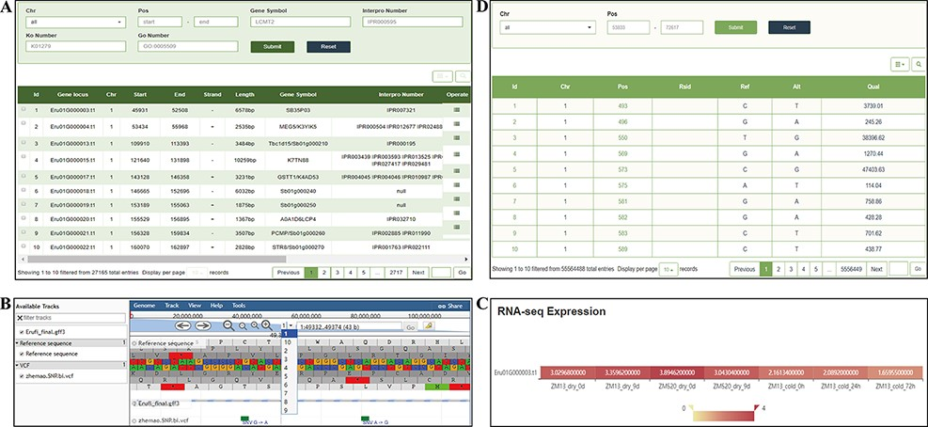
Figure 5. ‘Gene’ and ‘Variation’ modules. (A) ‘Gene’ search module. (B) Click on Gene ID to display detailed ...
Notes:
Figure 5. ‘Gene’ and ‘Variation’ modules. (A) ‘Gene’ search module. (B) Click on Gene ID to display detailed information in the JBrowse. (C) Click on Gene ID to display the expression level. (D) ‘Variation’ module.
Unless provided in the caption above, the following copyright applies to the content of this slide: © The Author(s) 2022. Published by Oxford University Press.This is an Open Access article distributed under the terms of the Creative Commons Attribution-NonCommercial License (https://creativecommons.org/licenses/by-nc/4.0/), which permits non-commercial re-use, distribution, and reproduction in any medium, provided the original work is properly cited. For commercial re-use, please contact journals.permissions@oup.com

Slide 3
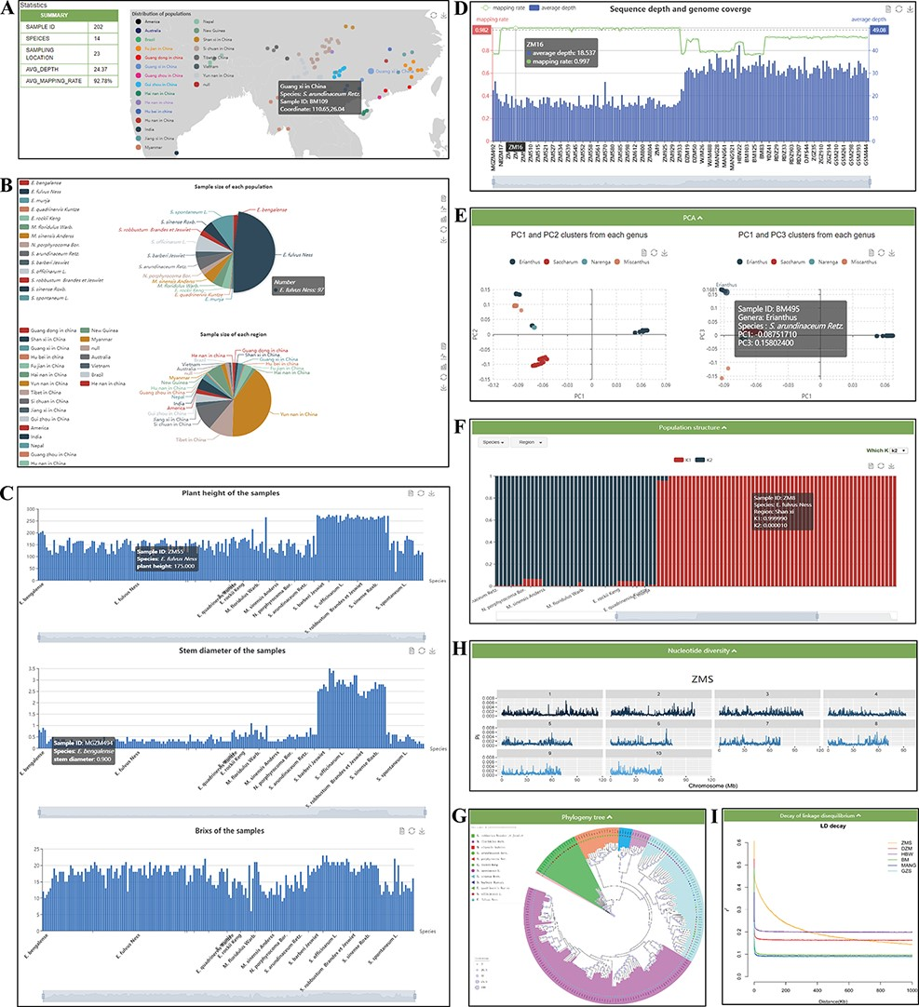
Figure 4. ‘Re-sequence’ module. The ‘Re-sequence’ module has subpages: ‘Statistics’ (A–D) and ‘Analysis’ pages (E–I). ...
Notes:
Figure 4. ‘Re-sequence’ module. The ‘Re-sequence’ module has subpages: ‘Statistics’ (A–D) and ‘Analysis’ pages (E–I). (A) Geographic distribution of 202 individuals. (B) Sample size of each species and region. (C) Statistics of plant height, stem diameter and brix for each sample. (D) Resequencing quality statistics. (E) PCA clusters from 202 individuals. (F) Bar plot of admixture analysis for all samples with K from 2 to 10. (G) Phylogenetic tree. (H) Nucleotide diversity statistics. (I) Decay of LD.
Unless provided in the caption above, the following copyright applies to the content of this slide: © The Author(s) 2022. Published by Oxford University Press.This is an Open Access article distributed under the terms of the Creative Commons Attribution-NonCommercial License (https://creativecommons.org/licenses/by-nc/4.0/), which permits non-commercial re-use, distribution, and reproduction in any medium, provided the original work is properly cited. For commercial re-use, please contact journals.permissions@oup.com

Slide 4
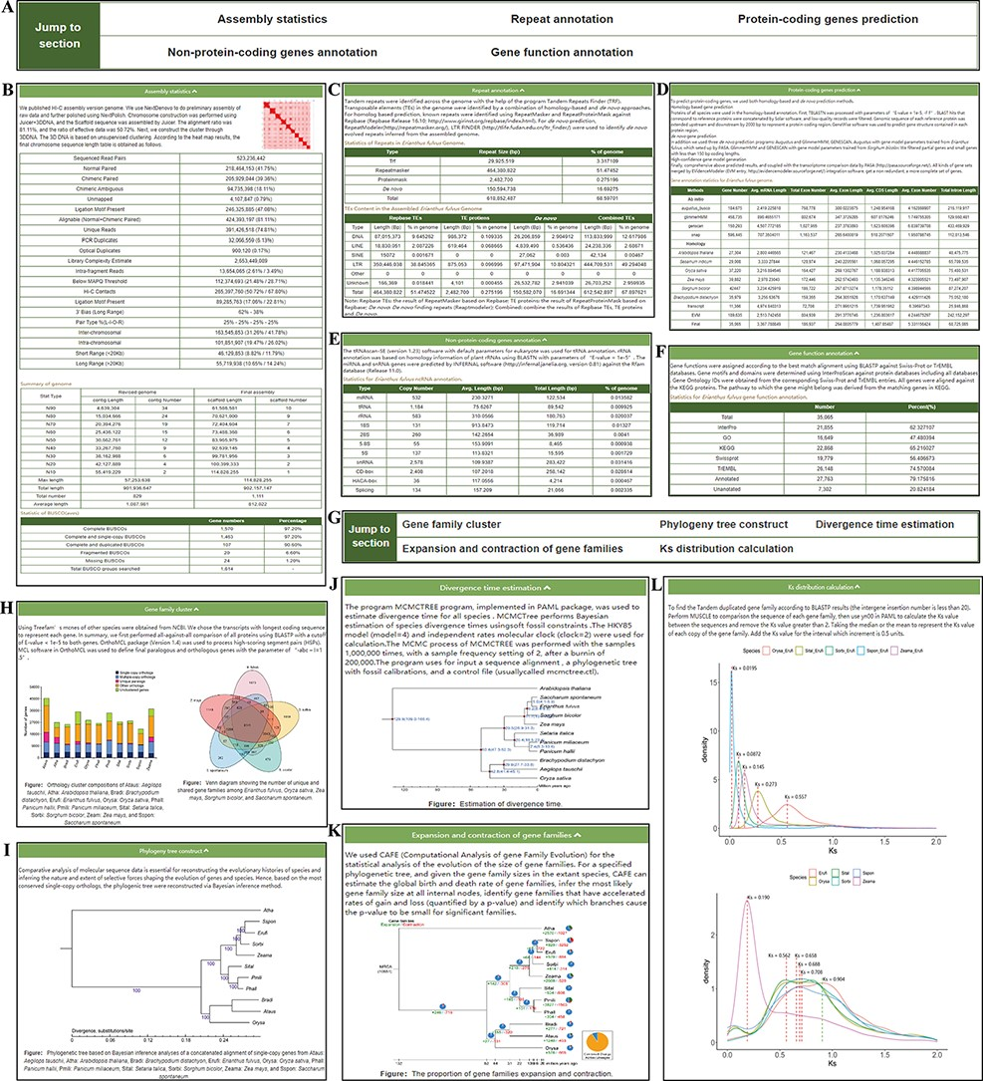
Figure 3. ‘Genome’ module. The ‘Genome’ module has subpages: ‘Statistics’ (A–F) and ‘Analysis’ pages (G–L). (A) The ...
Notes:
Figure 3. ‘Genome’ module. The ‘Genome’ module has subpages: ‘Statistics’ (A–F) and ‘Analysis’ pages (G–L). (A) The navigation bar of the ‘Statistics’ page provides quick access to each section. (B) Assembly statistics. (C) Repeat annotation. (D) Protein-coding genes prediction. (E) Nonprotein-coding genes annotation. (F) Gene functional annotation. (G) The navigation bar of the ‘Analysis’ page. (H) Gene family cluster. (I) Phylogenetic tree. (J) Divergence time. (K) Expansion and contraction of gene families. (L) Ks distribution.
Unless provided in the caption above, the following copyright applies to the content of this slide: © The Author(s) 2022. Published by Oxford University Press.This is an Open Access article distributed under the terms of the Creative Commons Attribution-NonCommercial License (https://creativecommons.org/licenses/by-nc/4.0/), which permits non-commercial re-use, distribution, and reproduction in any medium, provided the original work is properly cited. For commercial re-use, please contact journals.permissions@oup.com

Slide 5
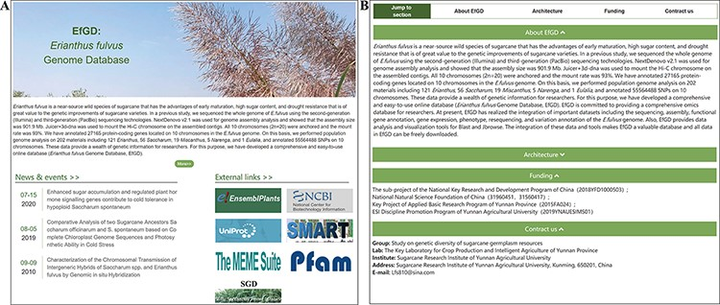
Figure 2. ‘Home’ and ‘About’ modules. (A) ‘Home’ module, basic introduction to EfGD and external quick links. (B) ...
Notes:
Figure 2. ‘Home’ and ‘About’ modules. (A) ‘Home’ module, basic introduction to EfGD and external quick links. (B) ‘About’ module, detailed introduction to EfGD.
Unless provided in the caption above, the following copyright applies to the content of this slide: © The Author(s) 2022. Published by Oxford University Press.This is an Open Access article distributed under the terms of the Creative Commons Attribution-NonCommercial License (https://creativecommons.org/licenses/by-nc/4.0/), which permits non-commercial re-use, distribution, and reproduction in any medium, provided the original work is properly cited. For commercial re-use, please contact journals.permissions@oup.com

Slide 6
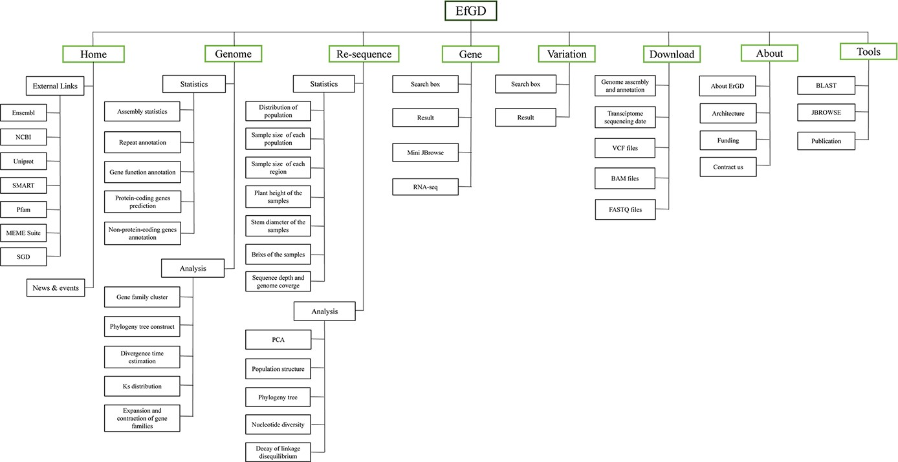
Figure 1. Architecture of EfGD. The EfGD was divided into eight main modules including ‘Home’, ‘Genome’, ‘Re-sequence‘, ...
Notes:
Figure 1. Architecture of EfGD. The EfGD was divided into eight main modules including ‘Home’, ‘Genome’, ‘Re-sequence‘, ‘Gene‘, ‘Variation’, ‘Download’, ‘About’ and ‘Tools’. The corresponding contents of each module are listed below.
Unless provided in the caption above, the following copyright applies to the content of this slide: © The Author(s) 2022. Published by Oxford University Press.This is an Open Access article distributed under the terms of the Creative Commons Attribution-NonCommercial License (https://creativecommons.org/licenses/by-nc/4.0/), which permits non-commercial re-use, distribution, and reproduction in any medium, provided the original work is properly cited. For commercial re-use, please contact journals.permissions@oup.com

